Slide 1
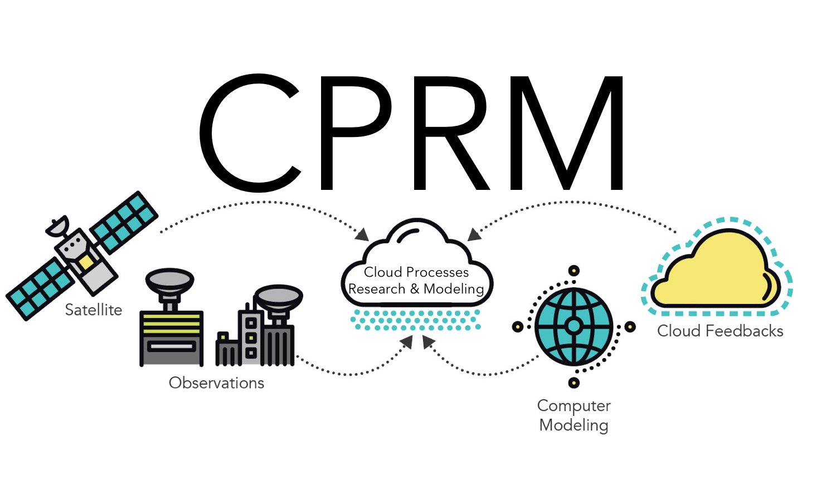
Observed Sensitivity of Low Cloud Radiative Effects to Meteorological Perturbations over the Global Oceans
Scientific Achievement Scientists at LLNL and their colleagues analyzed satellite cloud observations to shed light on the physical processes responsible for variations in low-level clouds and their radiative effects over the global oceans. The team found that distinct types of marine low clouds respond differently to changes in their large-scale meteorological environment.
Significance & Impact
The response of low-level clouds to planetary warming is a major source of climate change uncertainty. Quantifying the sensitivity of distinct types of marine low clouds to large-scale meteorological perturbations using satellite observations helps to reduce this uncertainty by illuminating physical processes responsible for cloud changes and by establishing a framework to constrain low cloud feedbacks.
Schematic showing the meteorological conditions that favor greater marine low cloudiness
based on the observational analysis carried out by the research team.
SST=sea surface temperature, EIS=estimated inversion strength, RH₇₀₀=relative humidity at 700 hPa, Tadv=surface temperature advection
Research Details In order to assess, identify, and understand the physical drivers of observed changes in marine low clouds, the team selected an exhaustive set of so-called “cloud-controlling factors” derived from observation-based datasets of the climate system. They carried out a statistical analysis between these cloud-controlling factors and various properties of low clouds over the oceans detected by satellites, including their horizontal coverage and reflectivity.
Scott, R. C., T. A. Myers, J. R. Norris, M. D. Zelinka, S. A. Klein, M. Sun, and D. R. Doelling, 2020: Observed Sensitivity of Low Cloud Radiative Effects to Meteorological Perturbations over the Global Oceans. J. Climate, doi: https://doi.org/10.1175/JCLI-D-19-1028.1.
Notes:
The Science
Scientists at Lawrence Livermore National Laboratory in collaboration with colleagues at the Scripps Institution of Oceanography, Science Systems and Applications, Inc., and NASA Langley Research Center analyzed satellite cloud observations to shed light on the physical processes responsible for variations in low-level clouds and their radiative effects over the global oceans. The team found that distinct types of marine low clouds respond differently to changes in their large-scale meteorological environment.
The Impact
The response of low-level clouds to planetary warming is a major source of climate change uncertainty. Almost all climate models project that climate change will act to reduce their coverage over the oceans, which would amplify planetary warming by increasing the amount of solar radiation absorbed by the Earth. Yet the magnitude of this amplifying feedback process is highly uncertain. Quantifying the sensitivity of distinct types of marine low clouds to large-scale meteorological perturbations using satellite observations helps to reduce this uncertainty by illuminating physical processes responsible for cloud changes and by establishing a framework to constrain low cloud feedbacks.
Summary
In order to assess, identify, and understand the physical drivers of observed changes in marine low clouds, the team selected an exhaustive set of so-called “cloud-controlling factors” derived from observation-based datasets of the climate system. They carried out a statistical analysis between these cloud-controlling factors and various properties of low clouds over the oceans detected by satellites, including their horizontal coverage and reflectivity. The analysis revealed that a stronger temperature inversion just above the clouds and enhanced horizontal transport of cold surface air favor greater coverage and reflectivity of eastern ocean stratocumulus clouds and middle latitude low clouds. Ocean surface warming was found to decrease the coverage and reflectivity of eastern ocean stratocumulus clouds but was found to have a much smaller impact on low-level clouds in the middle latitudes and shallow cumulus clouds over the tropical oceans. The team discovered that faster surface winds drive greater coverage of both eastern ocean stratocumulus and shallow cumulus clouds but have a much smaller impact on clouds in the middle latitudes. These results provide observational evidence that distinct low cloud types respond in unique ways to changes in their large-scale meteorological environment, suggesting that their responses to climate change will also be different.

