Slide 1
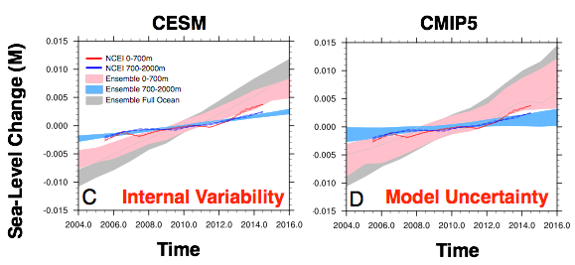
Effect of ocean internal variability on modeled steric sea-level rise
Objective
Comprehensive global climate model ensembles are used to evaluate uncertainties surrounding decadal trends in depth-integrated steric sea-level rise due to thermal expansion of the ocean
Approach
We analyze multiple sources of uncertainties influencing sea-level rise estimates, including:
  model uncertainties using the Coupled Model Intercomparison Phase 5 (CMIP5)
  “natural” variability using low-resolution CESM ensemble accounting for joint internal variability (including the deep ocean)
Above: Timeseries of 95% model ensemble range of steric sea‐level change over different ocean depths.
Below: 2100 steric sea-level rise estimates from CESM, highlighting effects of regional variability and internal ocean variability on upper bound estimates
Impact
Analysis shows that both internal “natural” variability and model uncertainties contribute substantially to spread in multi-decadal steric sea-level trends.
Results provide useful constraints on estimations of global and regional sea-level variability, in particular for upper bound estimates relevant to coastal flood risk assessments.
Hogan, E., & Sriver, R. (2017) Analyzing the Effect of Ocean Internal Variability on Depth-Integrated Steric Sea-Level Rise Trends Using a Low-Resolution CESM Ensemble. Water, 9(7), 483. https://doi.org/10.3390/w9070483

