Slide 1
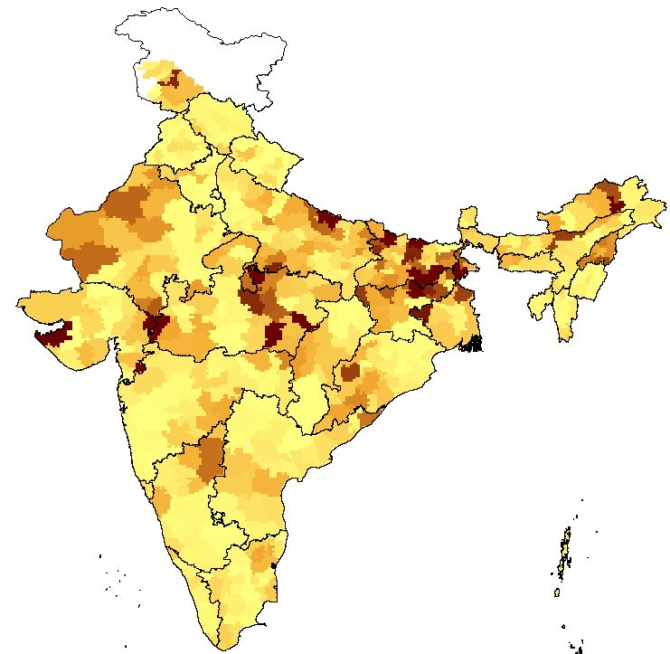
The Impact of Water Access on Short-Term Migration in Rural India
Objective
In this paper, we study the relationship between two important adaptation mechanisms used by rural households in India: irrigation; and short-term migration While short-term migration plays a role in reducing income uncertainty on its own, our interest in this paper is in how short-term migration interacts with the different sources and dimensions of groundwater irrigation.
Approach
Our empirical analysis integrates individual-level migration data with district level data on weather and irrigation. To remedy the paucity of reliable migration data in India, we use household-level data from the National Sample Survey Organization’s national survey of migration conducted from July 2007 through June 2008
Impact
In this paper, we highlight the relationship between two distinct adaptation responses: groundwater irrigation; and short-term migration; and show that groundwater availability and access do have an economically significant impact on rural, short-term labor mobility. The results from our empirical model suggest that short-term migration decisions respond to past rainfall variability and to the agricultural opportunity costs associated with irrigation.
Figure: The map shows the percentage of rural households with short-term migrants for each district. State boundaries are shown in black. The data used for this map is from the NSS 2007-08
Zaveri, E., D.H. Wrenn, and K.A. Fisher-Vanden, 2020, “The Impact of Water Access on Short-Term Migration in Rural India.” Australian Journal of Agricultural and Resource Economics, 64(2):505-532. doi: 10.1111/1467-8489.12364

