Slide 1
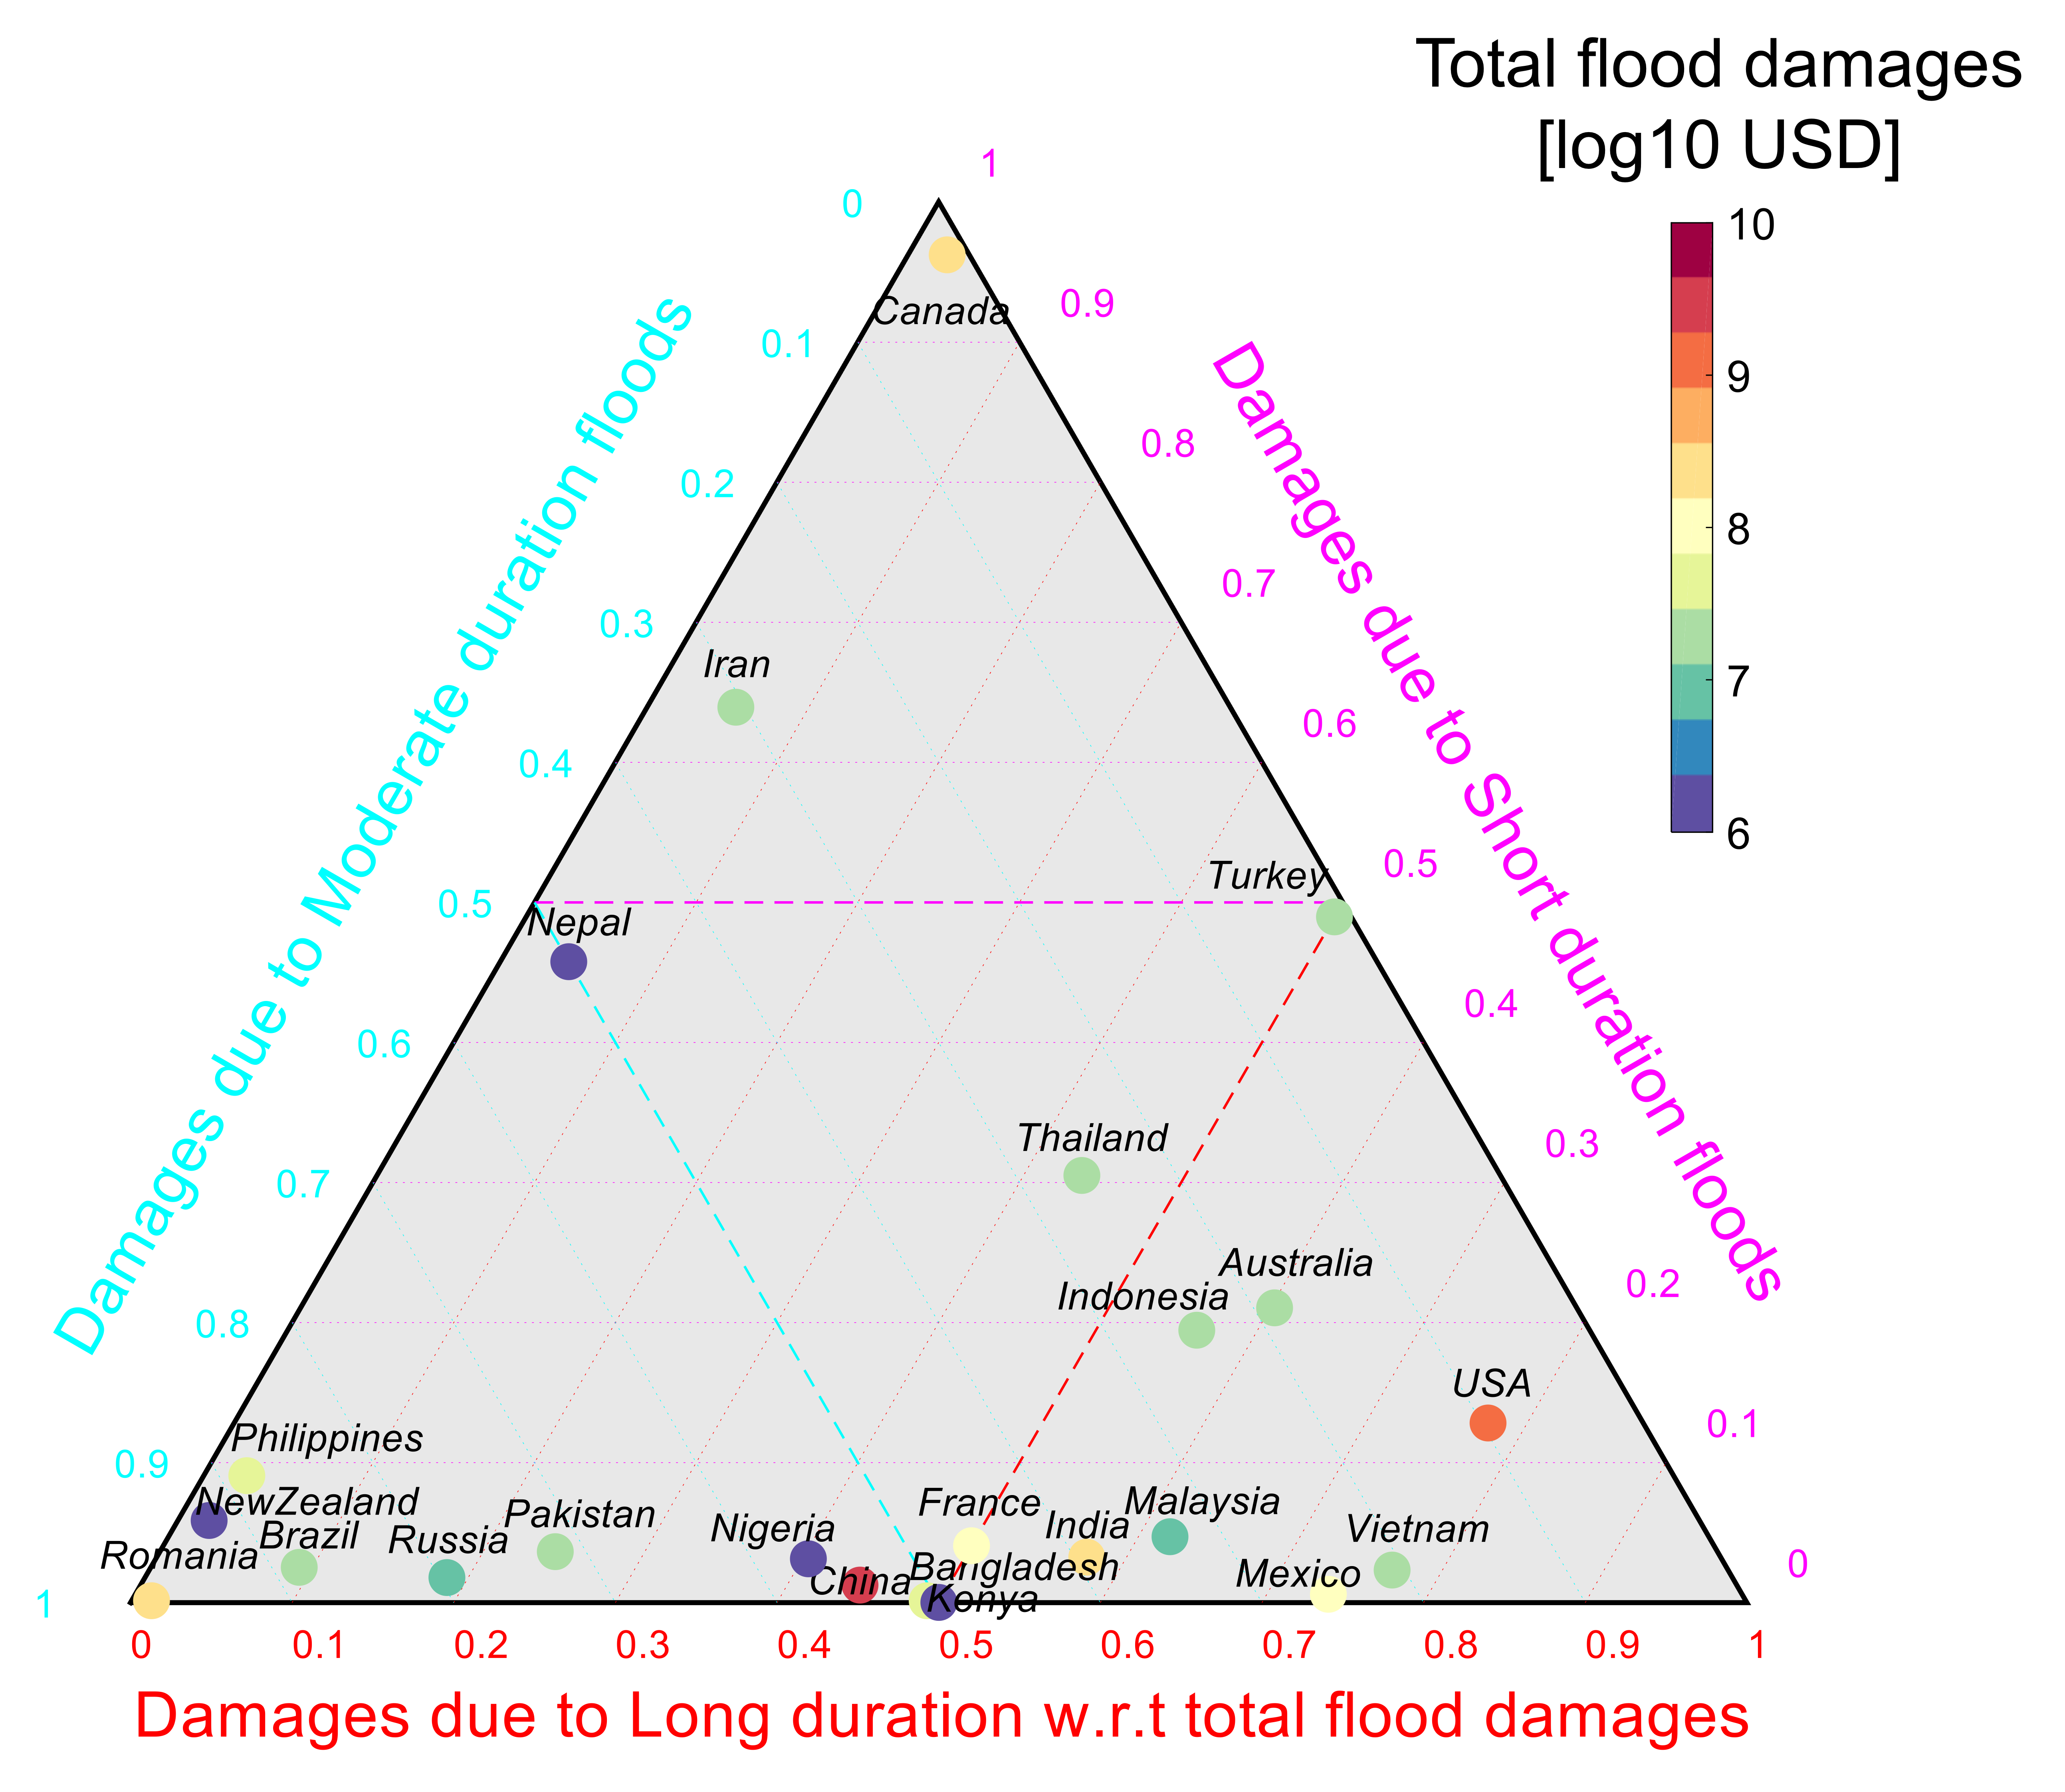
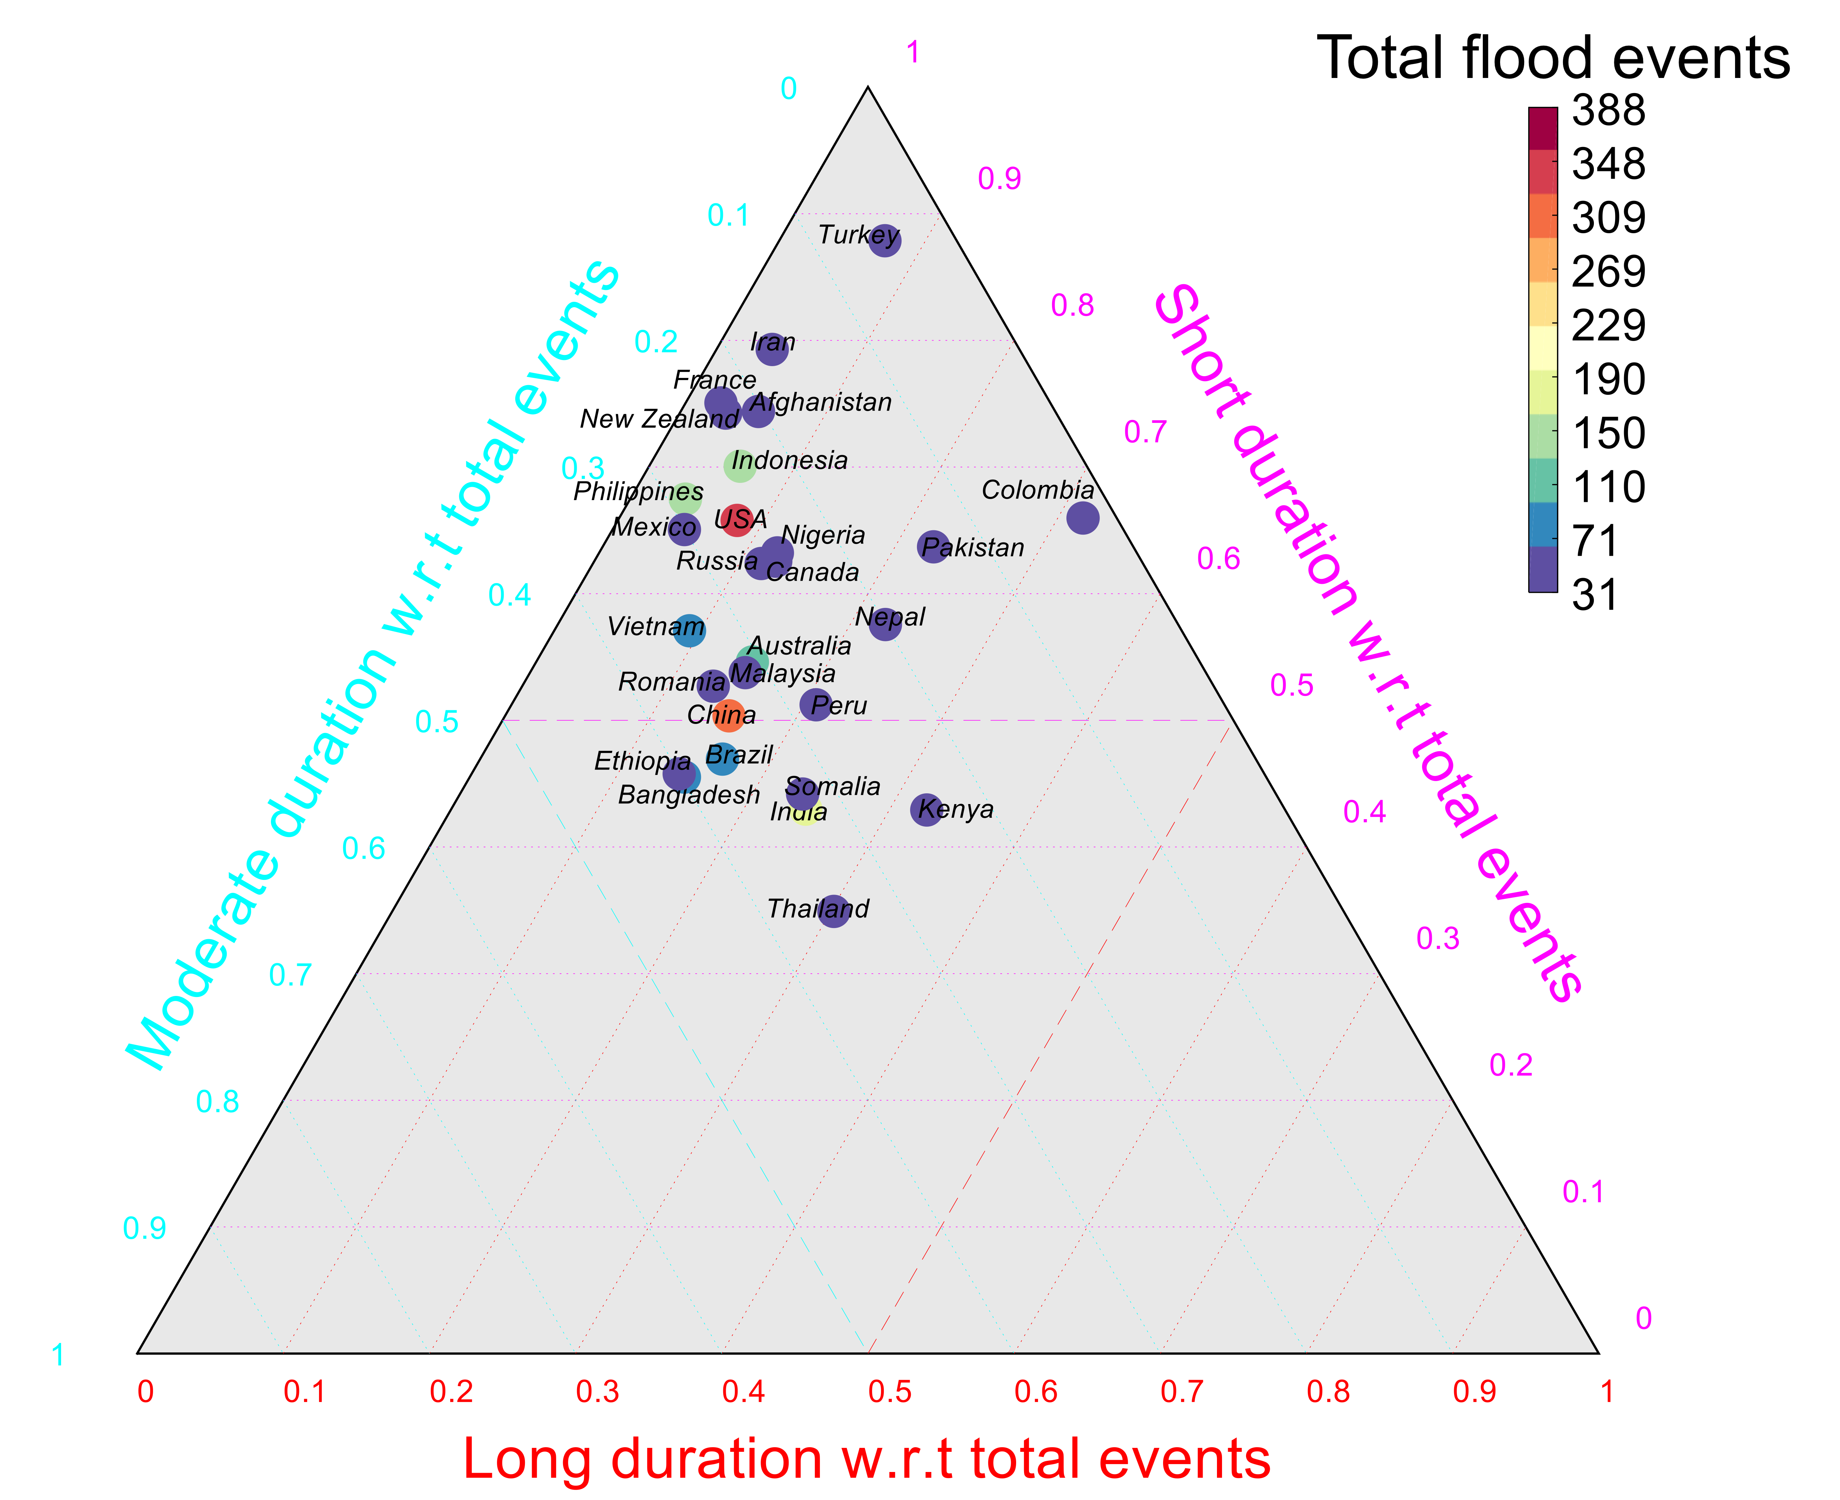


Analysis of the Frequency and Duration of Global Floods
Objective: To explore the variability in the frequency of floods, their moments and damages at global and latitudinal scales. To verify if there are large-scale atmospheric teleconnections.
Approach: Using a statistical hypothesis-testing framework on the three resistance moments (median, MAD, and skewness) and the 90th percentile (extreme flood duration) of the annual distribution of the flood duration and frequency of flood events along with a Generalized Linear Modeling Framework.
Results/Impacts: A global assessment of flood events using the Dartmouth Flood Observatory (DFO) database (1985-2015) is performed here to explore the planetary nature of the variability in the frequency and duration of floods (short, moderate, and long). This comprehensive study is the very first global study of actual flood events which identifies temporal changes in frequencies and characteristics of probability distribution of flood durations to understand the changing organization of the local to global dynamical systems.
Najibi, N., Devineni, N. Recent trends in the frequency and duration of global floods, Earth System Dynamics, 9(2), 757-783, 2018. https://doi.org/10.5194/esd-9-757-2018

