Slide 1
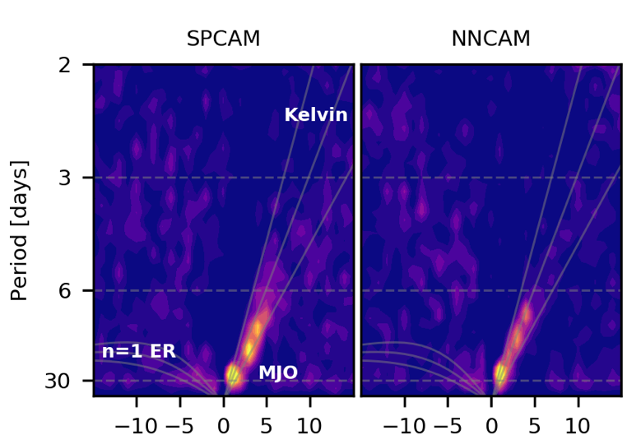


Deep learning to represent sub-grid processes in climate models.
Objective: To see if cloud resolving calculations can be skillfully emulated with modern deep learning methods and assess trade-offs.
Approach: Use SuperParameterized (SP)CAM to train a Neural Network (NN) on data flows between 9k cloud resolving models and their host global model on an idealized aquaplanet. Then let NN replace SP & feed back with global dynamics calculations in forward runs, as test of concept.
Results: Neural Network-CAM (NNCAM) successfully reproduces SPCAM’s climate (equatorial wave spectrum, precip extremes, and mean state). Affirms potential of machine learning-based subgrid parameterization.
Figure 1: NNCAM’s equatorial wave spectrum, showing Madden-Julian Oscillation and Moist Kelvin Wave variability reminiscent of SPCAM.
Figure 2: NNCAM’s precipitation extremes and their response to surface warming, a good match to SPCAM.
Rasp, Stephan, Mike Pritchard, and Pierre Gentine, 2018: Deep learning to represent subgrid processes in climate models. Proceedings of the National Academy of Science, 115, 9684 LP-9689, doi:10.1073/pnas.1810286115.

