Slide 1
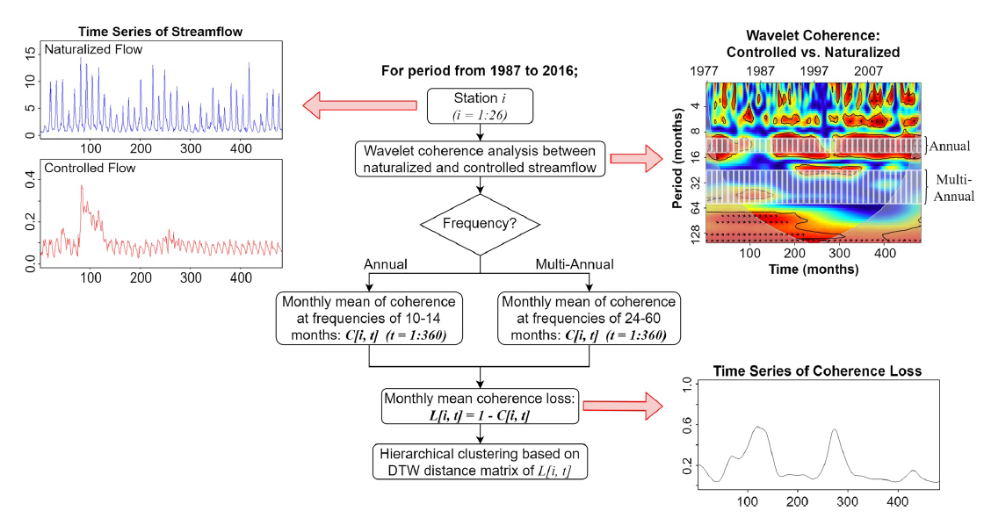
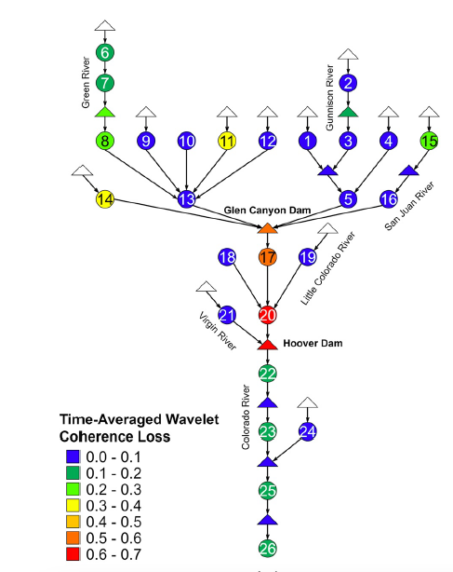
Quantifying Dam-Induced Fluctuations in Streamflow Frequencies Across the Colorado River Basin
Objective: To explain how dams affect the dominant frequencies of natural streamflow over a highly regulated river network.
Approach: We took both the naturalized and controlled streamflow series for each station and computed the wavelet coherence spectrum between them – delivering a localized coefficient for each of the 256 frequency scales over the given period. The wavelet coherence spectrum between the 10-month and 14-month frequency scales was then selected and averaged (across scales) into the annual frequency band for each timestep. Similarly, for the multi-annual frequency band, the wavelet coherence spectrum for frequency scales between the 24- and 60-months was selected and scale-averaged for each timestep. The scale-averaged wavelet coherence loss for each frequency band was then computed by subtracting the wavelet coherence value from 1. We finally grouped stations with similar time-varying wavelet coherence loss for each frequency band using the dynamic time warping hierarchical clustering method.
Results/Impacts: The annual frequency was relatively well preserved downstream of Hoover Dam while showing a systematic trend of alteration downstream of Glen Canyon Dam until Hoover Dam. Meanwhile, the multi-annual frequency component was highly altered for the entire Lower Colorado main stem (i.e., downstream of Glen Canyon). We also identified dams with significant impacts on streamflow frequency by comparing wavelet coherence estimates. This study advances the notion that dams fundamentally alter river flow regimes across multiple frequencies and with varying amplitudes over time and space.
Hwang, J., Kumar, H., Ruhi, A., Sankarasubramanian, A., & Devineni, N. (2021). Quantifying Dam‐Induced Fluctuations in Streamflow Frequencies Across the Colorado River Basin. Water Resources Research, 57(10), e2021WR029753. https://doi.org/10.1029/2021WR029753

