Slide 1
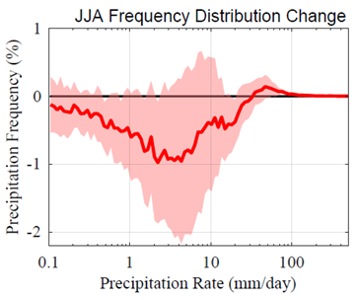
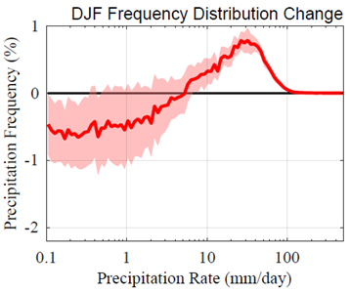
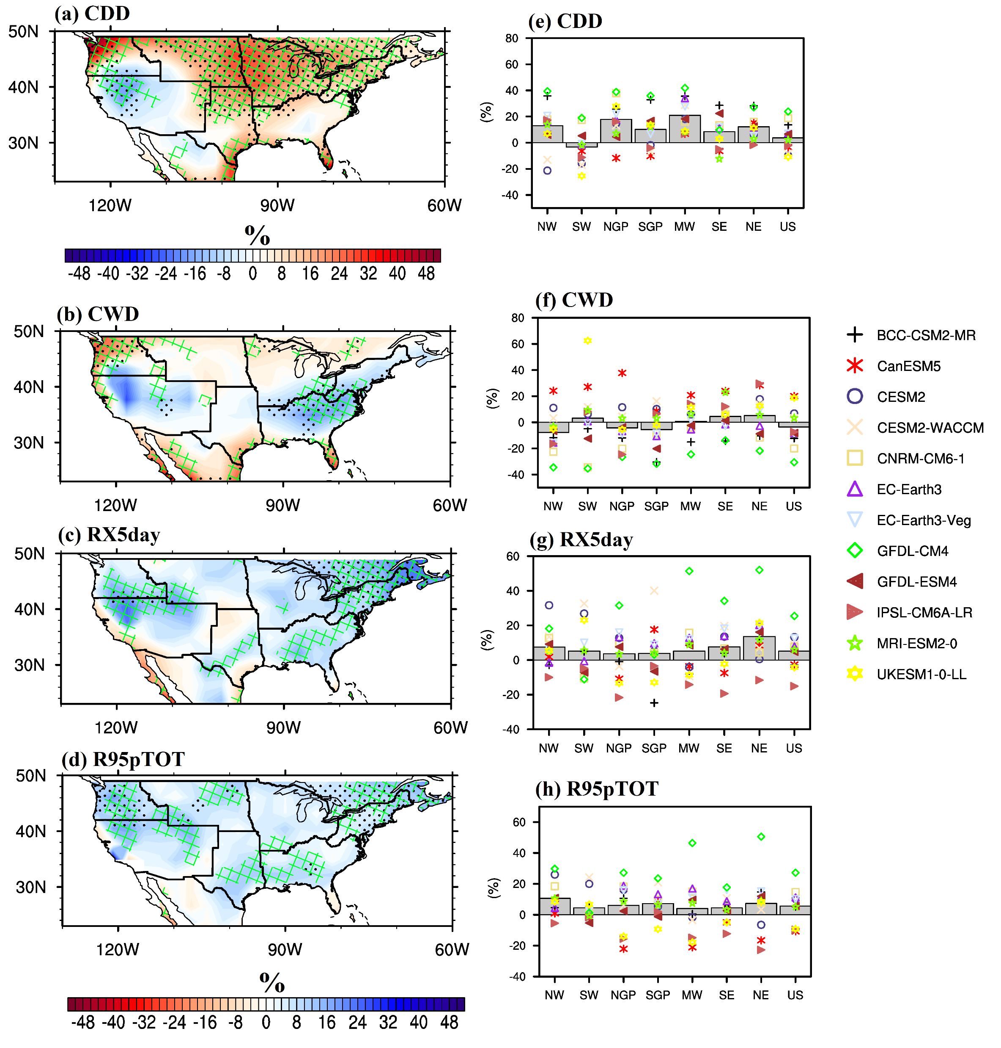
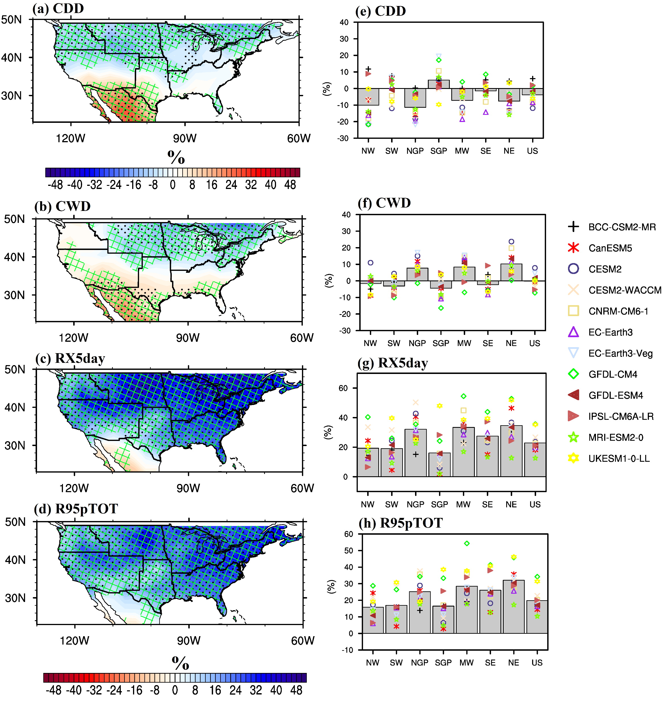
Projected changes in seasonal precipitation extremes over the United States in CMIP6 simulations
Changes in Daily Precipitation Frequency Distribution
Objective: Quantify the impact of climate change on precipitation extremes over the United States using newly developed Earth system models (i.e., CMIP6).
Approach: Investigate the changes (2061 - 2100 vs 1975 - 2014) in nine extreme precipitation indices and assess the robustness of these changes using multiple statistics.
Results/Impact: We found a robust enhancement (reduction) in winter precipitation frequency, evident for medium-heavy (light) rates over the United States. The projected changes in summer frequency distributions have considerable intermodel spread, which we interpret as an indication of uncertainty. The substantial projected increase in winter precipitation extremes has implications for flooding, transportation, and energy-use during winter.
Percentage Changes in Extreme Precipitation Indices
Akinsanola AA, Kooperman GJ, Reed KA, Pendergrass AG and Hannah WM (2020), Projected changes in seasonal precipitation extremes over the United States in CMIP6 simulations. Environ. Res. Lett. 15 104078. https://doi.org/10.1088/1748-9326/abb397
Summer JJA Winter DJF

