Slide 1
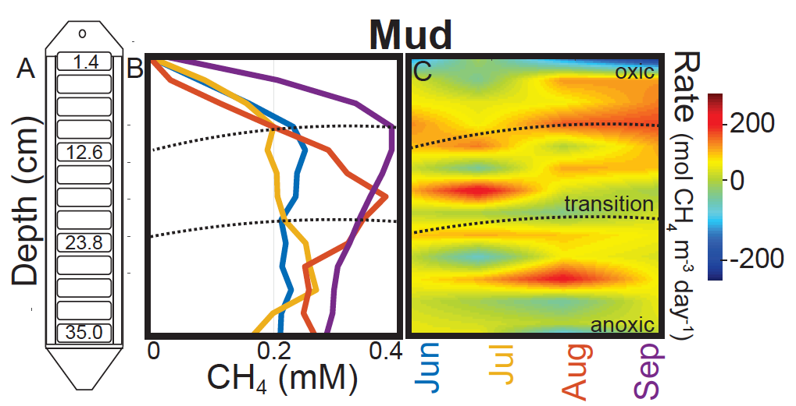
Methanogenesis in Oxygenated Soils is Important for Wetland Methane Emissions: Implications for Earth System Models
Scientific Achievement
Using porewater, greenhouse-gas flux measurements, and models, we demonstrated CH₄ production in well-oxygenated soils
Metagenomic and metatranscriptomic sequencing recovered the first near complete genomes for a novel methanogen species
Significance and Impact
Figure. Monthly observed porewater dissolved CH₄ concentrations. (C) Modeled net CH₄ fluxes show seasonal production (orange and red) in oxic soils.
Earth System Models (ESMs) assume methanogenesis occurs only under anoxic conditions.
We demonstrate here that up to 80% of CH₄ fluxes could be attributed to methanogenesis in oxygenated soils.
These results imply needed improvements to the DOE E3SM land model (ELMv1-ECA), which we are pursuing
Angle, J., T. Morin, L. Solden, A. Narrowe, G. Smith, M. Borton, C. Rey-Sanchez, R. Daly, G. Mirfenderesgi, D. Hoyt, W. J. Riley, C. Miller, G. Bohrer, and K. Wrighton (2017), Methanogenesis in oxygenated soils is a substantial fraction of wetland methane emissions, 8, 1567, DOI: 10.1038/s41467-017-01753-4, Nature Communications.
Research Details
We collected core samples, eddy covariance observations, and genomic observations from a freshwater wetland in Ohio
We applied a 1D numerical model to infer transient CH₄ production, transport, and emissions to the atmosphere

