Slide 1
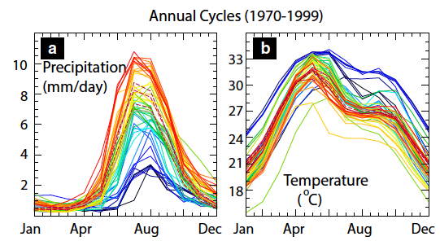
Sources of Errors in the Simulation of South Asian Summer Monsoon in the CMIP5 GCMs
Objective
Investigate the sources of errors in the South Asian Monsoon simulated by a multi-model ensemble of global climate models
Approach
Analyze the South Asian Monsoon in the Coupled Model Intercomparison Project Phase 5 (CMIP5) multi-model ensemble
Analyze a pair of simulations at low and high resolution with prescribed sea surface temperatures
Examine the relationships between the biases in the South Asian summer monsoon rainfall with biases in large-scale circulation, surface heat fluxes, monsoon depressions, and moisture transport
Evaluate the impacts of model resolution on the monsoon biases
Precipitation and temperature biases in the CMIP5 simulations of the South Asian Monsoon.
Impact
This study identifies improvements in representing land-atmosphere processes as a key step toward improving GCM simulations of the South Asian summer monsoon rainfall, which has significant implications for the well-being and economic security of the South Asian population
Ashfaq M, D Rastogi, R Mei, D Touma, and LR Leung. 2016. “Sources of Errors in the Simulation of South Asian Summer Monsoon in the CMIP5 GCMs.” Climate Dynamics. DOI: 10.1007/s00382-016-3337-7
Notes:
http://www.pnnl.gov/science/highlights/highlights.asp?division=749

