Slide 1
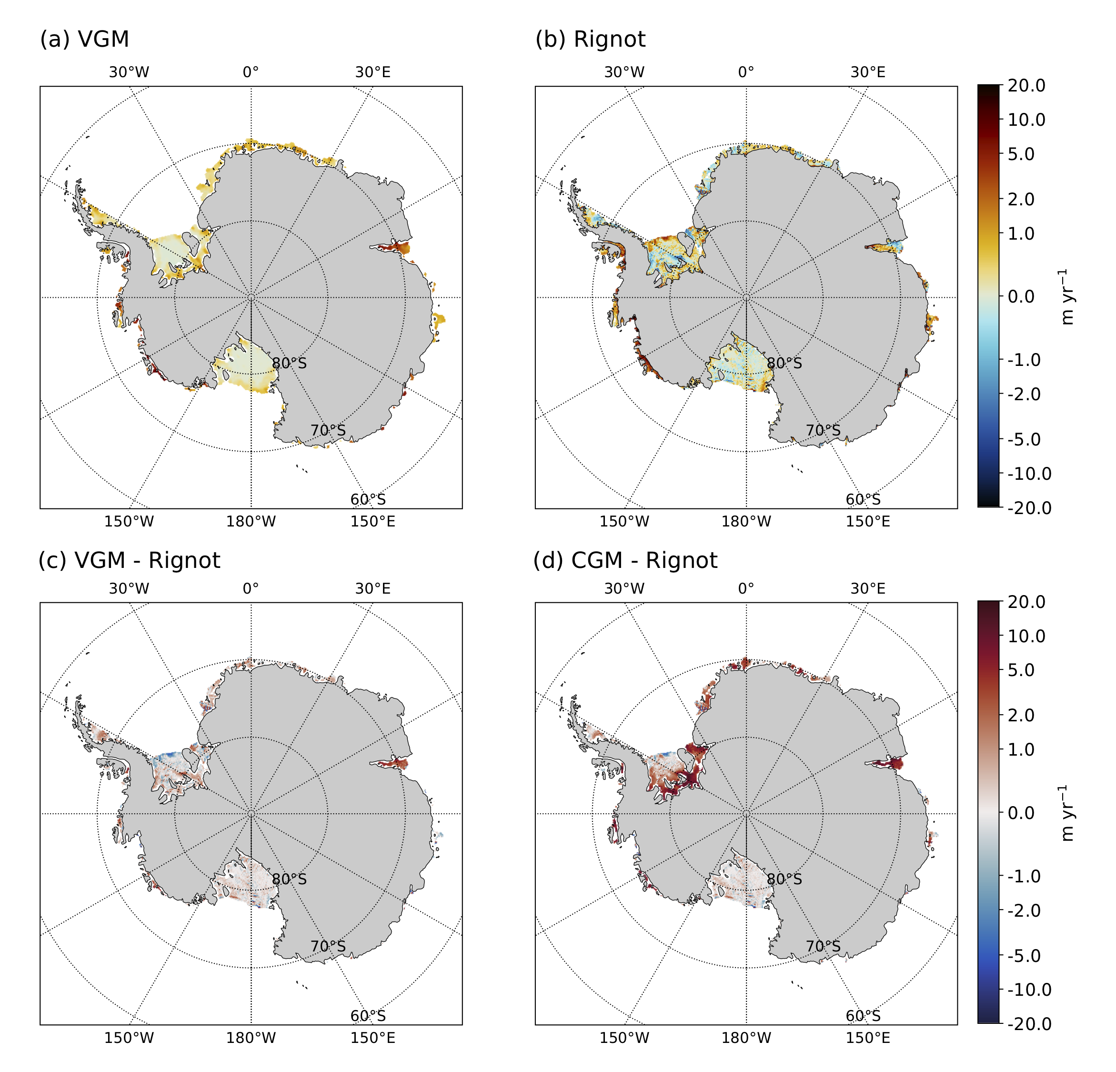
The DOE E3SM v1.2 Cryosphere Configuration Overview
Objective
Many Earth System Models crudely represent the way in which freshwater from the Antarctic Ice Sheet (AIS) enters the rest of the climate system.
Here, this is improved upon by more accurately representing the two main processes involved; ice-shelf basal melting and melting of calved icebergs.
These improvements will allow for more realistic projections of the AIS’s impact on regional and global climate in the future, most notably via sea-level rise.
Approach
In E3SM v1.2, the ocean domain has been extended below Antarctic ice-shelf cavities, allowing the model to calculate ice-shelf basal melt rates based on the surrounding ocean properties.
Realistic iceberg fluxes are accounted for through the addition of an observationally-based iceberg melt climatology.
Biases in the ocean were found to lead to very high melt-rates (relative to present-day observations) beneath certain ice-shelves. Changes to the ocean’s mesoscale eddy parameterization reduced ocean Southern Ocean biases, leading to greatly reduced biases in simulated ice-shelf basal melt rates.
Impact
Here we demonstrate the ability of E3SM v1.2 at standard resolution to simulate Antarctic ice-shelf basal melting in line with present day observations. This is an important step towards reducing uncertainties in projections of the Antarctic response to climate change and Antarctica’s contribution to global sea-level rise.
Figure: Simulated ice-shelf basal melt rates around Antarctica (a) compared to observations (b). Changes in the ocean model led to a drastic reduction in biases (c) vs. (d).
Citation: Comeau, Asay-Davis, and 12 coauthors, The DOE E3SM v1.2 Cryosphere Configuration: Description and Simulated Antarctic Ice-Shelf Basal Melting, Accepted at J. Adv. Model. Earth Syst. (2022)

