Slide 1
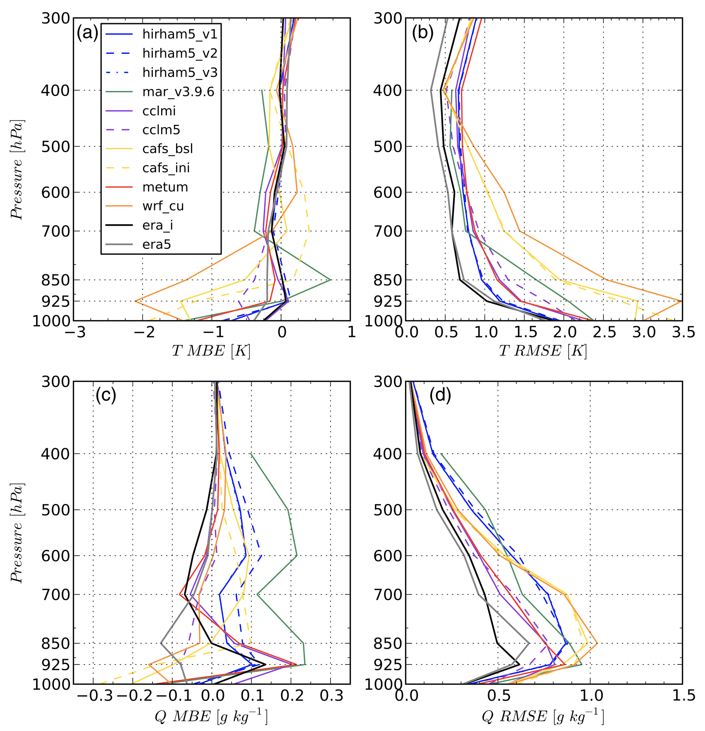
Confronting Arctic Troposphere, Clouds, and Surface Energy Budget Representations in Regional Climate Models with Observations
Objective
To evaluate six regional climate models (RCMs) in comparison to observations from the Arctic Clouds during Summer Experiment (ACSE).
Approach
Perform statistical comparisons of surface and upper-air meteorology observations, in addition to observations of the surface energy budget to different RCMs, and configurations of several of the RCMs.
Impact
First analyses in diagnosing the state of RCMs for the Arctic in over a decade
Provide data for the development and refinement of modeling capabilities of the Arctic climate system.
The resultant coordinated effort for this study will provide the framework for future larger studies using observations from the current year-long Multidisciplinary drifting Observatory for the Study of Arctic Climate (MOSAiC) expedition.
Sample comparison of RCMs to observations showing the vertical temperature and specific humidity profile statistics of mean bias error (MBE; a,c) and root mean square error (RMSE; b,d). Statistics are valid for the full ACSE campaign, 05 July at 01:00 UTC through 03 October at 07:00 UTC.
Sedlar, J. et al. (2020), Confronting Arctic Troposphere, Clouds, and Surface Energy Budget Representations in Regional Climate Models With Observations, Journal of Geophysical Research: Atmospheres, 125(6), doi:10.1029/2019JD031783.
Notes:
Wanda says that this is a general slide with no specific reference

