Slide 1
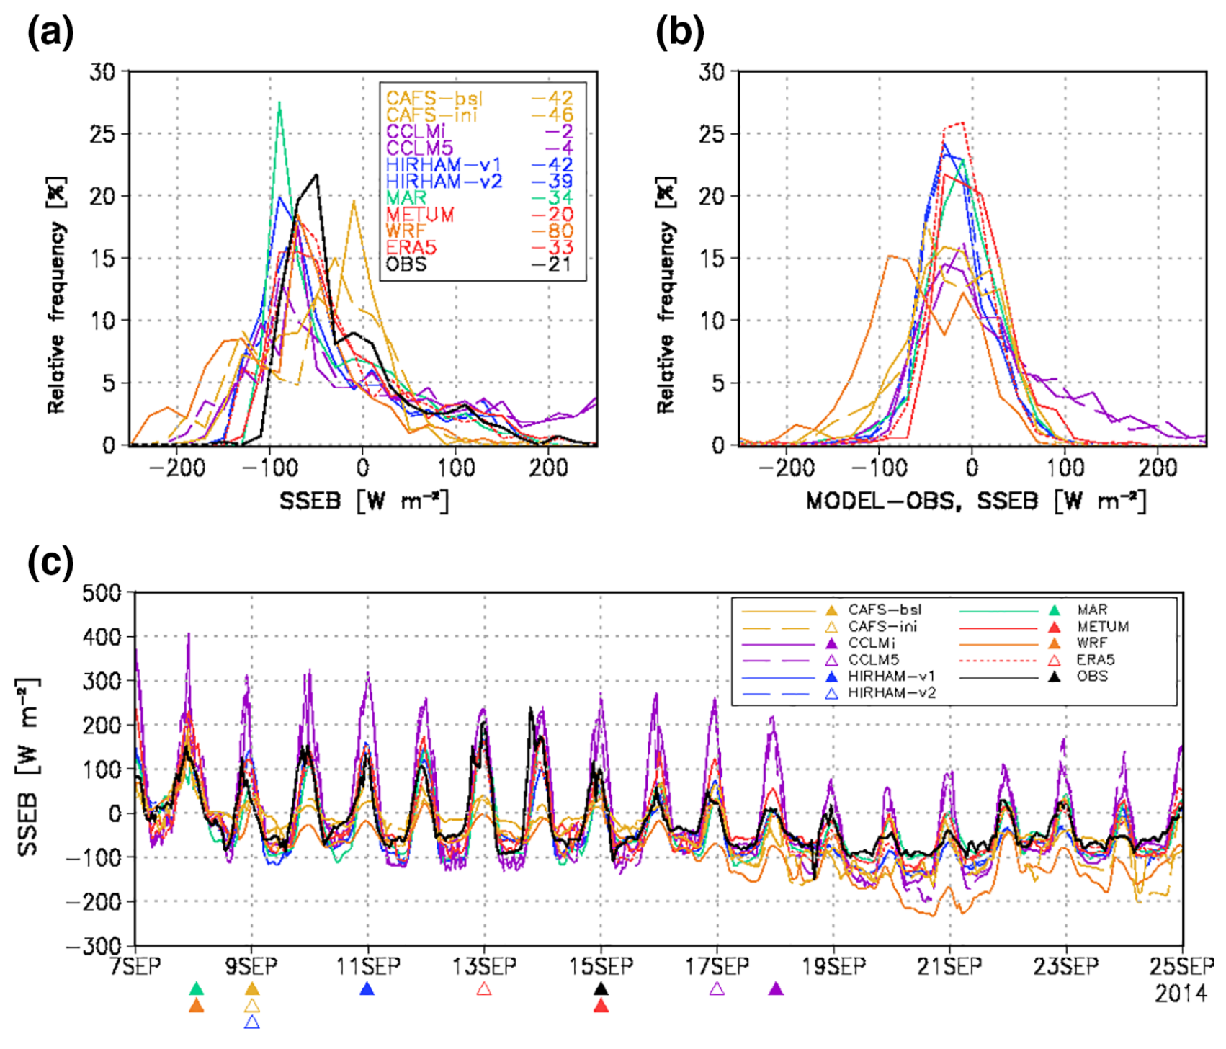
Clouds and Radiation Processes in Regional Climate Models Evaluated Using Observations Over the Ice‐free Arctic Ocean
Objective
To evaluate six regional climate models (RCMs) in comparison to observations from the Japanese RV Mirai research cruise over the ice-free Arctic Ocean.
Approach
Perform statistical comparisons of surface and upper-air meteorology observations, in addition to observations of clouds and the surface energy budget, to the RCMs in an evaluation of RCM performance over the ice-free ocean.
Impact
RCMs represent the surface meteorological state very well.
There are large differences in the representation of water and ice clouds between the RCMs and the observations and among the different RCMs.
This is a follow-up study to a previous RCM evaluation over the Arctic in the summer (Sedlar et al. 2020) and a precursor to the RCM evaluations to be completed using observations from the MOSAiC expedition.
Sample comparison of RCMs to observations showing the relative frequency of sea surface energy budget (SSEB) in bins (a), the difference between each RCM and observation of SSEB (b), and the time series of each RCM’s SSEB over the duration of the observations (c). Statistics are valid for the full Mirai campaign from 7 to 25 September 2014.
Inoue, J. et al. “Clouds and Radiation Processes in Regional Climate Models Evaluated Using Observations Over the Ice‐free Arctic Ocean”. Journal of Geophysical Research Atmospheres 126, (2021). [DOI: 10.1029/2020jd033904].

