Slide 1
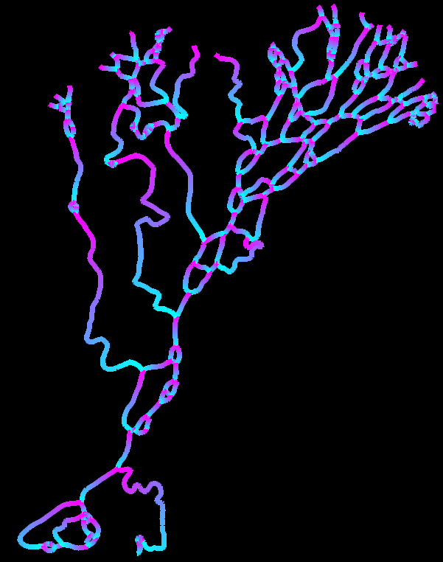
Novel method for determining flow directions in channel networks
Objective
Develop algorithms to automatically determine flow directions in complex channel networks
Impact
Rapid, automatic, and objective method to identify flow directions in channel networks
Advances capabilities for modeling fluxes of water, sediment, nutrients, heat, and contaminants through rivers and deltas
Generate improved understanding of channel network structure and its impact on river-ocean fluxes
Research
Used combinations of direction-predicting algorithms (DPAs) to make ”recipes” for delta and braided river channel networks
Tested against expert assessment with 97% success
Example of algorithm usage on the Colville delta, Alaska.
Left: Predicted low directions in the Colville channel network for each individual channel, with blue showing the upstream and pink showing the downstream portion of each link.
Right: Predicted flow directions can be used to determine the fraction of river discharge exiting the delta at each outlet. Channel network (warm colors) is superimposed on a mask of the channels (dark blue. Land is black. Circles indicate channel outlets, and the size of the circle scales with the proportion of river discharge exiting the delta at each outlet. The Colville shows a relatively even distribution of river discharge across its front.
flow direction
upstream
downstream
general
flow dir.
Schwenk, J., A. Piliouras, and J. C. Rowland. (2019). Determining flow directions in river channel networks using planform morphology and topology. Earth Surface Dynamics. https://doi.org/10.5194/esurf-2019-19.

