Slide 1
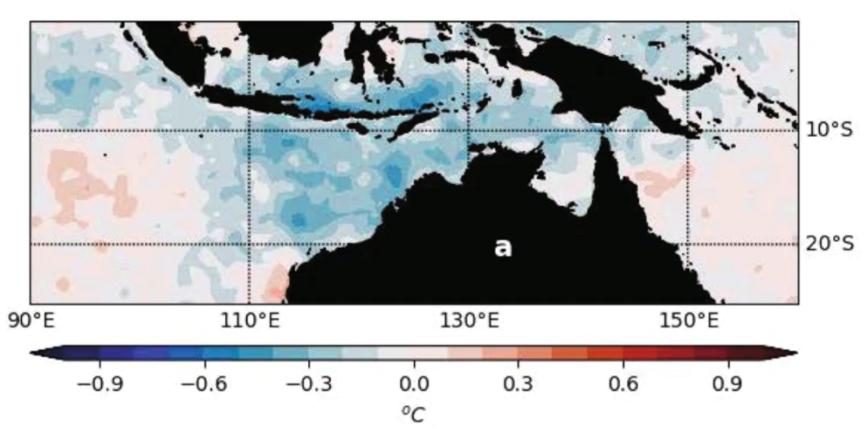
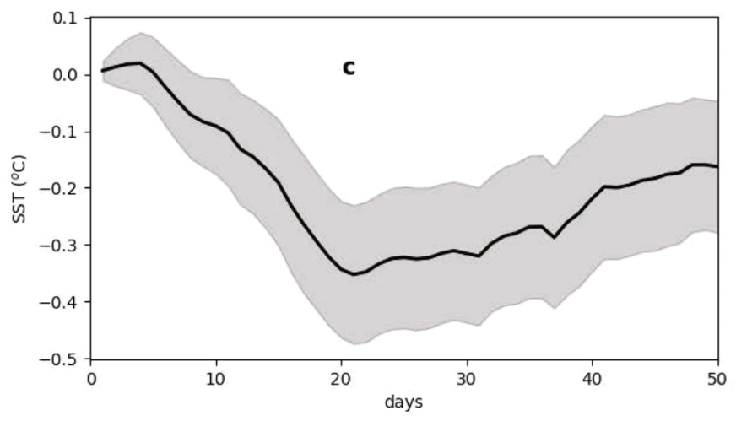
Understanding the Oceanic Influence of the Madden-Julian Oscillation on Tropical Cyclones
Objective
Determine if the Madden Julian Oscillation (MJO) can affect tropical cyclones (TCs) through the ocean, rather than just the atmosphere.
Approach
Evaluate the sea surface temperature (SST) response to the MJO over the Maritime Continent.
Analyze observations of the large-scale ocean-atmosphere environment, MJO events, and TCs over the Maritime Continent. Isolate the influence of MJO-induced SST change on TCs.
Use simulations based on the Advanced Weather Research and Forecasting (WRF-ARW) model at 4 km to understand the impact of the MJO on Cyclone Olga (March 2000).
Impact
TCs that form after MJO passage encounter cooler SSTs, and the reduced surface enthalpy fluxes decrease TC intensification rates by more than 50% on average.
In numerical simulations with the SST cooling from prior MJO included, Cyclone Olga remains a tropical storm. However, it intensifies to a Category 1 strength when the influence of the prior MJO on pre-storm SSTs is removed.
These results have significant implications for understanding subseasonal variability of TCs and the long-term impacts on TCs of future changes in MJO characteristics.
AA
B
By inducing SST cooling (panel A, NOAA OI SST [°C] for the period 1982–2019) that persists for more than 30 days (panel B, averaged over the region 110°E–130°E and 15°S–5°S), MJOs reduce TC intensification rates by over 50% on average. The x-axis in B represents days since the beginning of the MJO phase 3 and the gray shading represents the 95% confidence interval.
Balaguru K, LR Leung, SM Hagos, et al. “An oceanic pathway for Madden–Julian Oscillation influence on Maritime Continent Tropical Cyclones.” npj Clim Atmos Sci, 4, 52, (2021). [DOI: 10.1038/s41612-021-00208-4]
Notes:
http://www.pnnl.gov/science/highlights/highlights.asp?division=749

