Slide 1
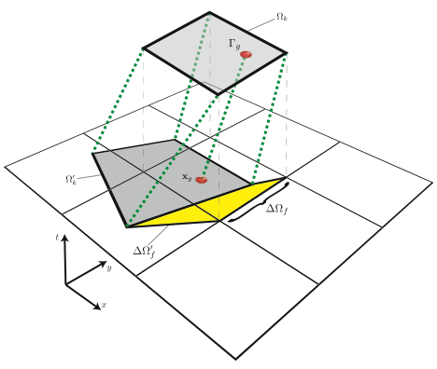
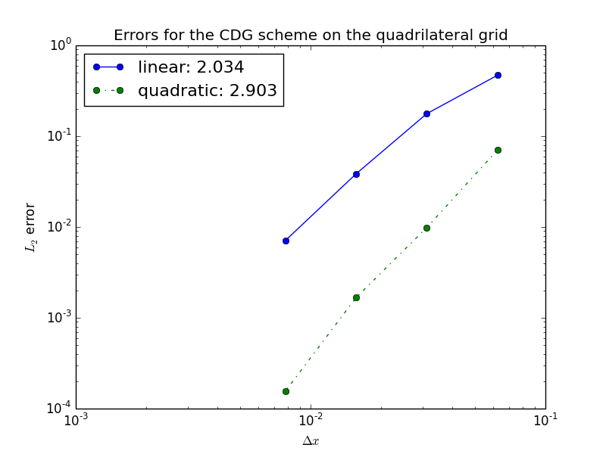
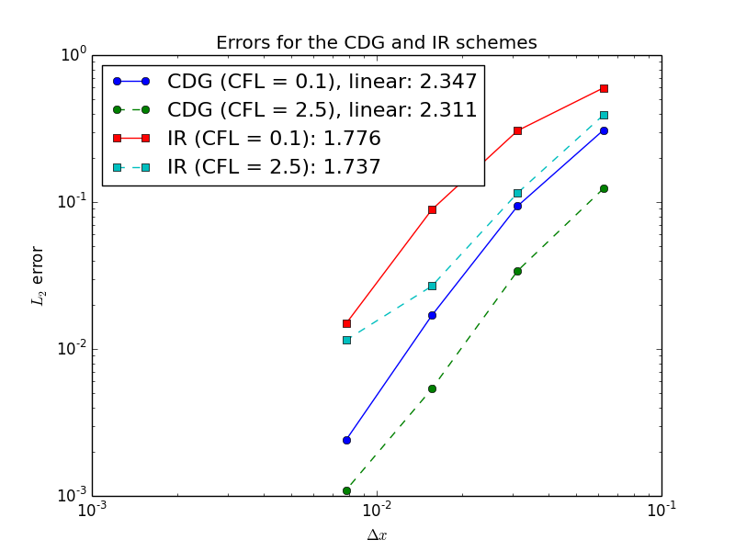
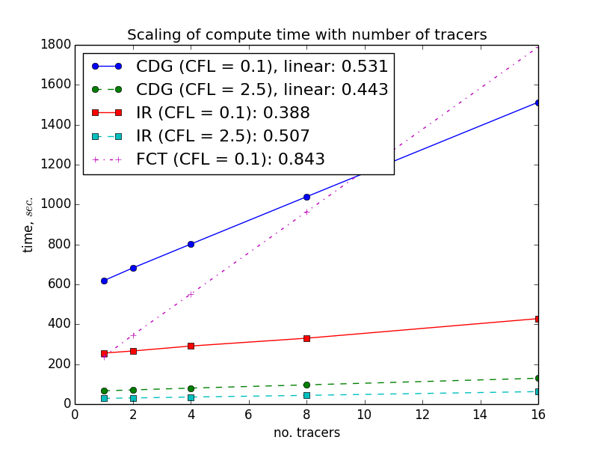
Characteristic Discontinuous Galerkin Advection
Objective
Modern ocean models involve the transport of large numbers of tracers (ie: temperature, salinity). This process can be very computationally expensive. A transport scheme which scales sub-linearly with the number of tracers, and may be implemented on an unstructured mesh is required. This is being developed for the MPAS-Ocean model, with potential for use in other dynamical cores (ie: atmosphere, sea-ice).
Left: convergence of errors with grid resolution for linear and quadratic basis representations. Right: errors reduce for larger time steps (which are not limited by a CFL condition), and are approximately equal to those for an incremental remap (IR) scheme with twice the resolution.
Research
Schematic of the CDG advection scheme: edges are traced backwards along velocity characteristics to create a swept region denoting the volume of material fluxes across the edge, and quadrature points are integrated forwards along characteristics in order to enforce conservation
Implementation of a “characteristic discontinuous Galerkin” advection scheme
Tracers are represented by a polynomial basis in each element
Tracer fluxes across edges are evaluated by integrating the edges backwards along velocity characteristics and integrating each of the basis functions across this area
Areas are common for all tracers, so computation scales sub-linearly with number of tracers
Basis coefficients are evaluated via the solution of a linear system in each element
Agnostic to mesh geometry and topology
Conservative
Stable for large time steps
Monotonicity may be enforced for tracer fields
Left: compute time scales sub-linearly with number of tracers. Performance is greatly improved for larger time steps.
Impact
Improved performance over current scheme for large numbers of tracers
Improved accuracy over Incremental Remap scheme
No restriction on time step. For simple flows accuracy is improved for large time steps
Option for higher order representation of tracers and accuracy
Lee, D., Lowrie, R. Petersen, M. Ringler, T. and Hecht, M., 2016. A High Order Characteristic Discontinuous Galerkin Scheme for Advection on Unstructured Meshes Journal of Computational Physics.
Notes:
Wanda says that this is a general slide with no specific reference

