Slide 1
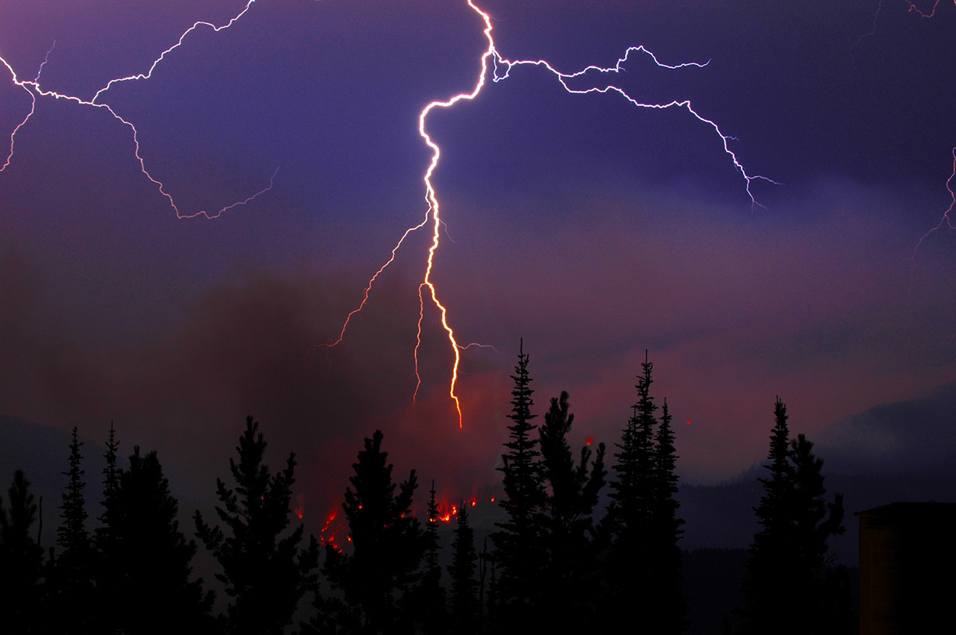
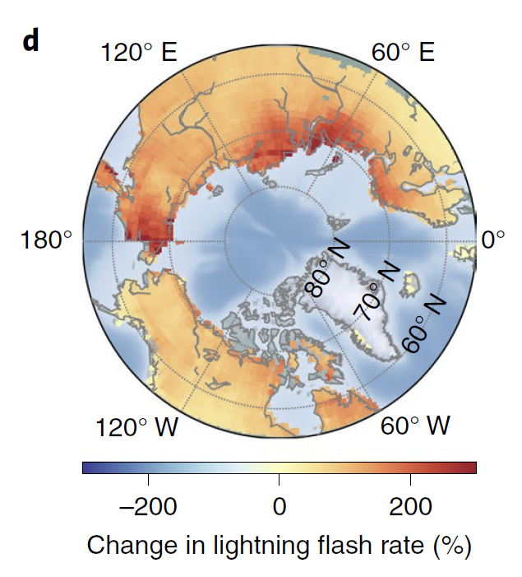
Future increases in Arctic lightning and fire risk for permafrost carbon
Objectives: To quantify future changes in Arctic lightning caused by climate change, and explore implications for wildfires.
Approach: Develop a climate – lightning flash rate relationship from contemporary reanalysis (ERA5) and satellite lightning observations. Use this relationship with CMIP6 projections of future climate change to estimate end-of-century lightning levels in high northern latitude regions.
Results/Impacts: Lightning more than doubles in Arctic tundra by 2100, increasing at a rate that is more than 3 times higher than previous estimates for CONUS. More frequent lightning strikes are expected to increase wildfires and expedite northward migration of conifer forests into Arctic tundra.
Chen, Yang, D. M. Romps, J. T. Seeley, S. Veraverbeke, William J. Riley, Zelalem A. Mekonnen, and James T. Randerson (2021), Future Increases in Arctic Lightning and Fire Risk for Permafrost Carbon, Nat. Clim. Change, doi:10.1038/s41558-021-01011-y.
Figure: A) Lightning above a wildfire in Alberta, Canada. Credit: The Government of Alberta. B) Change in lightning flash rate expected by 2100 for RCP85

