Slide 1
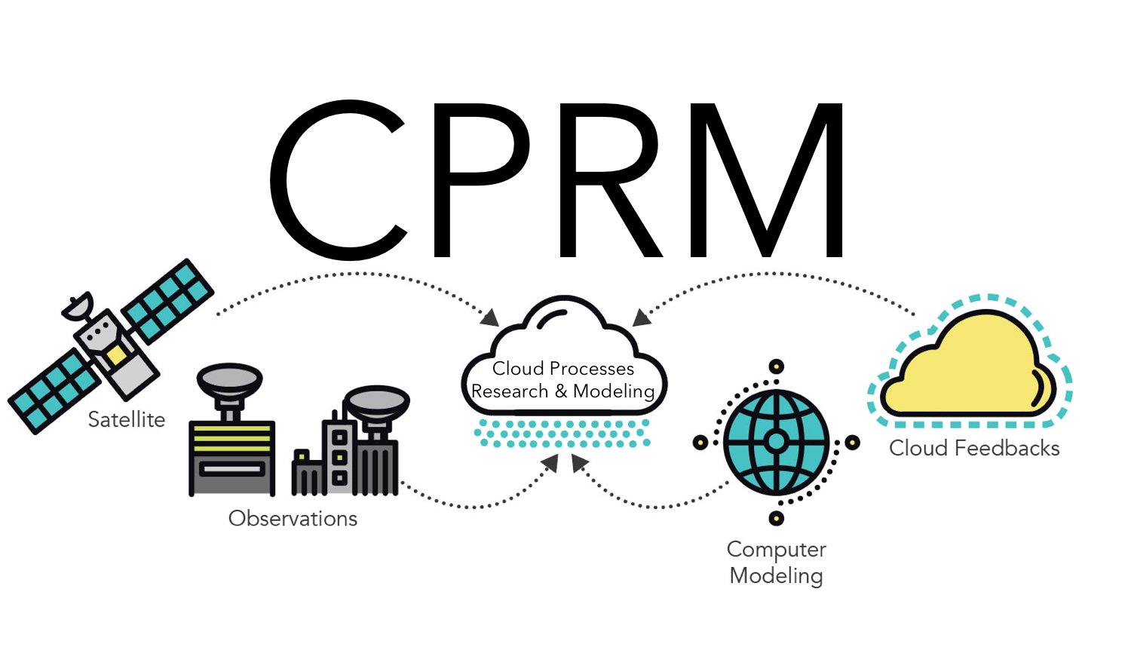
Separating natural from externally-forced contributions to observed cloud cover trends
Scientific Achievement LLNL scientists and their colleagues have used climate models to estimate how much of the satellite-observed trends in cloud cover of the period 1983–2009 can be explained by internal decadal climate variability versus external greenhouse gas forcing. The team found that decadal variability shows a similar spatial pattern and magnitude to the observed cloud cover trends, and that its contribution to cloud cover trends is larger than that from GHG forcing in nearly all regions over the globe.
Significance & Impact
Observed cloud trends include an unknown mix of responses due to greenhouse gas forcing and to natural climate variability, complicating their use for constraining cloud feedback. The team finds that recent observed cloud cover trends are primarily driven by decadal climate variability rather than greenhouse gas forcing. Hence caution is needed when comparing the cloud feedback obtained from observational data with the cloud feedback obtained from model warming experiments.
Low Cloud Cover Trends, 1983-2009
Observed by ISCCP
Variability Contribution
%/decade
%/decade
(left) Trend of low cloud cover in ISCCP observations (1983–2009). The plus signs indicate the sign of the trend of PATMOS-x observations is consistent with ISCCP. (right) The estimated contribution of decadal variability (PDO + AMO) to observed low cloud cover trends. The 60˚S–60˚N mean trend has been removed
Research Details The team used CMIP5 output to estimate the relative roles of anthropogenic and natural factors in driving observed cloud trends. The cloud cover trend patterns associated with decadal variability –particularly the Pacific decadal oscillation and Atlantic multidecadal oscillation – are significantly correlated with patterns of cloud cover trends in observations during the period of 1983–2009.
Chen, Y.-J., Y.-T. Hwang, M. D. Zelinka, and C. Zhou, 2019: Distinct patterns of cloud changes associated with decadal variability and their contribution to observed cloud cover trends, J. Climate, 32, 7281-7301, doi:10.1175/JCLI-D-18-0443.1.
Notes:
The Science
Scientists at Lawrence Livermore National Laboratory in collaboration with colleagues from National Taiwan University and Nanjing University have used climate models to estimate how much of the satellite-observed trends in cloud cover over the period 1983–2009 can be explained by internal decadal climate variability versus external greenhouse gas forcing. The team found that decadal variability shows a similar spatial pattern and magnitude to the observed cloud cover trends, and that its contribution to cloud cover trends is larger than that from GHG forcing in nearly all regions. In particular, observations of decreasing clouds in the equatorial central Pacific, a zonally asymmetric pattern in the North Pacific, and hemispherically asymmetric low cloud cover trends in the Atlantic are all consistent with the signature of decadal variability. The results suggest that internally-generated climate variability has contributed markedly to observed cloud cover trends.
The Impact The responses of clouds and their radiative effects to global warming – the cloud feedback – represents the largest unknown in future climate predictions. Ideally, cloud trends in response to the warming that has occurred over recent decades would provide some constraints on the cloud feedback, but this is complicated in part by the fact that the observed trends include an unknown mix of responses due to greenhouse gas forcing and to natural climate variability. In this study, the relative roles of forcing and natural variability in driving observed cloud trends are sorted out. Over most regions, recent observed cloud cover trends are primarily driven by natural modes of decadal climate variability rather than greenhouse gas forcing. This suggests that caution is needed when comparing the cloud feedback obtained from observational data, in which forced and internally generated responses are comparable, with the cloud feedback obtained from model warming experiments, in which the forced signal dominates over the noise of natural variability by design.
Summary
To better understand the relative roles of anthropogenic and natural factors in driving observed cloud trends, the team investigated cloud changes associated with decadal variability including the Pacific decadal oscillation (PDO) and the Atlantic multidecadal oscillation (AMO). In the preindustrial simulations of CMIP5 global climate models (GCMs), the spatial patterns and the vertical structures of the PDO-related cloud cover changes in the Pacific are consistent among models. Meanwhile, the models show consistent AMO impacts on high cloud cover in the tropical Atlantic, subtropical eastern Pacific, and equatorial central Pacific, and on low cloud cover in the North Atlantic and subtropical northeast Pacific. The cloud cover changes associated with the PDO and the AMO can be understood via the relationships between large-scale meteorological parameters and clouds on interannual time scales. When compared to the satellite records during the period of 1983–2009, the patterns of total and low cloud cover trends associated with decadal variability are significantly correlated with patterns of cloud cover trends in ISCCP observations. On the other hand, the pattern of the estimated greenhouse gas (GHG)-forced trends of total cloud cover differs from that related to decadal variability, and may explain the positive trends in the subtropical southeast Pacific, negative trends in the midlatitudes, and positive trends poleward of 50˚N/S. In most models, the magnitude of the estimated decadal variability contribution to the observed cloud cover trends is larger than that contributed by GHG, suggesting the observed cloud cover trends are more closely related to decadal variability than to GHG-induced warming.

