Slide 1
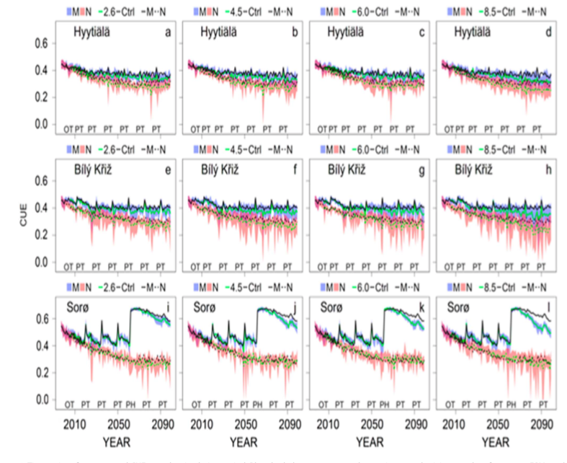
Thinning Can Reduce Losses in Carbon Use Efficiency and Carbon Stocks in Managed Forests Under Warmer Climate
Scientific Achievement
We focus on changes in carbon use efficiency and carbon stocks as a result of warming, rising atmospheric CO₂ concentration, and forest thinning.
Our results show that autotrophic carbon sequestration decreases with forest development, and the decrease is faster with warming and in unthinned forests.
Significance and Impact
These results suggest that the combined impacts of climate change and changing CO₂ concentrations cause forests to grow faster, mature earlier, and die younger.
Altogether, our results show that thinning can improve the efficacy of forest-based mitigation strategies and should be carefully considered within a portfolio of mitigation options.
Figure: Time series of mean annual CUE over the simulation period. Blue shaded area represents the maximum and minimum values for among ESMs and RCPs when management is considered (M), and red shaded area represents when management is not considered (N).
Research Details
Forest carbon use efficiency (CUE, the ratio of net to gross primary productivity) represents the fraction of photosynthesis that is not used for plant respiration. Here we assess the potential impact of thinning on projected carbon cycle dynamics and implications for forest CUE.
Collalti, A., Trotta, C., Keenan, T.F., Ibrom, A., Bond-Lamberty, B., Grote, R., et al. (2018). Thinning Can Reduce Losses in Carbon Use Efficiency and Carbon Stocks in Managed Forests Under Warmer Climate. J. Adv. Model. Earth Syst., 10, 2427–2452.

