Slide 1
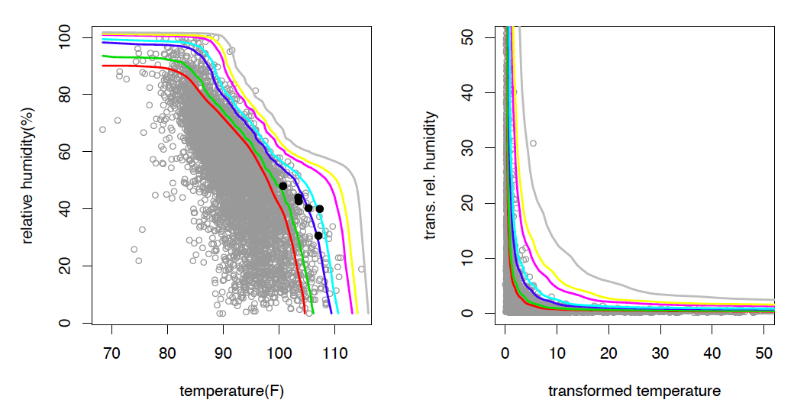
A nonparametric method for producing isolines of bivariate exceedance probabilities
We present a method for drawing isolines indicating regions of equal joint exceedance probability for bivariate data. The method relies on bivariate regular variation, a dependence framework widely used for extremes. The method we utilize for characterizing dependence in the tail is largely nonparametric. The extremes framework enables drawing isolines corresponding to very low exceedance probabilities and may even lie beyond the range of the data; such cases would be problematic for standard nonparametric methods. Furthermore, we extend this method to the case of asymptotic independence and propose a procedure which smooths the transition from hidden regular variation in the interior to the first-order behavior on the axes. We propose a diagnostic plot for assessing the isoline estimate and choice of smoothing, and a bootstrap procedure to visually assess uncertainty.
Scatterplot of the Karachi temperature and relative humidity and estimated survival function isolines on the original scale (left), and on the transformed scale (right). This example isof the more general tail independent case. Previous methods are invalid in this case. Estimated isolines correspond to survival probabilities of 0.01, 0.005, 0.001, 0.0005, 0.0001, 0.00005, and 0.00001.
This new statistical method fills a long standing gap in describing multi-variate extremes. It was motivated by those multi-variate extremes where the combination of values are rare but one or more of the variables itself is not. The method will have broad ranging impacts ranging from model validation, detection and attribution, and future climate projection among others.
D. Cooley, E. Thibaud, F.C. Castillo, M.F. Wehner (2019) A Nonparametric Method for Producing Isolines of Exceedance Probabilities. Extremes. https://doi.org/10.1007/s10687-019-00348-0
It is now possible to calculate long period return values of a wide range of multi-variate climate and weather extremes.

