Slide 1
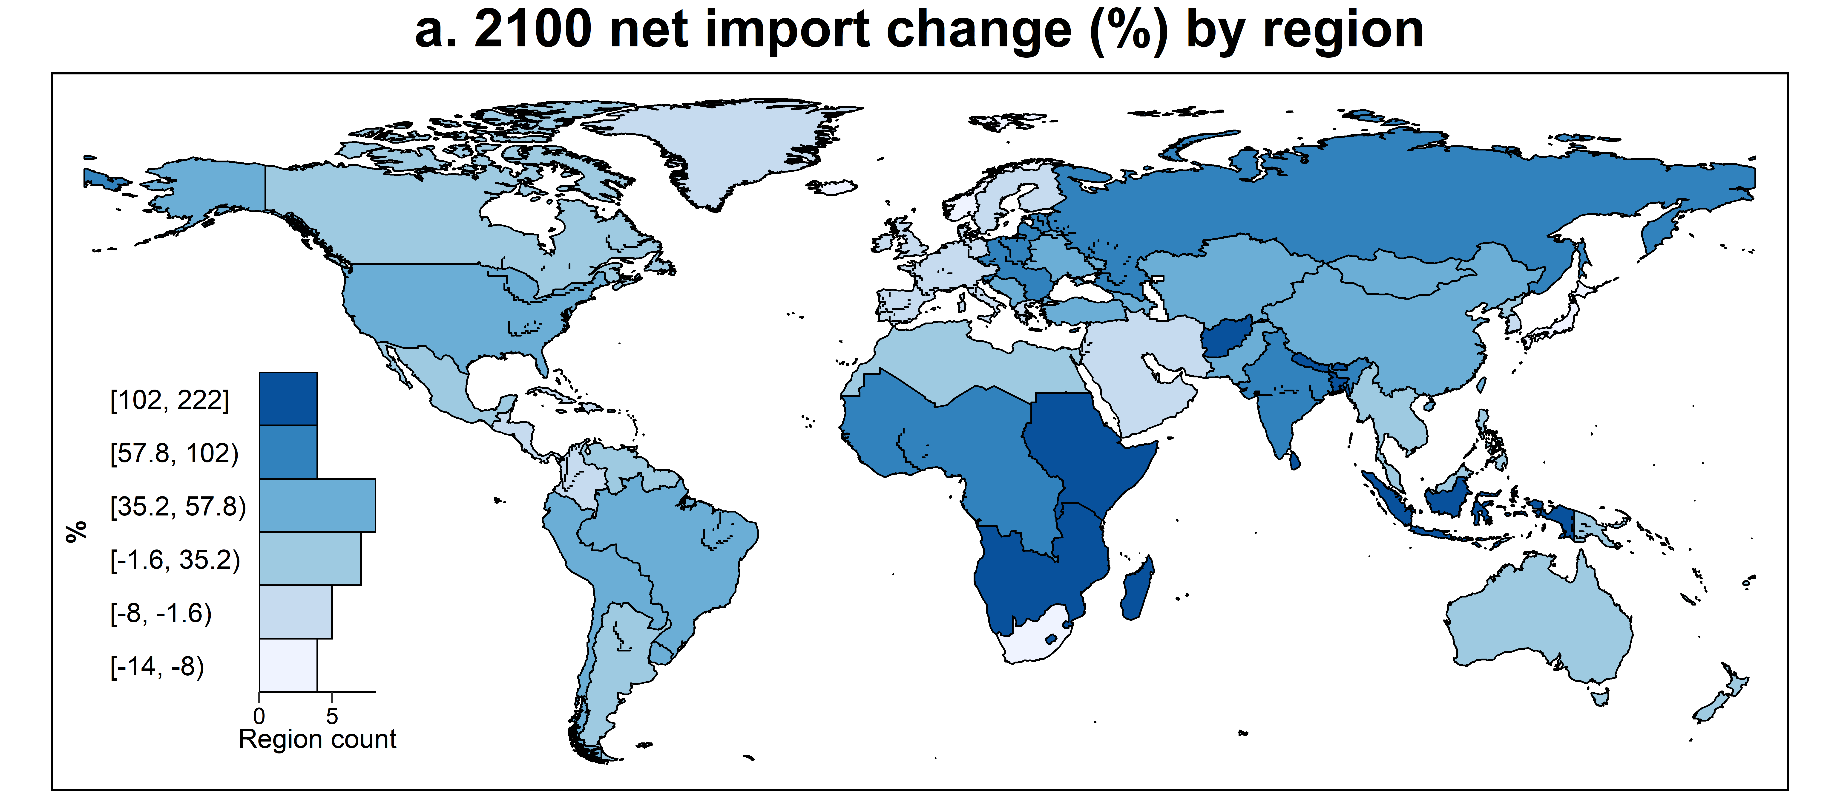
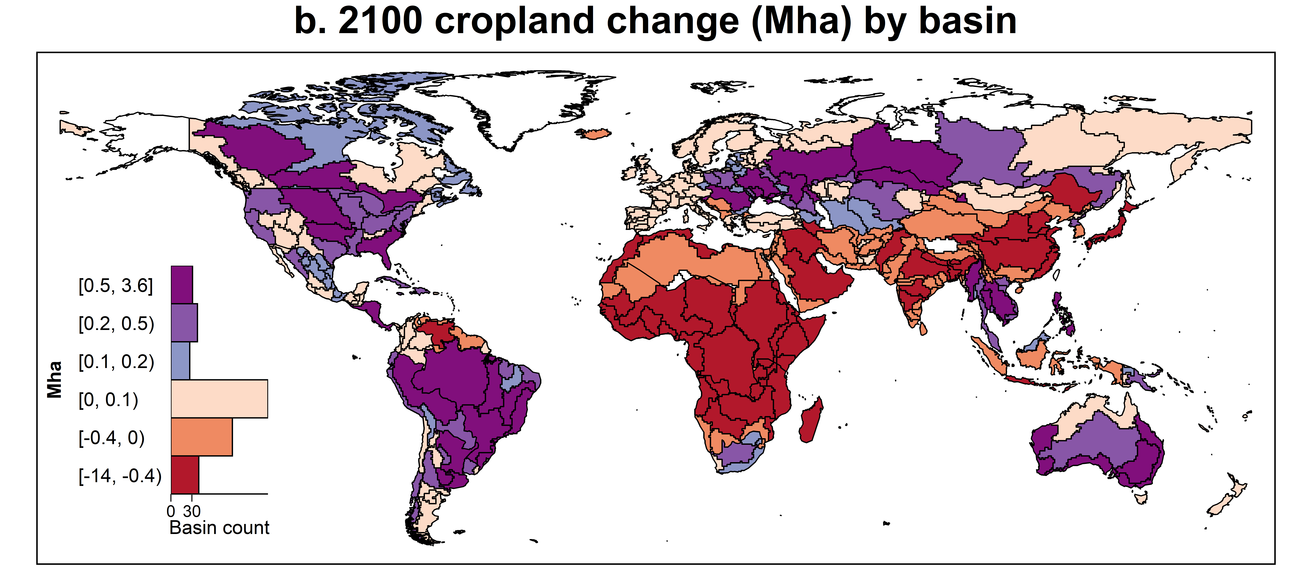
Global Agriculture Market Integration is Critical for Modeling Land Use Change
Objective
Validate a newly enhanced agricultural trade model against historical data to then assess the economic and environmental consequences of historical and future globalization.
Approach
Generalize a logit-based Armington approach to account for a trend of global market integration in trade projections.
Use hindcast experiments to validate the generalized model in 1995–2015.
Simulate estimated agricultural globalization trends in the Global Change Analysis Model up to 2100.
Impact
Discovered a strong historical trend of global agricultural market integration.
Showed the high sensitivity of long-term agroeconomic projections to future trade and market integration scenarios.
The approach created in this study provides a remedy to the “missing globalization” issue in global economic models and lays a foundation for developing future globalization scenarios.
Impacts of considering a dynamic trend of global market integration on the net import of grain and oil crops (a) and cropland (b) by 2100. Results were from the default scenario with the trend implied by historical data. Globally, 27 million hectares (Mha) of cropland are saved by 2100, with large heterogeneity across regions.
Zhao, X., Calvin, K.V., Wise, M.A. and Iyer, G. “The role of global agricultural market integration in multiregional economic modeling: Using hindcast experiments to validate an Armington model.” Economic Analysis and Policy, 72, 1–17, (2021). [DOI: 10.1016/j.eap.2021.07.007]
Notes:
http://www.pnnl.gov/science/highlights/highlights.asp?division=749

