Slide 1
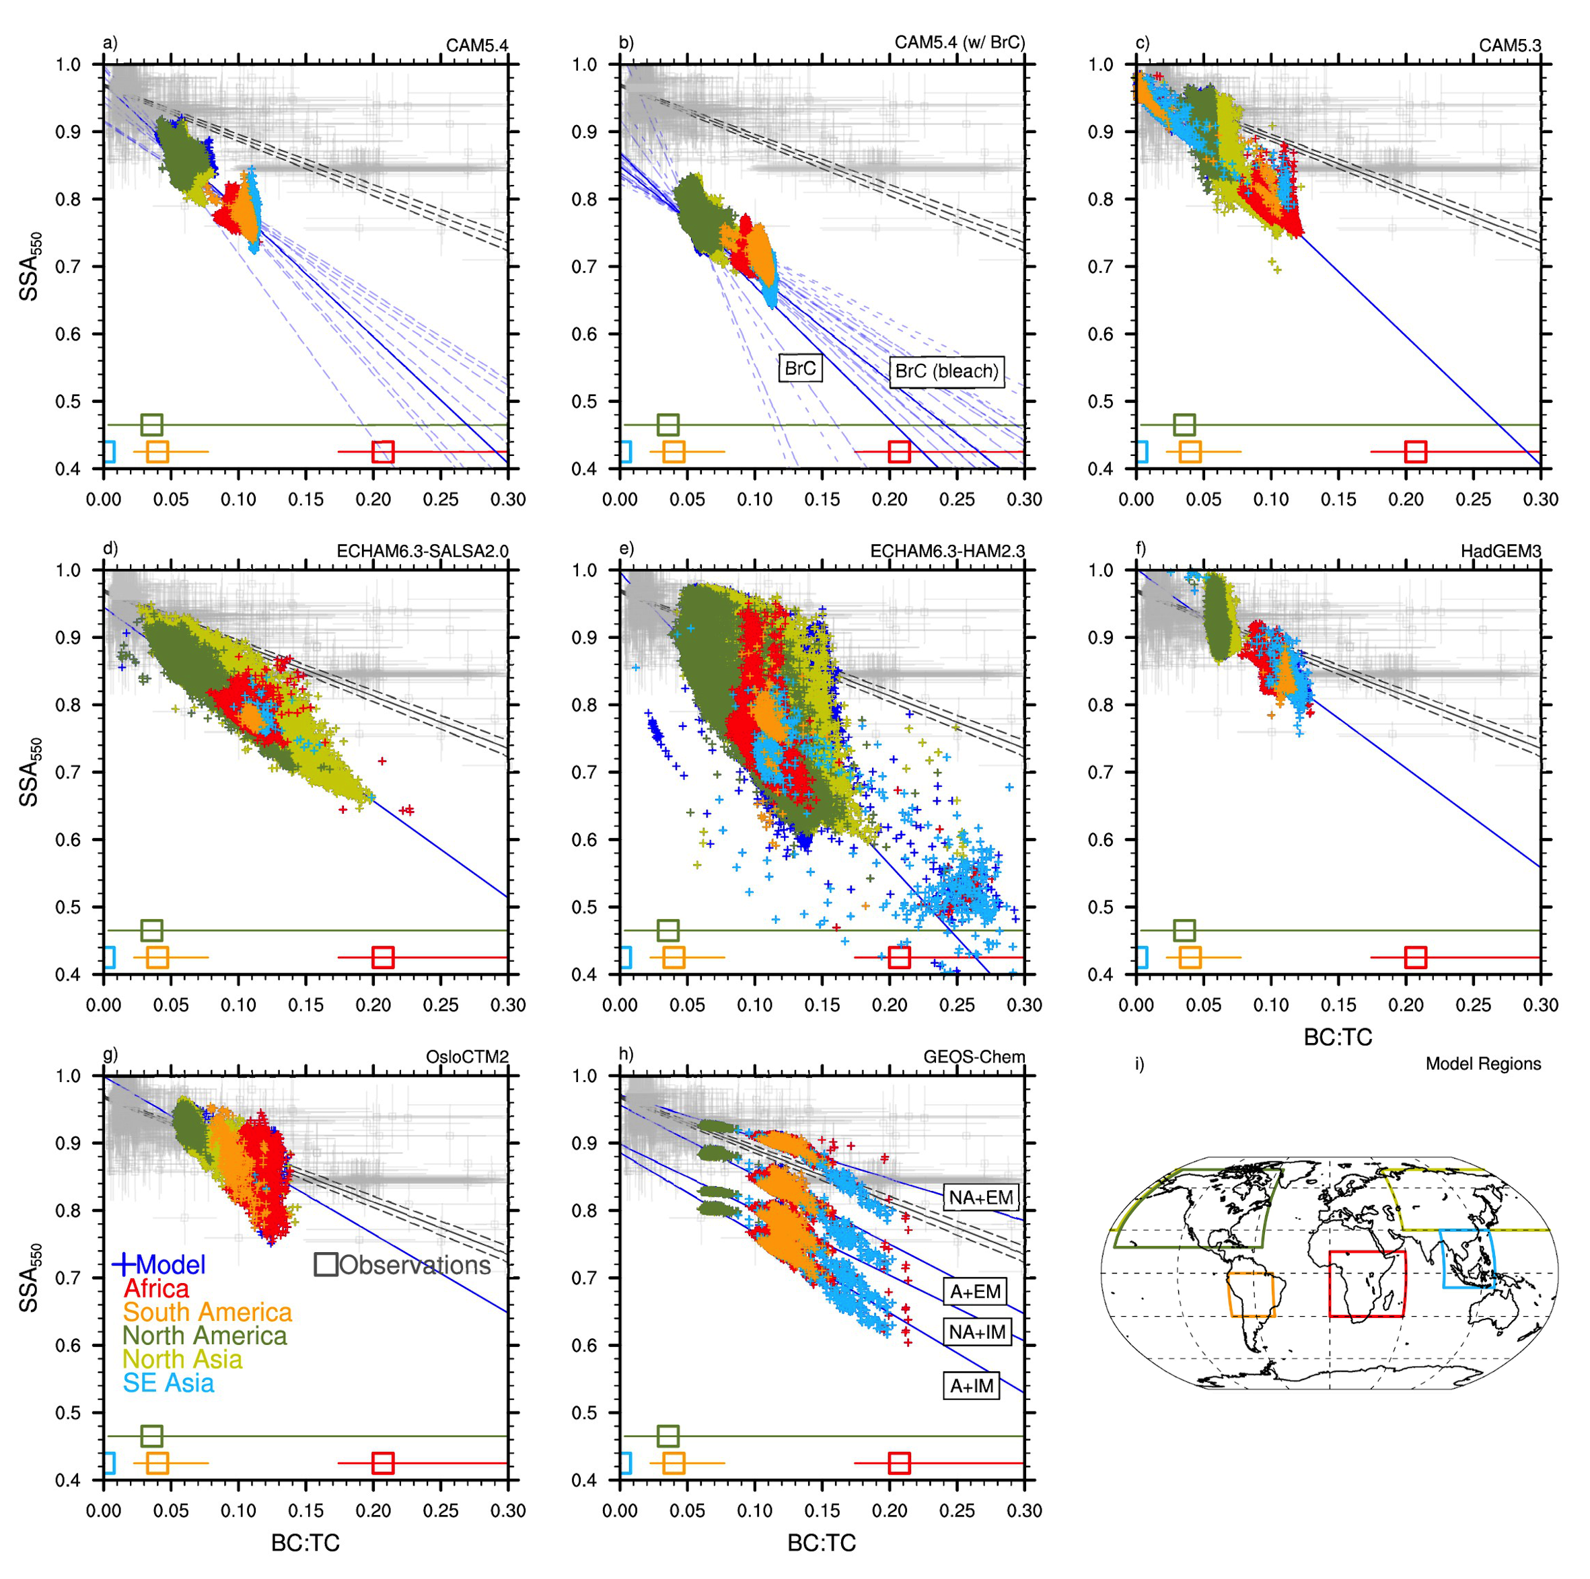
Biomass burning aerosols in most climate models are too absorbing
Objective
Compare light absorption by biomass burning (BB) aerosols across a range of climate models to observations
Test how improvements to BB radiative and microphysical properties might affect BB climate impact
Approach
Compile a diverse set of observations into an aerosol scattering relative to extinction (SSA) versus aerosol composition (BC:TC) framework (gray squares/line in Figure)
Compare a wide range of models within this framework, identifying where some models perform better/worse than others (see Figure)
Run sensitivity tests with the Community Atmosphere Model (CAM5.4) and calculate the radiative effect of BB aerosols from each of the CAM5.4 sensitivity tests.
Impact
Radiative effect of BB aerosols as reported by model ensemble studies such as the International Panel on Climate Change (IPCC) and the Phase 6 of the Coupled Model Intercomparison Project (CMIP6) may be too absorbing.
Comparison of the observation data (in gray) to a variety of global climate models. The best-fit to the model data is represented by the solid blue line. The model data is from (a) this study, (b) Brown et al. (2019) with Brown carbon (BrC), (c-g) AeroCom Phase-III simulations, and (h) Saleh et al. (2015). Model data is representative of BB influenced regions which are color coded in the model output and are specified on the global plot in panel (i). Observational data from the specific regions are averaged, and the regional average and range of the BC:TC observational data is included at the bottom of the plot (color coded squares).
Brown, H., X. Liu, et al. (2021), “Biomass burning aerosols in most climate models are too absorbing”, Nature Communications, 12, 277. https://doi.org/10.1038/s41467-020-20482-9.

