Slide 1
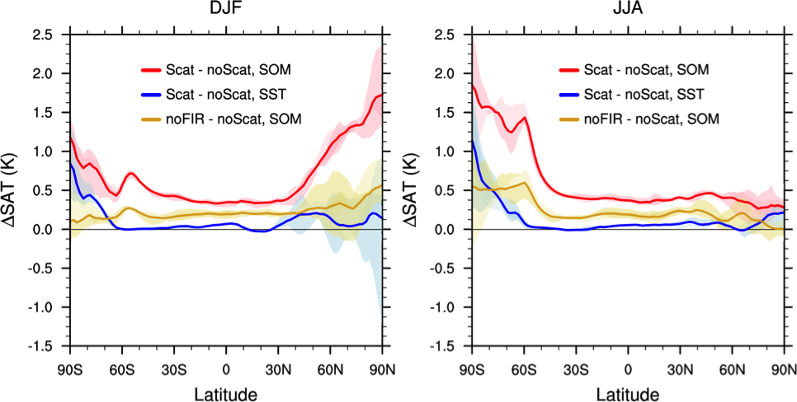
The impact of cloud LW scattering effect
polar >> tropics/mid-latitudes
polar winter > polar summer
In polar regions, far-IR >> mid-IR impacts
Out of 30+ models participating in the CMIP6, only three modeling centers take cloud longwave scattering into account.
Chen, Y.-H., X. L. Huang, P. Yang, C.-P. Kuo, X. H. Chen, Seasonal Dependent Impact of Ice-Cloud Longwave Scattering on the Polar Climate, Geophysical Research Letters, in press, https://doi.org/10.1029/2020GL090534.
Contact: Xianglei Huang (xianglei@uich.edu)
Blackbody surface

