Slide 1
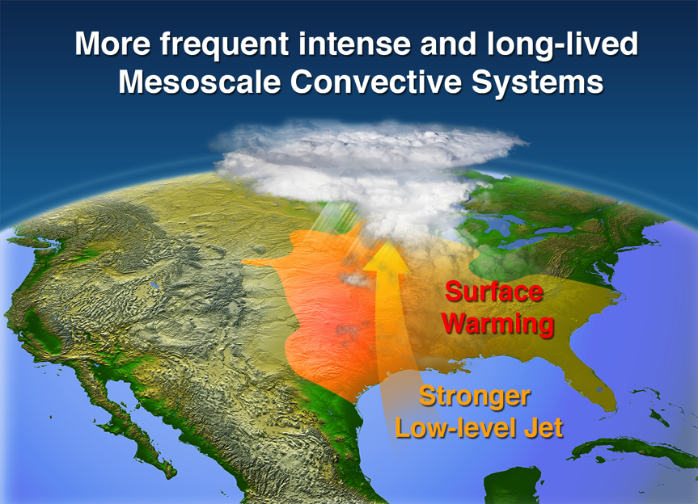
More Frequent, Intense, and Long-lived Storms Dominate Springtime Trend in Central U.S. Rainfall
Objective
Determine the causes of the observed increase in extreme rainfall in the central US over the past several decades and the connections to climate change
Approach
Develop and train an automated algorithm informed by satellite data to identify mesoscale convective systems (MCSs), the largest type of convective storm, based on precipitation data alone
Develop an MCS database for the past 36 years using an observed high-resolution precipitation dataset
Examine long-term trends in extreme MCS rainfall frequency, intensity, and connection to changes in large-scale circulation associated with climate change
Surface warming over the Rockies increased the
pressure gradient across the central US, strengthening the southerly low-level jet and associated moisture transport, favoring more frequent intense and long-lived MCSs.
EMBARGOED
Impact
Determined that the increases in MCS frequency and intensity dominate the observed increasing trend in springtime total and extreme rainfall in the central USA
Linked MCS changes to large-scale circulation changes consistent with a warmer climate
Provided an observational foundation for future research to improve understanding and modeling of MCSs and their response to warming
Feng Z, LR Leung, S Hagos, RA Houze, CD Burleyson and K Balaguru. 2016. “More Frequent Intense and Long-lived Storms Dominate the Springtime Trend in Central US Rainfall.” Nature Communications 7, 13429. DOI: 10.1038/ncomms13429
Notes:
http://www.pnnl.gov/science/highlights/highlights.asp?division=749

