Slide 1
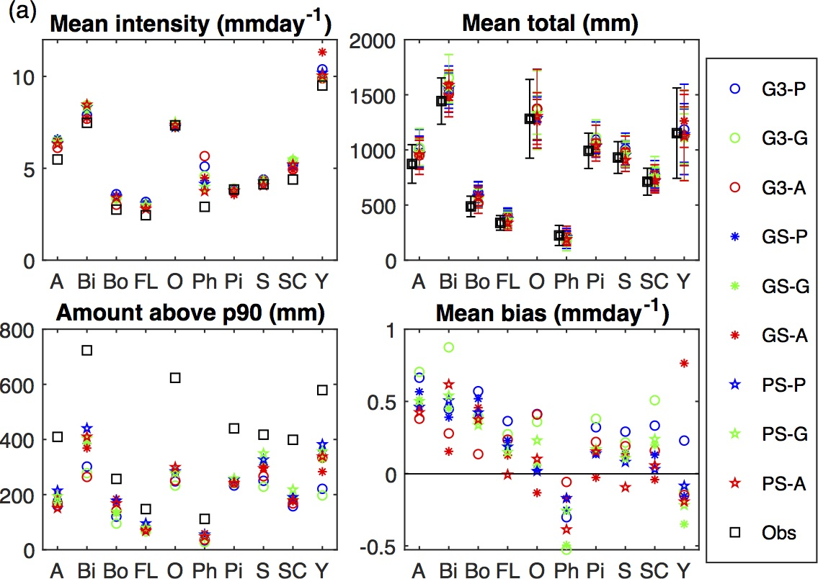
A hierarchical analysis of key decision points on downscaling of daily precipitation and air temperatures
New robust hierarchical framework for statistical downscaling presented and used in a rigorous assessment of the relative importance of 1) Model structure (generalized linear models, GLM v machine learning), 2) Predictor type (grid cell v. indices of weather types) and 3) Link functions to downscaling of air temperature and precipitation.
Downscaling of precipitation climate at 10 sites (x-axis); mean intensity on a wet day, mean bias on a wet day, mean annual total (and interannual variability by bars) and the amount (in mm) of precipitation above the 90th percentile value using 9 different model formulations.
We show that nonlinear machine learning models (ANN) are generally more skillful than GLM and that use of predictors with a larger spatial footprint (via weather typing indices) also leads to more skillful prediction. This is particularly true for extremes, for which simple approaches typically exhibit the largest errors.
A systematic experiment across diverse climates is presented using a new model framework.
Pryor S.C. and Schoof J.T. (2019): A hierarchical analysis of the impact of methodological decisions on statistical downscaling of daily precipitation and air temperatures. International Journal of Climatology: https://rmets.onlinelibrary.wiley.com/doi/pdf/10.1002/joc.5990

