Slide 1
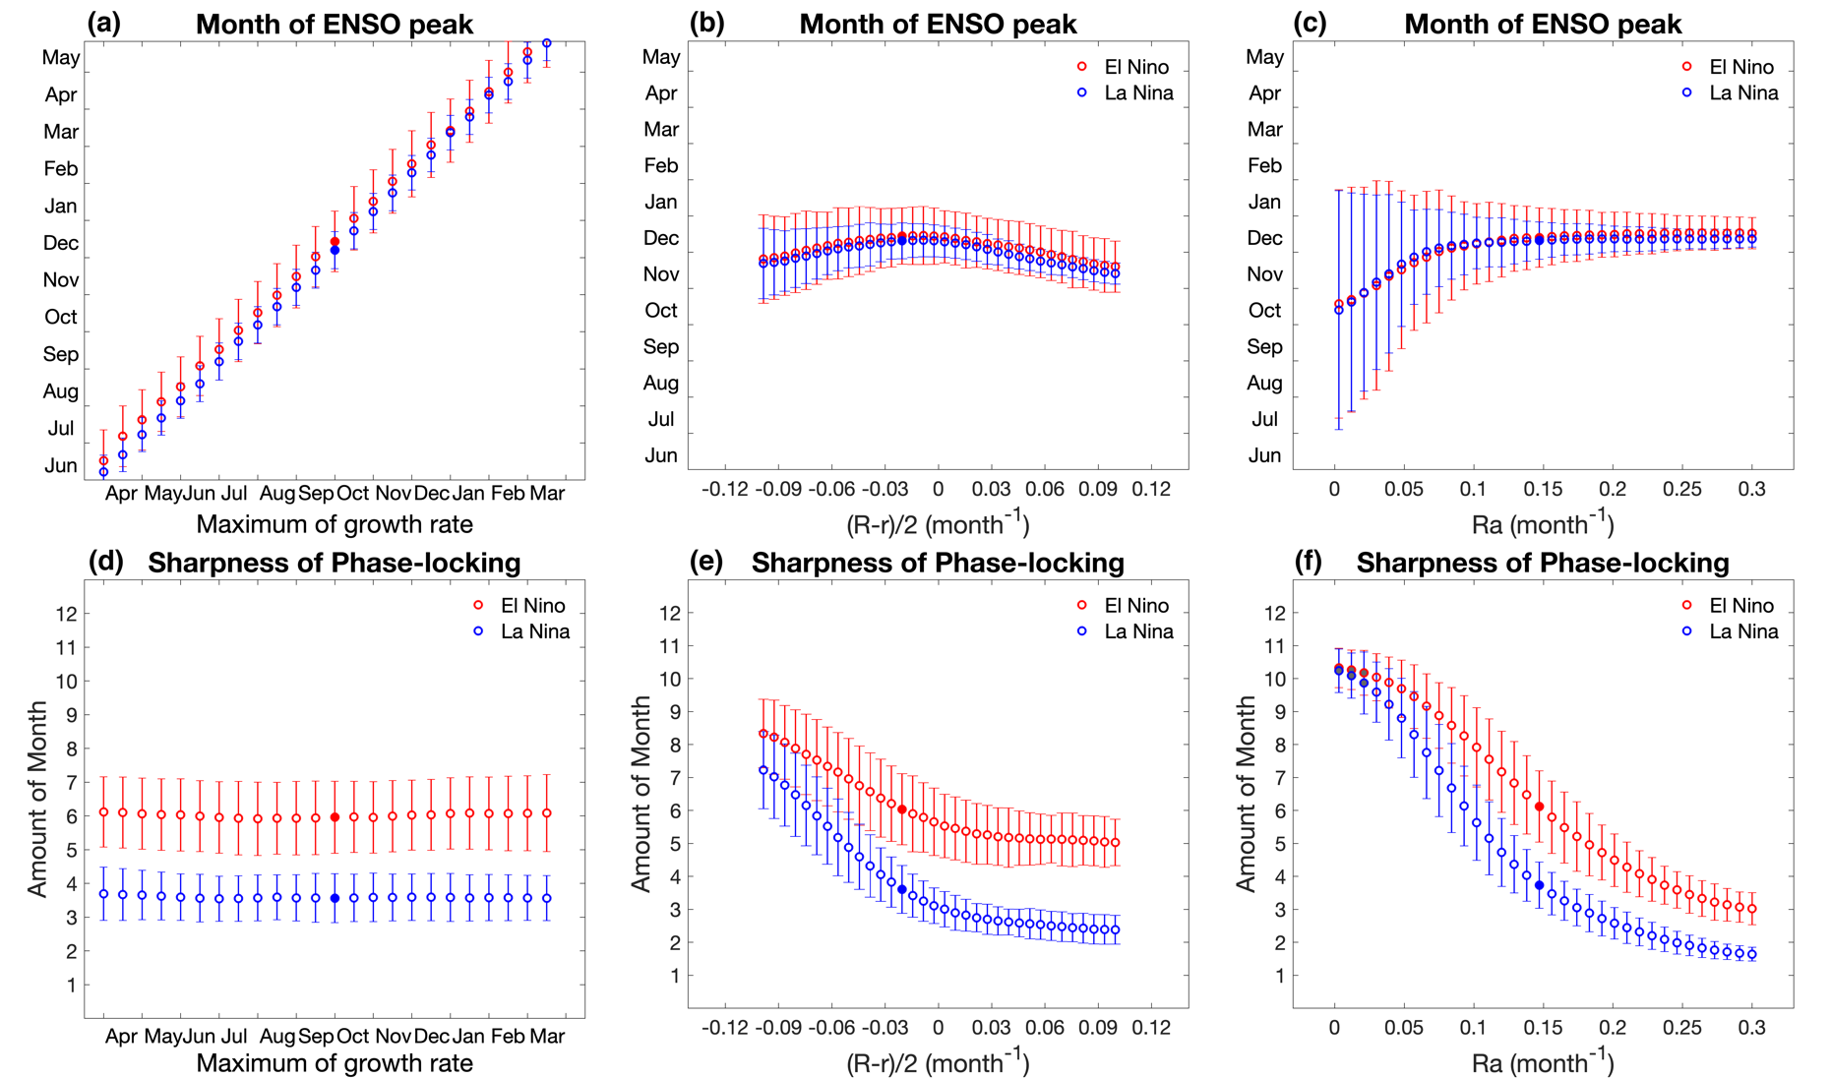
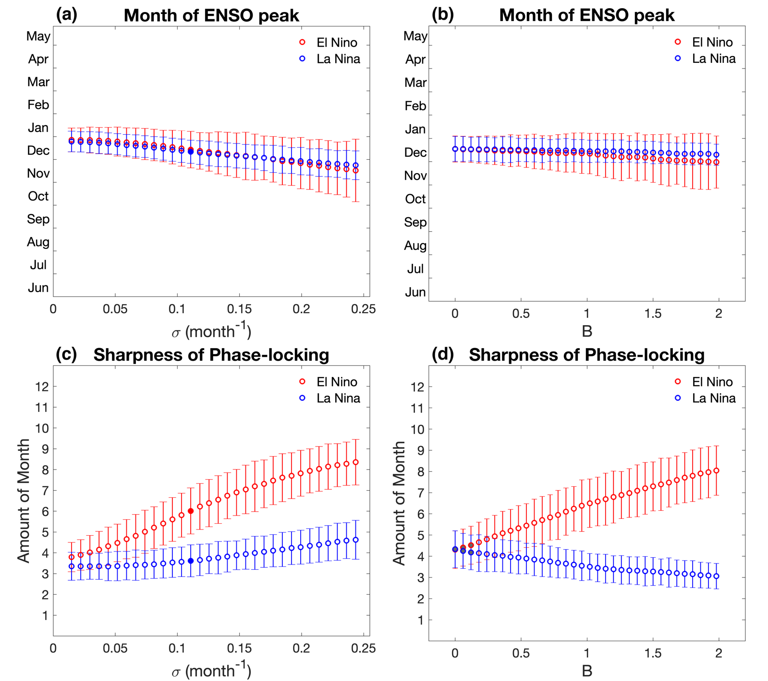
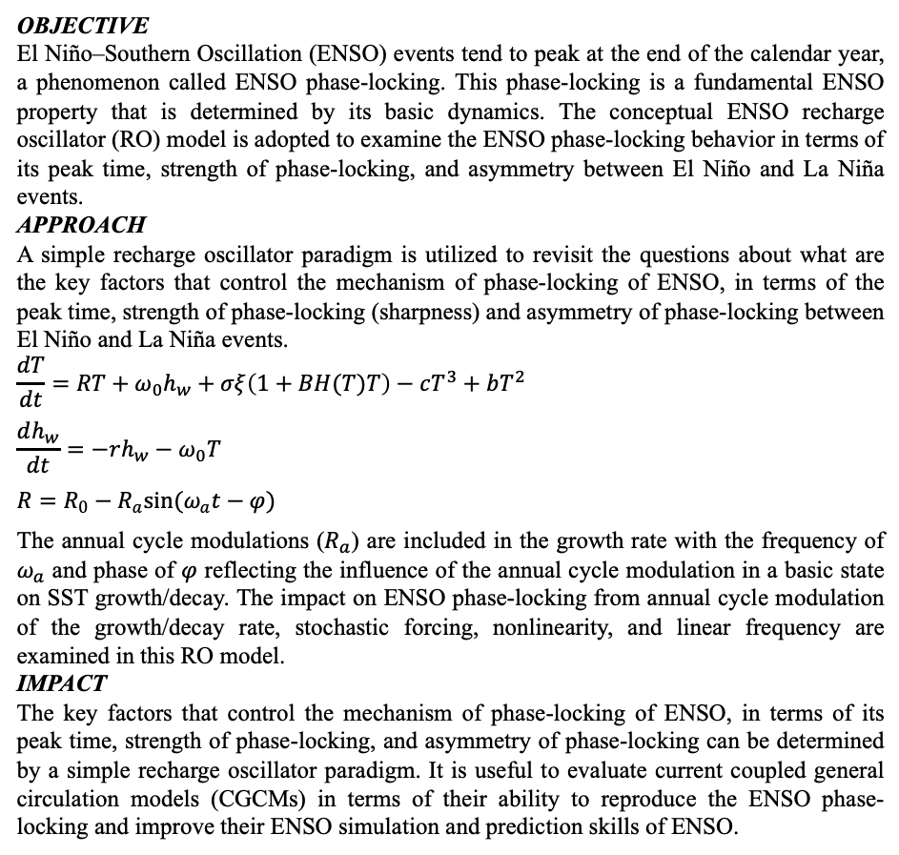
Fundamental Behavior of ENSO Phase-locking
Han-Ching Chen and Fei-Fei Jin, J. Climate, 33, 1953–1968, https://doi.org/10.1175/JCLI-D-19-0264.1
Figure 1
OBJECTIVE
El Niño–Southern Oscillation (ENSO) events tend to peak at the end of the calendar year, a phenomenon called ENSO phase-locking. This phase-locking is a fundamental ENSO property that is determined by its basic dynamics. The conceptual ENSO recharge oscillator (RO) model is adopted to examine the ENSO phase-locking behavior in terms of its peak time, strength of phase-locking, and asymmetry between El Niño and La Niña events.
APPROACH
A simple recharge oscillator paradigm is utilized to revisit the questions about what are the key factors that control the mechanism of phase-locking of ENSO, in terms of the peak time, strength of phase-locking (sharpness) and asymmetry of phase-locking between El Niño and La Niña events.
$$\frac{dT}{dt}=RT+ω_{0}h_{w}+σξ\left(1+BΗ(T)T\right)−cT^{3}+bT^{2}$$
$$\frac{dh_{w}}{dt}=−rh_{w}−ω_{0}T$$
$$R=R_{0}−R_{a}sin(ω_{a}t−φ)$$
The annual cycle modulations ($R_{a}$) are included in the growth rate with the frequency of $ω_{a}$ and phase of $φ$ reflecting the influence of the annual cycle modulation in a basic state on SST growth/decay. The impact on ENSO phase-locking from annual cycle modulation of the growth/decay rate, stochastic forcing, nonlinearity, and linear frequency are examined in this RO model.
IMPACT
The key factors that control the mechanism of phase-locking of ENSO, in terms of its peak time, strength of phase-locking, and asymmetry of phase-locking can be determined by a simple recharge oscillator paradigm. It is useful to evaluate current coupled general circulation models (CGCMs) in terms of their ability to reproduce the ENSO phase-locking and improve their ENSO simulation and prediction skills of ENSO.
Figure 2
Figure 1. (Top) Month of ENSO peak and (Bottom) the sharpness of ENSO phase-locking dependence on the phase of growth rate [(a), (d)], linear growth rate [(b), (e)], and amplitude of annual cycle [(c), (f)] for El Niño (red circles) and La Niña events (blue circles). The vertical bars are the standard deviation error bars for the ensemble. The red and blue dots indicate the simulation of idealized case. The grey shaded circles indicate the difference of sharpness between El Niño and La Niña phase-locking does not pass the 95% significance level.
Figure 2. As in Fig. 1, but for the dependence on the amplitude of noise [(a), (c)] and SST-dependent factor [(b), (d)].
Funded by DOE RGMA Program

