Slide 1
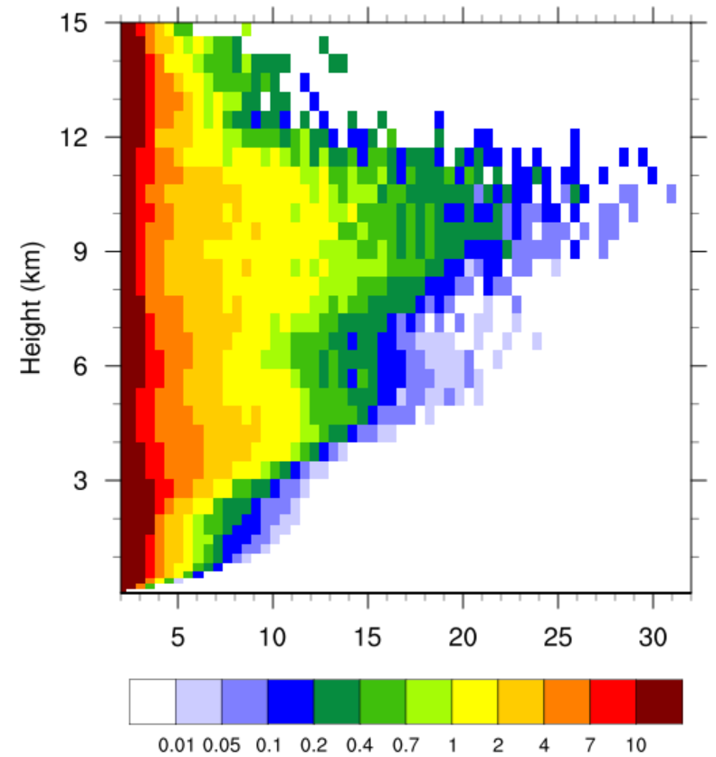
Urbanization Shapes Thunderstorms Near the Gulf Coast
(a) Control run
(b) Joint effect
Objective
Determine both the joint and individual roles of urban land use and anthropogenic aerosols in altering convective storm evolution and precipitation in the Houston area.
Approach
Simulate a typical sea-breeze-induced thunderstorm in the Houston area using a detailed aerosol, cloud, and urban canopy model (WRF-Chem-SBM with BEP-BEM) and 0.5-km grid spacing.
Evaluate the simulations of aerosol, radar reflectivity, and precipitation properties using observations.
Carry out sensitivity tests and apply a cell-tracking algorithm.
Impact
The joint effect drastically enhances the storm intensity, radar reflectivity, and peak precipitation rate (by ~ 45%), with the effects of anthropogenic aerosols playing a dominant role.
Houston urban land use strengthens sea breeze circulation, leading to faster development of warm clouds into mixed-phase clouds and earlier rainfall.
Freq (%)
Updraft velocity
(c) Urban land effect
(d) Aerosol effect
Vertical profiles of convective intensity frequencies from the storm simulations. (a) The reference run; (b) the joint effect of urban land and anthropogenic aerosols; (c) and (d) show the individual effects. The joint effect enhances the frequencies of stronger convective intensities, mainly caused by the aerosol effects.
Fan, J., Zhang, Y., Li, Z., Hu, J., and Rosenfeld, D.: Urbanization-induced land and aerosol impacts on sea breeze circulation and convective precipitation, Atmos. Chem. Phys., 20, 14163–14182, https://doi.org/10.5194/acp-20-14163-2020, 2020.

