Slide 1
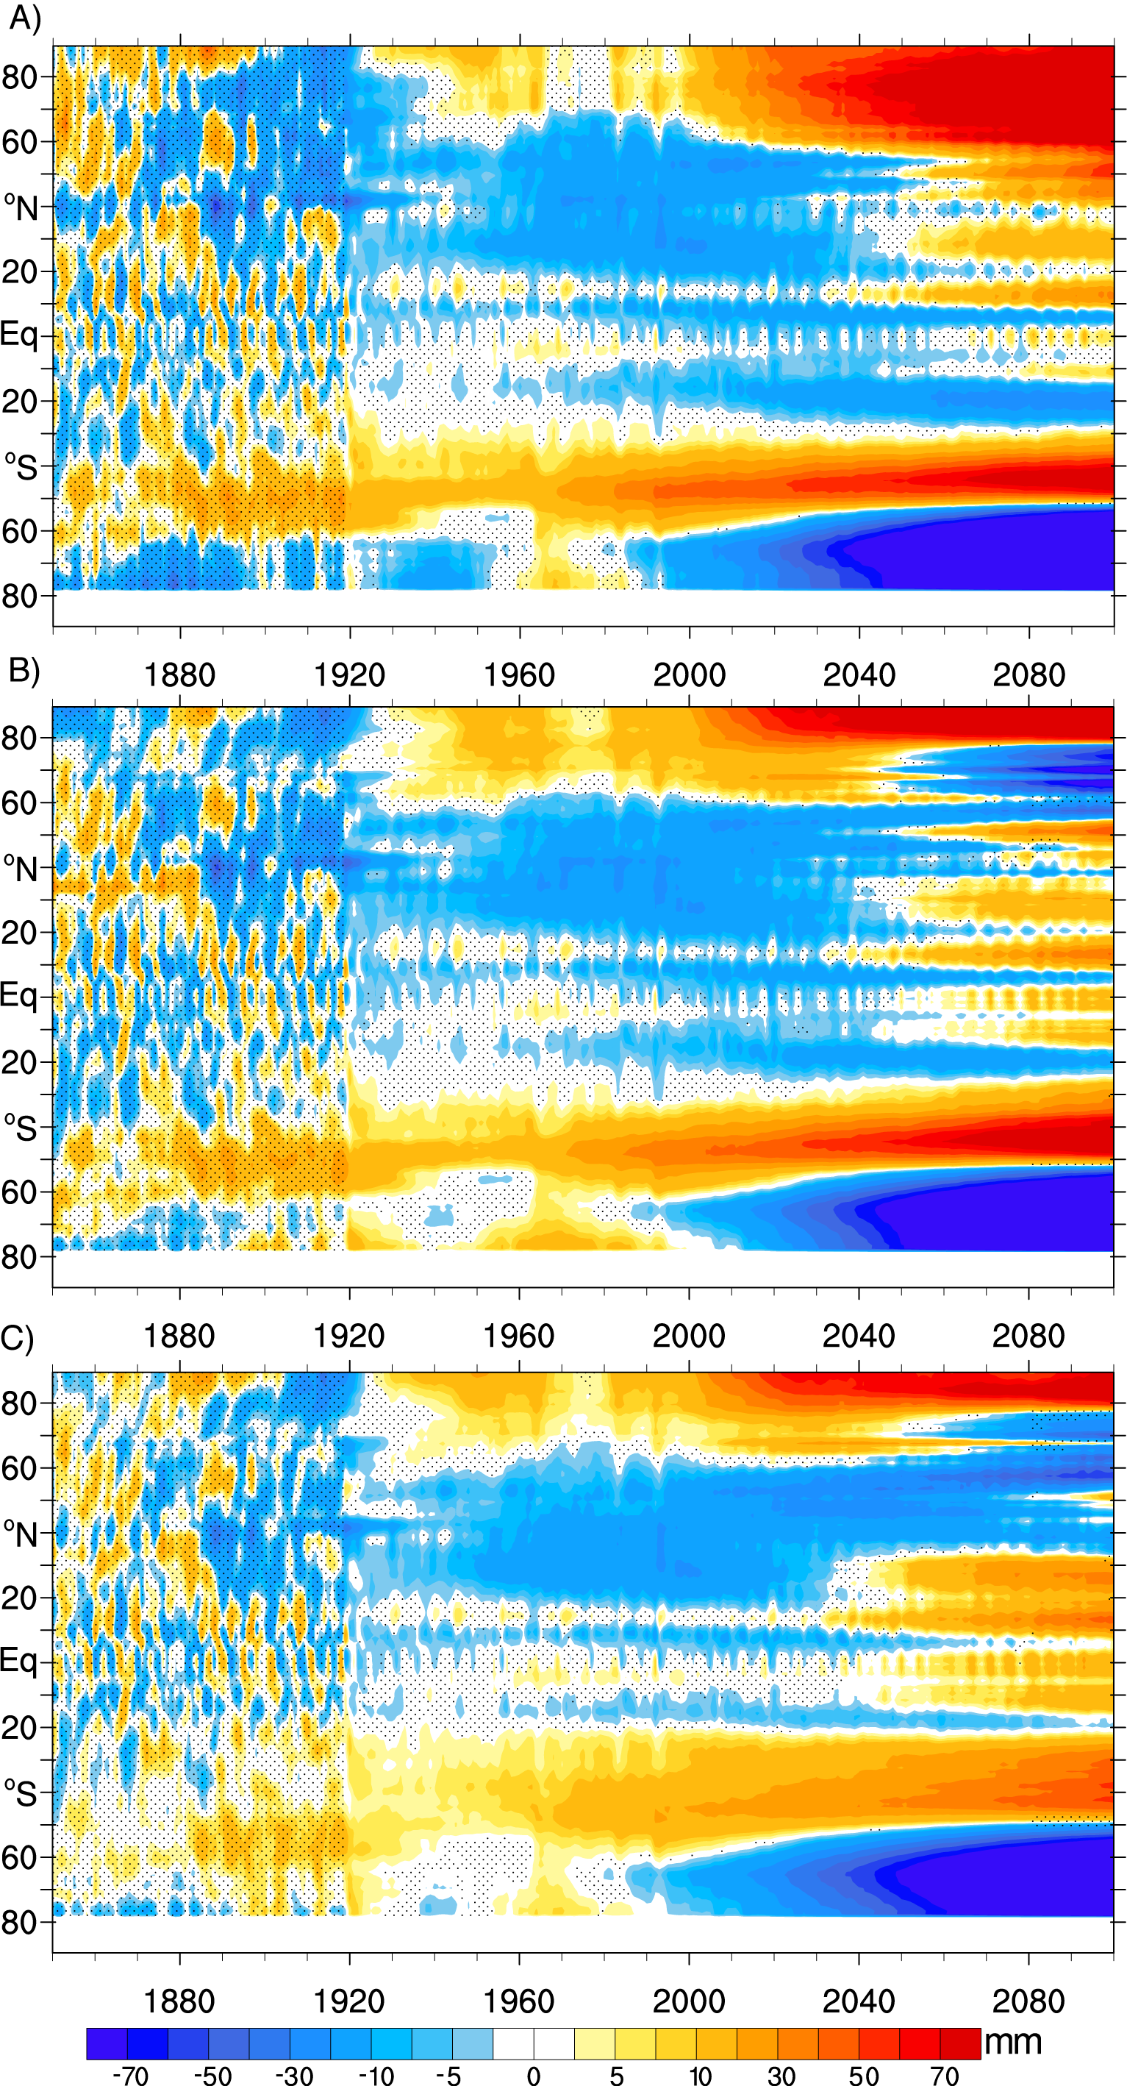
Forced Patterns of Sea Level Rise in the Community Earth System Model Large Ensemble from 1920 to 2100
Fasullo, J. T., P. Gent, R. S. Nerem(2020). J. Geophys. Res. - Ocn. Doi: DOI:10.1029/2019JC016030.
OBJECTIVE
Patterns of forced sea level rise through the 20th and 21st centuries are identified and explored in the CESM Large Ensemble. Relevant mechanisms and broader implications are documented and discussed.
APPROACH
The transient response of sea level rise has been shown to exhibit a significant S/N and is a key driver of impacts under climate change. In this work, its forced response is documented using the CESM Large Ensemble and the roles of steric and dynamic contributions is assessed, along with the relative roles of surface heat fluxes and ocean energy divergence.
IMPACT
The analysis reveals that the forced response in regional sea level rise reached several centimeters in key regions as early as the mid 20th C and varied substantially in space and time. Regional rates of rise were suppressed in the northern hemisphere in the mid 20th century and have rebounded substantially since that time, with implications for reconstructions of the tide gauge record and regional sea level rise in the coming decades.
The zonal-mean pattern of sea level rise (A) driven by external forcing based on the CESM Large Ensemble and (B) its steric component.

