Slide 1
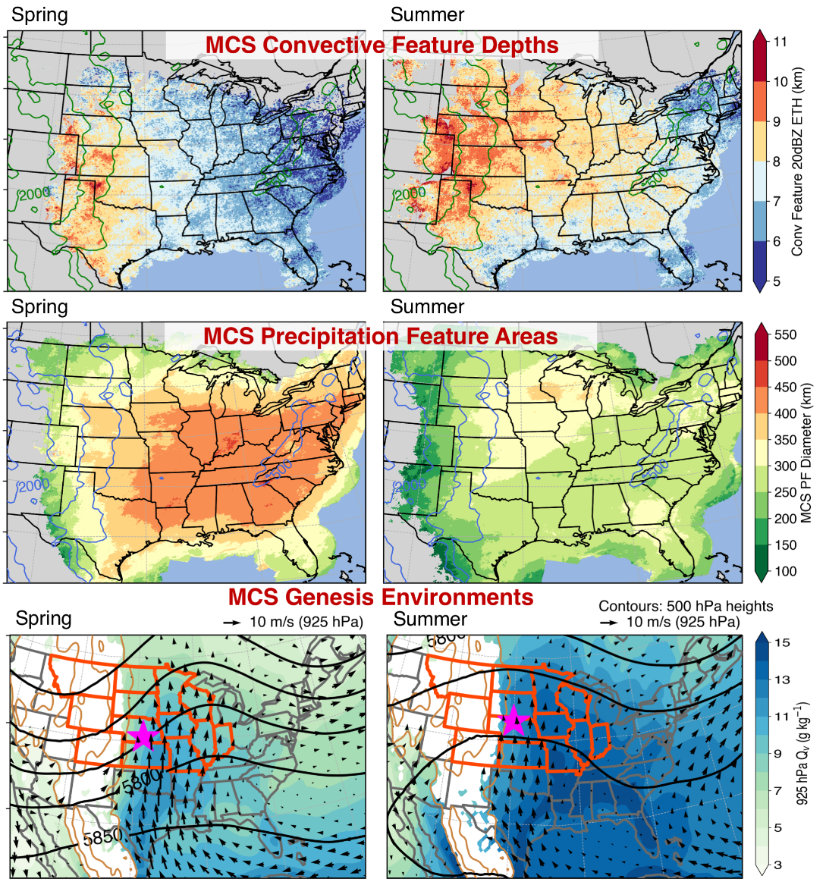
Storm System Characteristics and Large-Scale Environments over the United States
Objective
Characterize spatiotemporal variability and three-dimensional structures of mesoscale convective systems (MCSs) east of the Rocky Mountains and associated large-scale environments across all seasons
Approach
Construct a 13-year database of MCSs east of the Rockies using synthesized high-resolution satellite and radar network observations
Impact
Results showed that spring MCSs feature both large and deep convection, with a large stratiform rain area and high-volume rainfall; summer MCSs have the largest and deepest convective features, the smallest stratiform rain area, and lowest rainfall volume
Spring/fall MCSs initiate under strong baroclinic forcing, while summer MCSs initiate under weak baroclinic forcing with warm humid low-level air
Results suggested simulation of transition season MCSs should be achievable for global models, although summer MCSs may be most challenging
Feng Z, RA Houze Jr., LR Leung, F Song, JC Hardin, J Wang, WI Gustafson, and CR Homeyer. 2019. “Spatiotemporal Characteristics and Large-Scale Environments of Mesoscale Convective Systems East of the Rocky Mountains.” Journal of Climate 32(21):7303‒7328, doi:10.1175/JCLI-D-19-0137.1.
Distinctly different MCS convective intensity (top row) and stratiform precipitation areas (middle row) during spring and summer are consistent with differences in the large-scale environments (bottom row).

