Slide 1
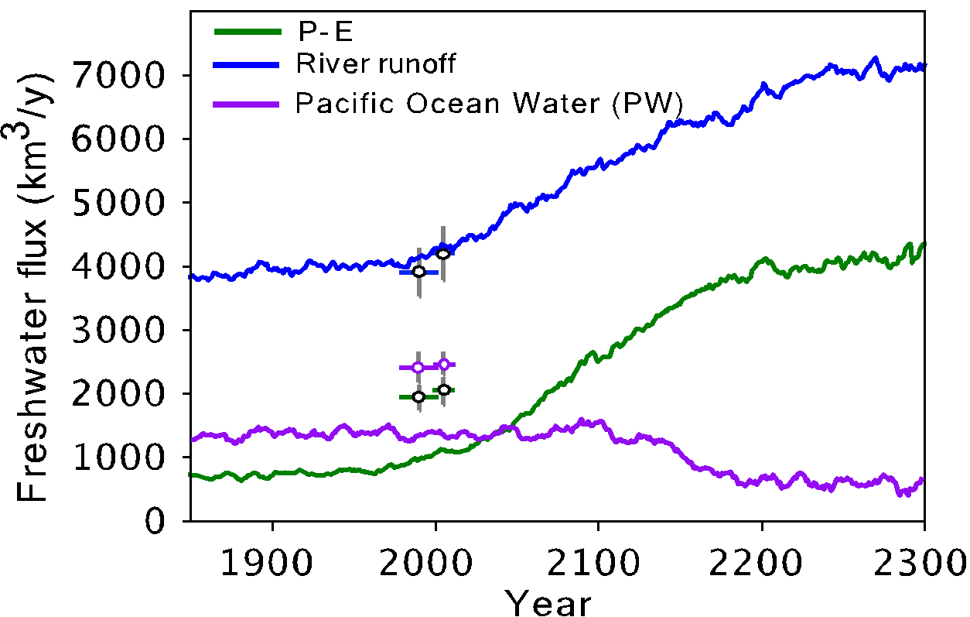
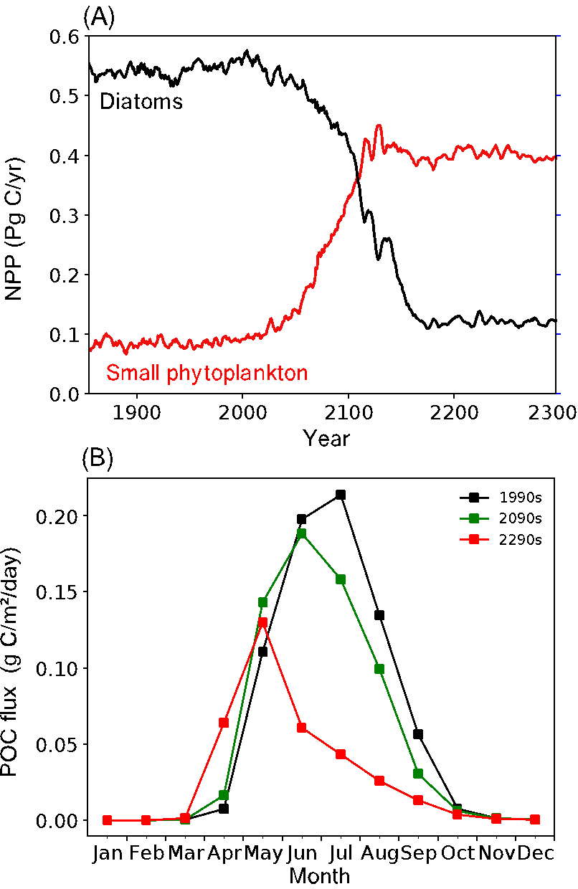
A Growing Freshwater Lens in the Arctic Ocean with Sustained Climate Warming Disrupts Marine Ecosystem Function
Objective: To study climate change impacts on marine biogeochemistry and productivity over multi-century timescales.
Approach: Analyze Community Earth System Model (CESMv1.0) simulation to year 2300 with RCP8.5/ECP8.5 scenario (atmospheric CO₂ exceeds 1960 ppm).
Results/Impacts: A growing freshwater lens in the Arctic Ocean continues to expand after the year 2100, which increases nutrient stress and overrides gains in marine productivity associated with sea ice loss. By 2300, export production declines by 53% and the peak bloom shifts from July to May, strongly influencing arctic marine food web dynamics.
Fu, Weiei, J. Keith Moore, F. W. Primeau, K. Lindsay, and James T. Randerson (2020), A growing freshwater lens in the Arctic Ocean with sustained climate warming disrupts marine ecosystem function, J. Geophys. Res. Biogeosci., 125, e2020JG005693, doi:10.1029/2020JG005693.
Figure: A freshwater lens drives phytoplankton community shift, leading to bloom 2 months earlier.

