Slide 1
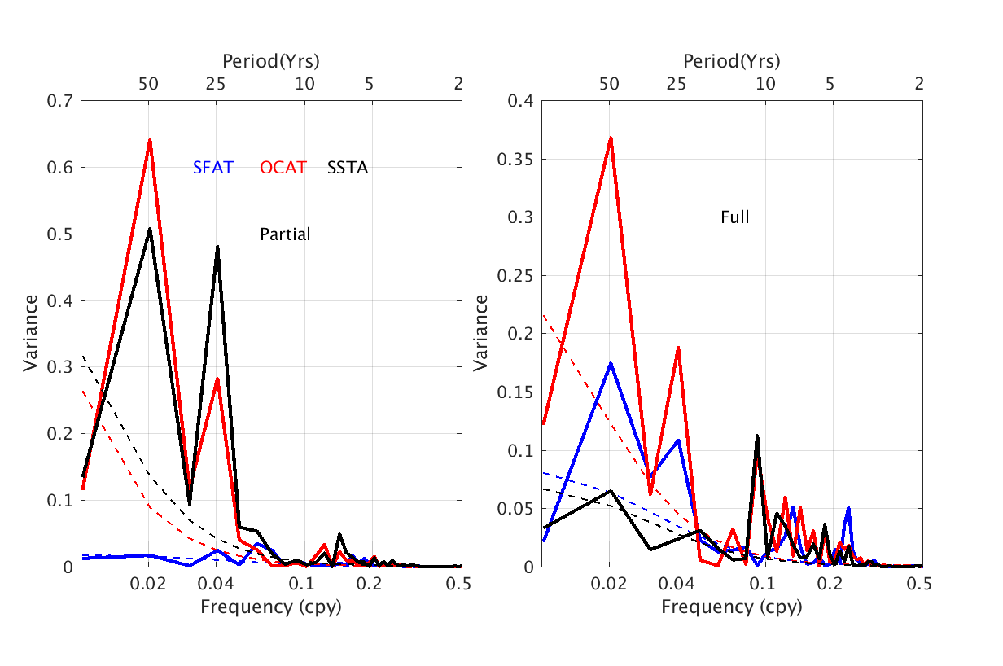
Disentangling the Ocean-Atmosphere Interactions in the North Atlantic
Objective
Isolate the roles of the ocean and atmosphere and their interaction in generating Atlantic Multidecadal Variability (AMV)
Approach
Decompose ocean temperature variability into ocean circulation variability and surface heat flux exchange between components
Decouple the exchanges associated with ocean driven temperature anomalies from those driven by the atmosphere to produce a “partially coupled” simulation
Compare North Atlantic variability in fully- and partially-coupled mode to identify the mechanisms that drive and dissipate that variability
Impact
This study identifies some of the important physical mechanisms responsible for SST changes and heat transport in the North Atlantic, with the main driver of variability due to ocean-driven circulation features
Models with a weak AMV compared to observations probably have too-strong surface coupling
Power spectra of the AMV index (black) and their ocean-driven (red) and surface-driven (blue) components in the partially (left) and fully (right) coupled simulations. Note the ordinate range change in the two panels.
The difference in amplitude of the variance and relative importance of surface and ocean variability in the two simulations indicates that ocean circulation features drive the AMV, and surface heat fluxes help to dissipate the variability.
Garuba OA, J Lu, HA Singh, F Liu, and PJ Rasch. 2018. “On the relative roles of the atmosphere and ocean in the Atlantic Multi‐decadal Variability,” Geophysical Research Letters, 45:9186-9196. DOI: 10.1029/2018GL078882.
Notes:
http://www.pnnl.gov/science/highlights/highlights.asp?division=749

