Slide 1
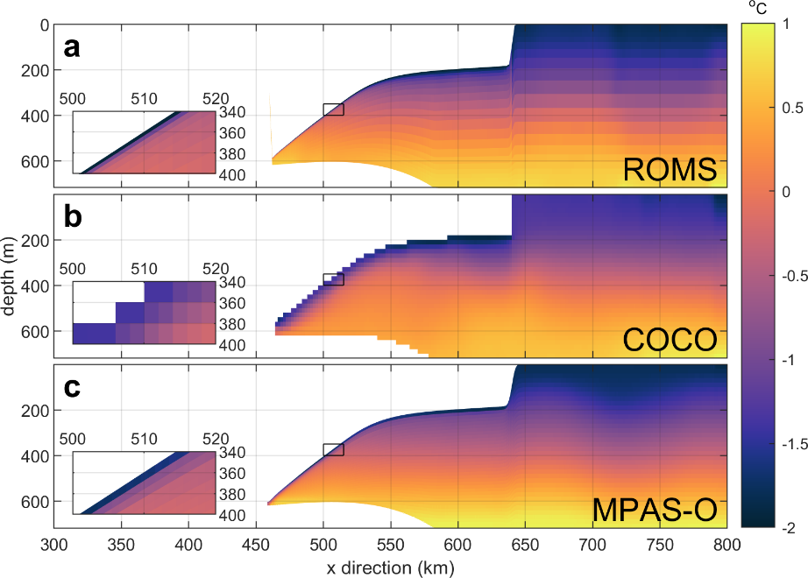
Choice of vertical coordinates impacts ice-shelf basal melting
Objective
Results from the Marine Ice Sheet-Ocean Model Inter- comparison Project (MISOMIP) suggest that ocean models with different vertical discretizations produce significantly different melt rates in idealized simulations of the cavities under ice shelves.
Using three models that participated in MISOMIP, this work explores the relevant differences in vertical resolution and boundary-layer parameterization that explain these differences.
New Science
Models with high vertical resolution near the ice-ocean boundary are shown to produce a thin boundary layer and low melt rates unless the model explicitly attempts to thicken the boundary layer.
With current boundary-layer parameterizations, a melt rate independent of vertical resolution can only be achieved by fixing the thickness of the boundary layer to a constant value, independent of resolution.
However, the behavior of the boundary layer is not known to a degree that this thickness can be determined from the resolved model physics.
Significance
Current parameterizations of boundary-layer physics likely need to be updated or replaced based on observations and high- resolution process modeling if ocean models are to produce robust, reliable estimates of ice-shelf melting.
The representation of ocean temperature in the ocean cavity under an ice shelf in three ocean models (ROMS, COCO and MPAS-Ocean) with different vertical coordinates and boundary-layer parameterizations. The inset shows that melt water with colder temperature is distributed over significantly different thicknesses in the models.
Citation - Gwyther, D. E., K. Kusahara, X. S. Asay-Davis, M. S. Dinniman, and B. K. Galton-Fenzi. “Vertical Processes and Resolution Impact Ice Shelf Basal Melting: A Multi-Model Study.” Ocean Modelling, January 20, 2020, 101569. https://doi.org/10.1016/j.ocemod.2020.101569.

