Slide 1
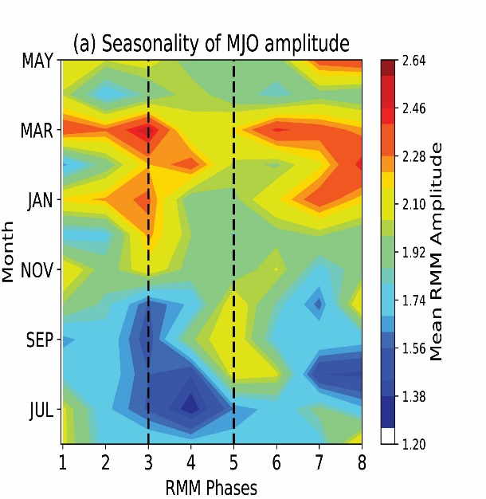
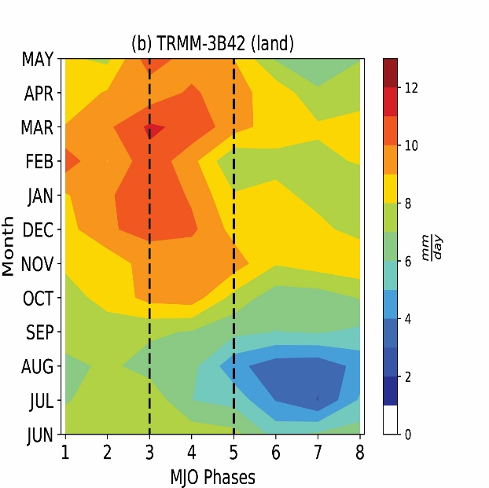
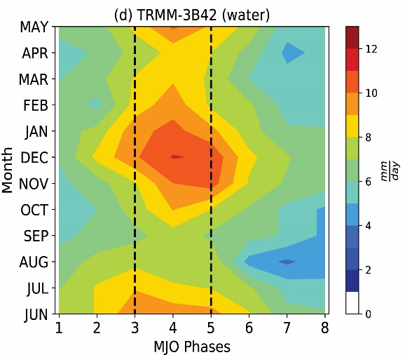
Sunlight Favors Growth of Madden-Julian Oscillation Events Over Maritime Continent
Objective
Investigate factors that influence variability in the propagation of the Madden-Julian Oscillation (MJO) across the Indo-Pacific Maritime Continent
Approach
Analyze observed seasonality and MJO phase dependence of precipitation and soil moisture over this region; develop a hypothesis for testing.
Design and run regional convection permitting simulations to quantify the comparative roles of seasonal variations in solar insolation and soil moisture
Impact
Increased insolation increases precipitation, including that associated with MJO moisture convergence over the Maritime Continent (MC) region
The MJO response to high insolation is related to an increase in the basic state moisture over this region
The study highlights the combined effects of monsoonal annual cycle and semi-annual variability due to insolation over the Maritime Continent islands as influence on the seasonal variability of MJO events that impact extreme weather events worldwide
Seasonality of MJO amplitude
Observed Precipitation over MC Islands
MJO Phases
MJO Phases
Along with the seasonal peak in winter, MJO events over the Maritime Continent (between the two dashed lines) also tend to be strong in March and September (upper left). This variability is related to the semi-annual solar cycle which hastens the arrival of MJO precipitation to the MC islands (upper right panel) relative to the surrounding waters (lower right panel).
Over the surrounding waters
MJO Phases
S Hagos, C Zhang, RL Leung, O Garuba, C Burleyson, and K Balaguru. 2020. “Impacts of Insolation and Soil Moisture on Seasonality of Interactions Between the Madden-Julian Oscillation and Maritime Continent,” Journal of Geophysical Research, 125:e2020JD032382. DOI: 10.1029/2020JD032382
Notes:
http://www.pnnl.gov/science/highlights/highlights.asp?division=749

