Slide 1
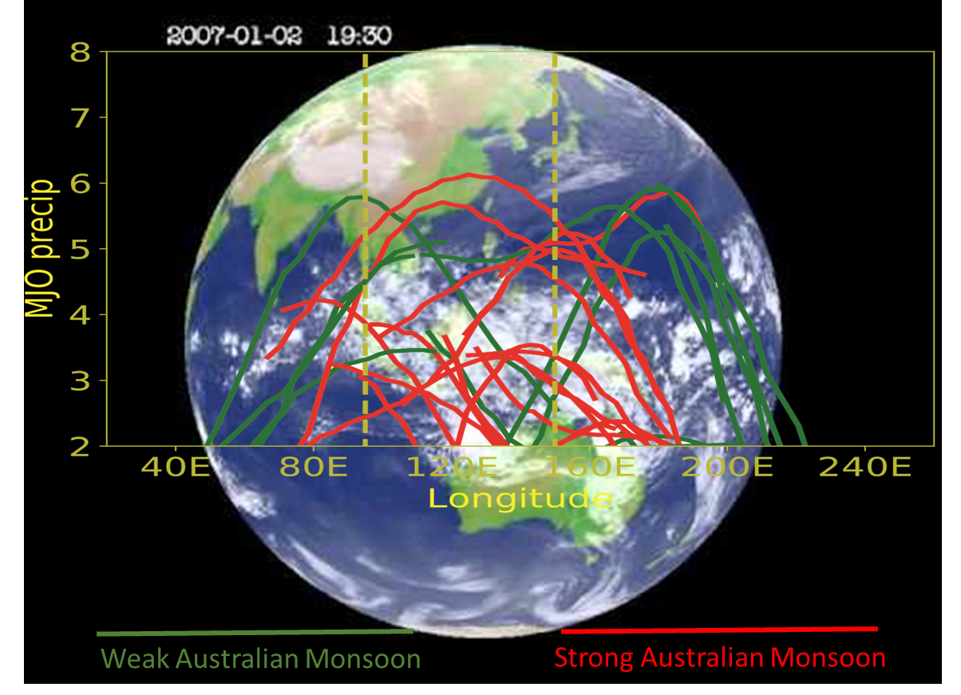
Madden-Julian Oscillation Events Ride a Monsoonal Seesaw
Objective
Understand why Madden‐Julian Oscillation (MJO) events vary in strength as they migrate across the Indo‐Paciﬁc Maritime Continent region
Approach
Develop a method to calculate the zonal and meridional components of moisture fluxes and moisture flux convergence from observed precipitation
Use the new method to isolate the effect of seasonal zonal migration of monsoons on MJO variability
Impact
MJO events found to be strongest in the monsoon moisture flux convergence region
Variability in the strength of individual MJO events during their lifetime found to be related to their propagation across the slowly migrating moisture convergence flux controlled by the monsoons
Study revealed that the El Niño-Southern Oscillation (ENSO) also modulates the monsoon moisture flux convergence and hence the MJO strength, such that MJO events are strong over the eastern Indian Ocean during La Niña and over the western Pacific during El Niño
An image from the MTSAT-1R satellite shows an MJO event crossing the Maritime Continent. The overlaying graph shows the strength of MJO events during weak and strong Australian monsoon months defined by the Australian summer monsoon index (AUSMI). The dashed lines represent the approximate boundaries of the Maritime Continent region. While MJO events are usually strong at either the eastern Indian Ocean or the western Pacific, peak MJO strength is also observed over the MC region.
Hagos S, C Zhang, LR Leung, CD Burleyson, and K Balaguru. 2019. “A zonal migration of monsoon moisture flux convergence and the strength of
Madden‐Julian Oscillation events.” Geophysical Research Letters, 46:8554–8562. https://doi.org/10.1029/2019GL083468.
Notes:
http://www.pnnl.gov/science/highlights/highlights.asp?division=749

