Slide 1
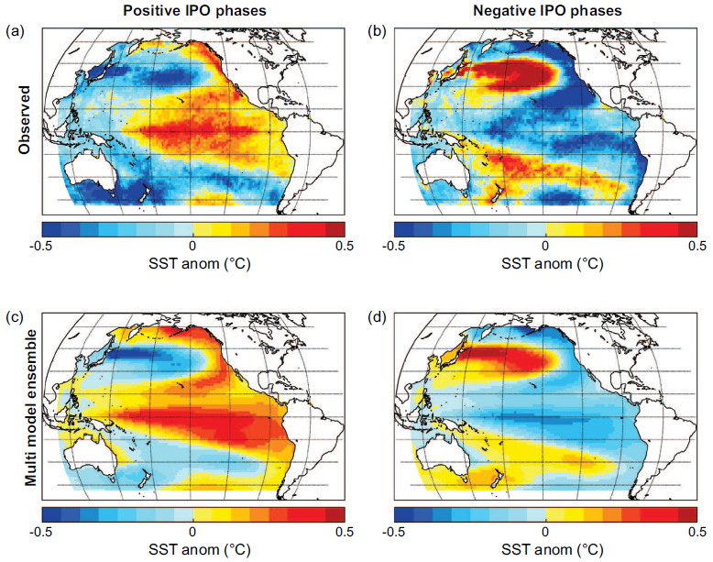
Earth system models can successfully simulate a major mode of decadal variability, the Interdecadal Pacific Oscillation (IPO)
Objective: Explore how well current Earth System Models simulate a major mode of internally generated, naturally-occurring decadal earth system variability, the Interdecadal Pacific Oscillation (IPO)
Research:
--Analyze the CMIP5 multi-model ensemble to document the models’ capability to simulate the IPO
--Compare model results to observations, and quantify agreement
Spatial IPO patterns show good agreement between models and observations. Observed IPO spatial patterns in (a) IPO positive and (b) IPO negative phases; Multi-model pre-industrial control mean spatial patterns of IPO in (c) IPO positive and (d) IPO negative
Impact: A systematic evaluation of the simulation of the IPO in the suite of Coupled Model Intercomparison Project 5 (CMIP5) models shows that the Pacific basin-wide spatial pattern of positive and negative phases of the IPO are simulated reasonably well, thus building confidence in initialized decadal climate simulations that include the IPO
Henley, B.J., G.A. Meehl, S.B. Power, C.K. Folland, A.D. King, J.N. Brown, D.J. Karoly, F. Delage, A.J.E. Gallant, M. Freund, and R. Neukom, 2017: Spatial and temporal agreement in climate model simulations of the Interdecadal Pacific Oscillation, Env. Res. Lett., 12, 044011.

