Slide 1
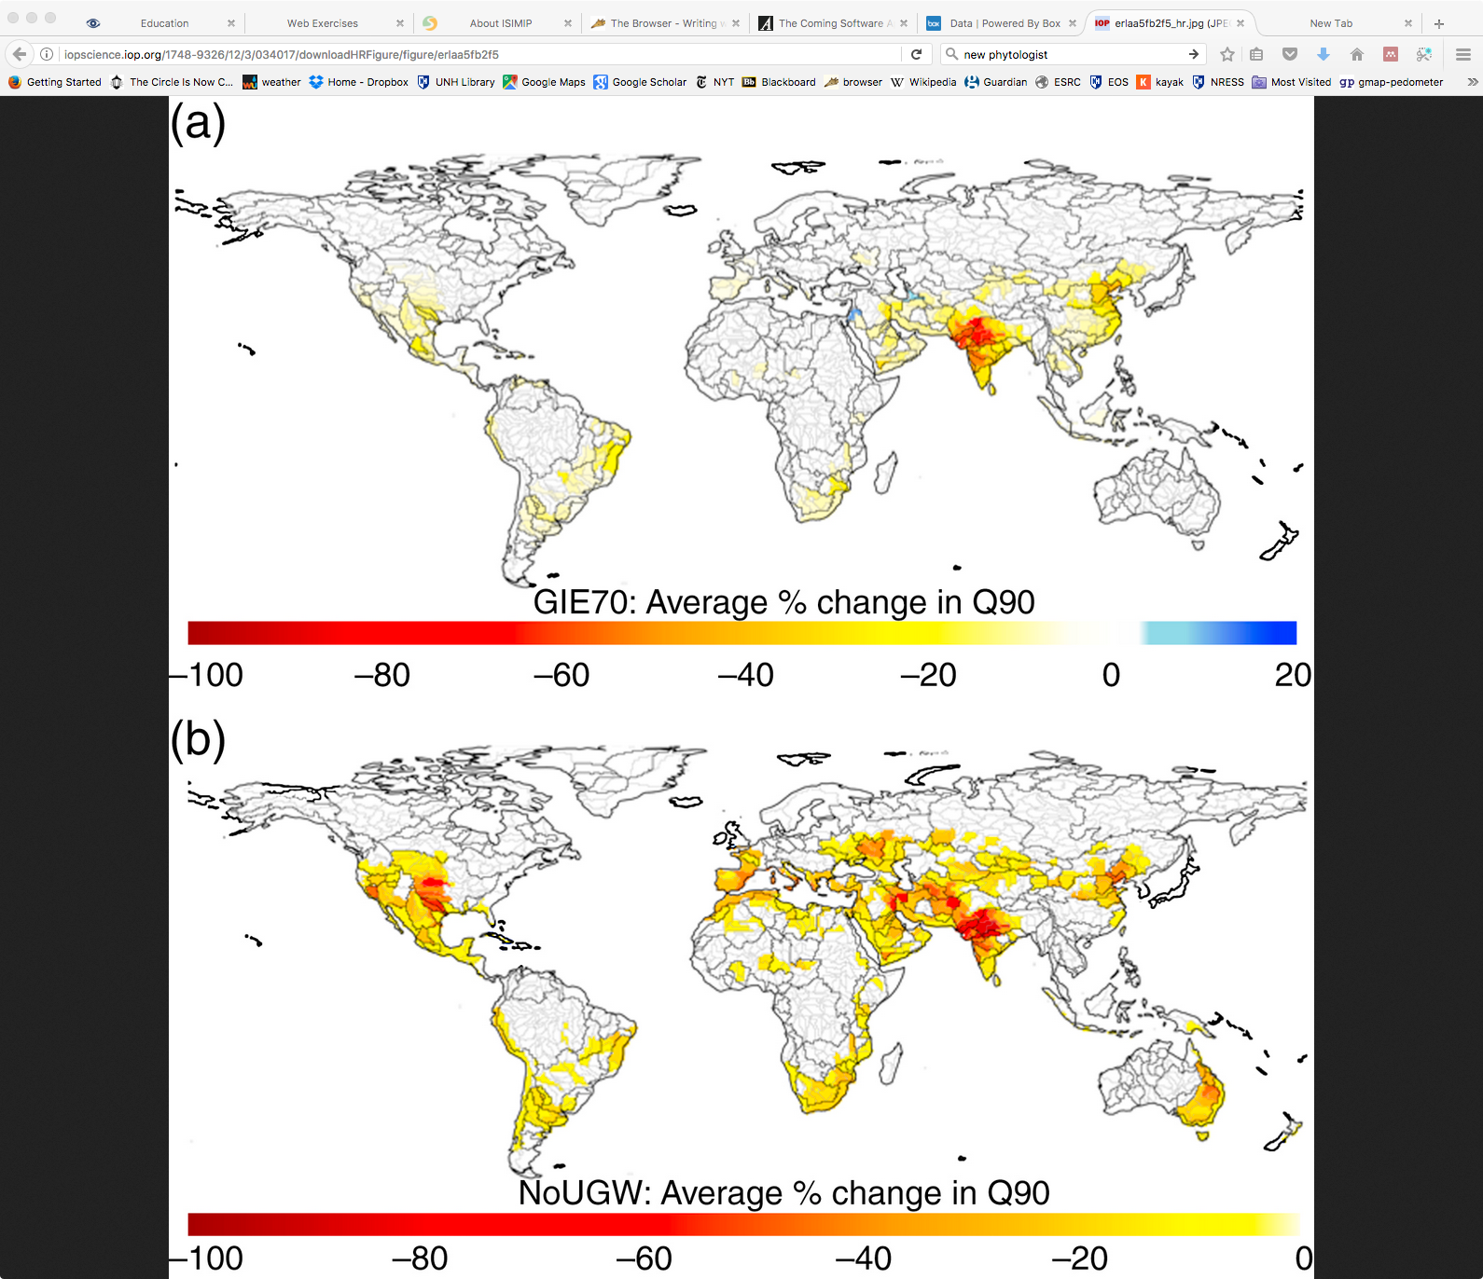
Quantifying Non-Renewable Groundwater Return-Flow and Re-Use in Global Irrigation
Objective
Quantify importance of irrigation return flow to downstream water supply.
Approach
Global hydrological model tracks flow and re-use of non-renewable groundwater pumped for irrigation but ‘lost’ to percolation and run-off.
Assess impact of less irrigation return flow by increasing irrigation efficiency (less water loss), and by using less non-renewable groundwater.
Impact
Inefficient use of irrigation water leads to large amounts of groundwater entering the surface water supply via agricultural runoff, where it can be re-used for irrigation downstream.
Reducing irrigation return flow leads to reduced water supply downstream in major irrigated-agriculture river basins around the world.
Higher efficiency cannot eliminate the need for non-renewable sources for global irrigation water.
Percent change in annual river low flows (lowest 10%) with (a) increased irrigation efficiency, and (b) no non-renewable groundwater use. Both decrease river low-flow values significantly in many major river basins, due to reduced return flow from groundwater irrigation water into the surface water system.
Grogan D, D Wisser, A Prusevich, RB Lammers, S Frolking. 2017. The use and re-use of unsustainable groundwater for irrigation: A global budget, Environmental Research Letters. 12 (2017) 034017,
doi: 10.1088/1748-9326/aa5fb2.

Slide 2
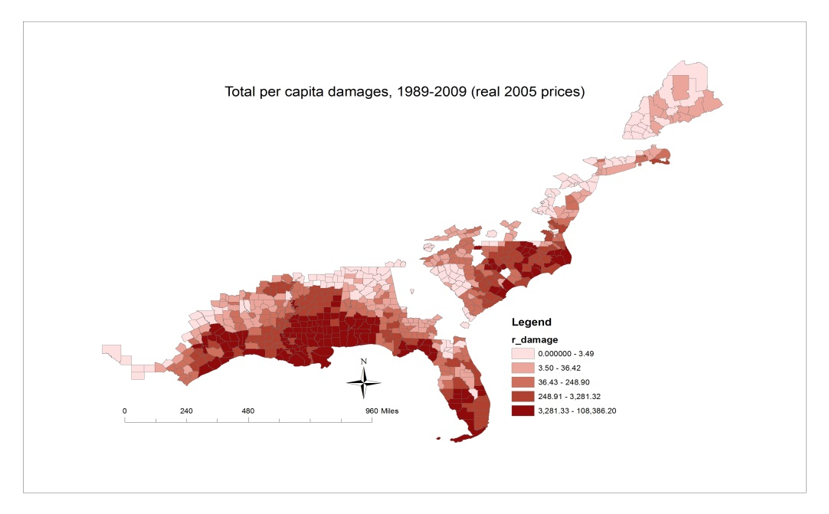
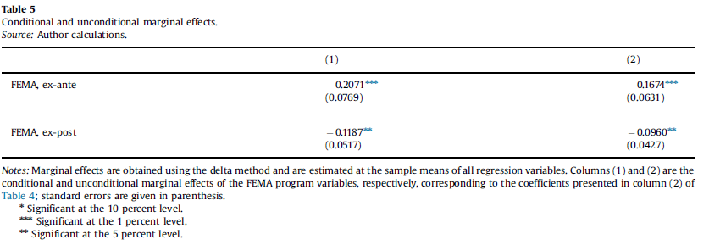
The effects of adaptation measures on hurricane induced property losses
Objective
Measure the relative effectiveness of FEMA expenditures on hurricane induced property losses.
Approach
Compare the relative effectiveness of pre-disaster risk reduction activities and post-disaster response and recovery assistance by econometrically estimating a model of historical property damages.
Model comprises 651 counties along the Atlantic coast that have incurred hurricane-induced property losses at least once during the period 1989-2009.
Impact
Spending on FEMA ex-ante mitigation and planning projects leads to greater reductions in property losses than spending on ex-post adaptation programs.
Marginal return from spending on programs that target long-term mitigation and risk management to be almost twice that from spending on ex-post recovery programs.
There are important potential gains that could be realized from the further diversification of FEMA spending across project categories.
A one percent increase in annual spending on ex-ante risk reduction and warning projects reduces damages by 0.21 percent while a one percent increase in ex-post recovery and clean-up spending reduces damages by 0.12
Davlasheridze, M.; K. Fisher-Vanden; H.A. Klaiber. 2017. The effects of adaptation measures on hurricane induced property losses: Which FEMA investments have the highest returns? Journal of Environmental Economics and Management. 81 (2017): 93-114.

Slide 3
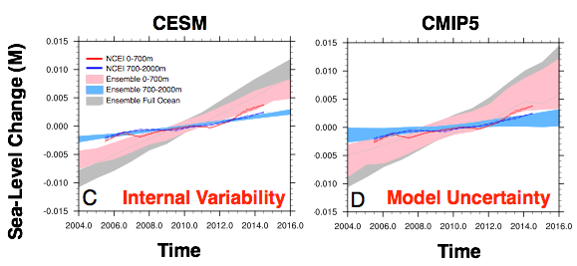
Effect of ocean internal variability on modeled steric sea-level rise
Objective
Comprehensive global climate model ensembles are used to evaluate uncertainties surrounding decadal trends in depth-integrated steric sea-level rise due to thermal expansion of the ocean
Approach
We analyze multiple sources of uncertainties influencing sea-level rise estimates, including:
  model uncertainties using the Coupled Model Intercomparison Phase 5 (CMIP5)
  “natural” variability using low-resolution CESM ensemble accounting for joint internal variability (including the deep ocean)
Above: Timeseries of 95% model ensemble range of steric sea‐level change over different ocean depths.
Below: 2100 steric sea-level rise estimates from CESM, highlighting effects of regional variability and internal ocean variability on upper bound estimates
Impact
Analysis shows that both internal “natural” variability and model uncertainties contribute substantially to spread in multi-decadal steric sea-level trends.
Results provide useful constraints on estimations of global and regional sea-level variability, in particular for upper bound estimates relevant to coastal flood risk assessments.
Hogan, E. E. and Sriver, R. L. (2017), Analyzing the effect of ocean internal variability on depth-integrated steric sea-level rise trends using a low-resolution CESM ensemble, Water, 9, 483, doi:10.3390/w9070483

Slide 4
Improving the characterization of sea-level projection uncertainties
Objective
Quantify the effects of common methodological choices on projection uncertainties using the example of sea-level changes
Approach
Implement three commonly used approaches to data-model fusion
Apply these approaches to a published data set and model structure
Assess the approaches in terms of hindcasts and projections
Comparison of the projected sea-level changes from three data-model fusion approaches. The heteroskedastic Bayesian method (dark blue line) best represents the properties of the data-model residuals within the considered methods and suggests an increased upper-tail projection.
Impact
Improving the representation of the statistical properties of the data-model discrepancies can increase the upper tail projection.
K. L. Ruckert, Y. Guan, A. M. R. Bakker, C. E. Forest, and K. Keller: The effects of time-varying observation errors on semi-empirical sea-level projections. Climatic Change (2017) 140:349–360DOI 10.1007/s10584-016-1858-z. Open access: https://link.springer.com/content/pdf/10.1007%2Fs10584-016-1858-z.pdf

