Slide 1
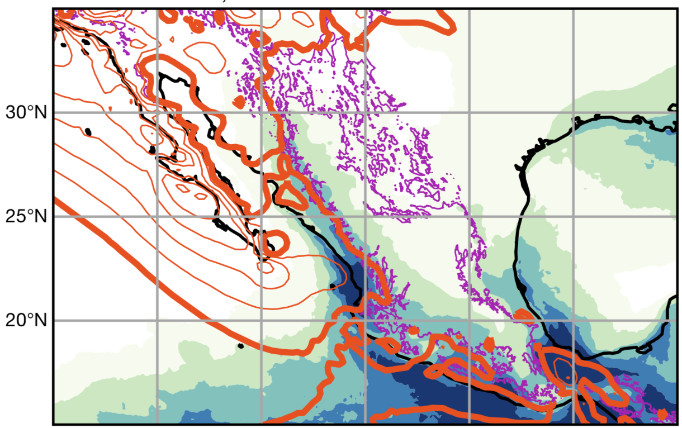
North American monsoon shown to be caused by deflection of the jet stream by mountains [PRESS EMBARGO UNTIL 11 AM NOV. 24, 2021]
Objective
To determine the fundamental cause of the North American monsoon, which supplies water to much of Mexico and the U.S. Southwest.
To understand how mountains influence extreme rainfall in western North America during summer.
Approach
Analyzed dynamic and thermodynamic structures of winds and rainfall in observational datasets.
Performed high-resolution global climate model simulations and theoretical calculations of the influence of mountain ranges on the jet stream.
Impact
This research overturns our prior understanding of the fundamental science of that monsoon, placing new emphasis on the jet stream and its interaction with mountain ranges.
This has implications for projections of future trends in North American rainfall, making changes in the extratropical jet stream of central importance.
Deflection of the eastward jet stream (orange contours) from the midlatitudes toward the equator, where it produces precipitation (blue shading, units of mm/day) as it then ascends over the Sierra Madre mountain range (outlined by magenta contour).
Boos, W. R., and S. Pascale (2021). Mechanical forcing of the North American monsoon by orography. Nature. [DOI: 10.1038/s41586-021-03978-2]
Notes:
http://www.pnnl.gov/science/highlights/highlights.asp?division=749

