Slide 1
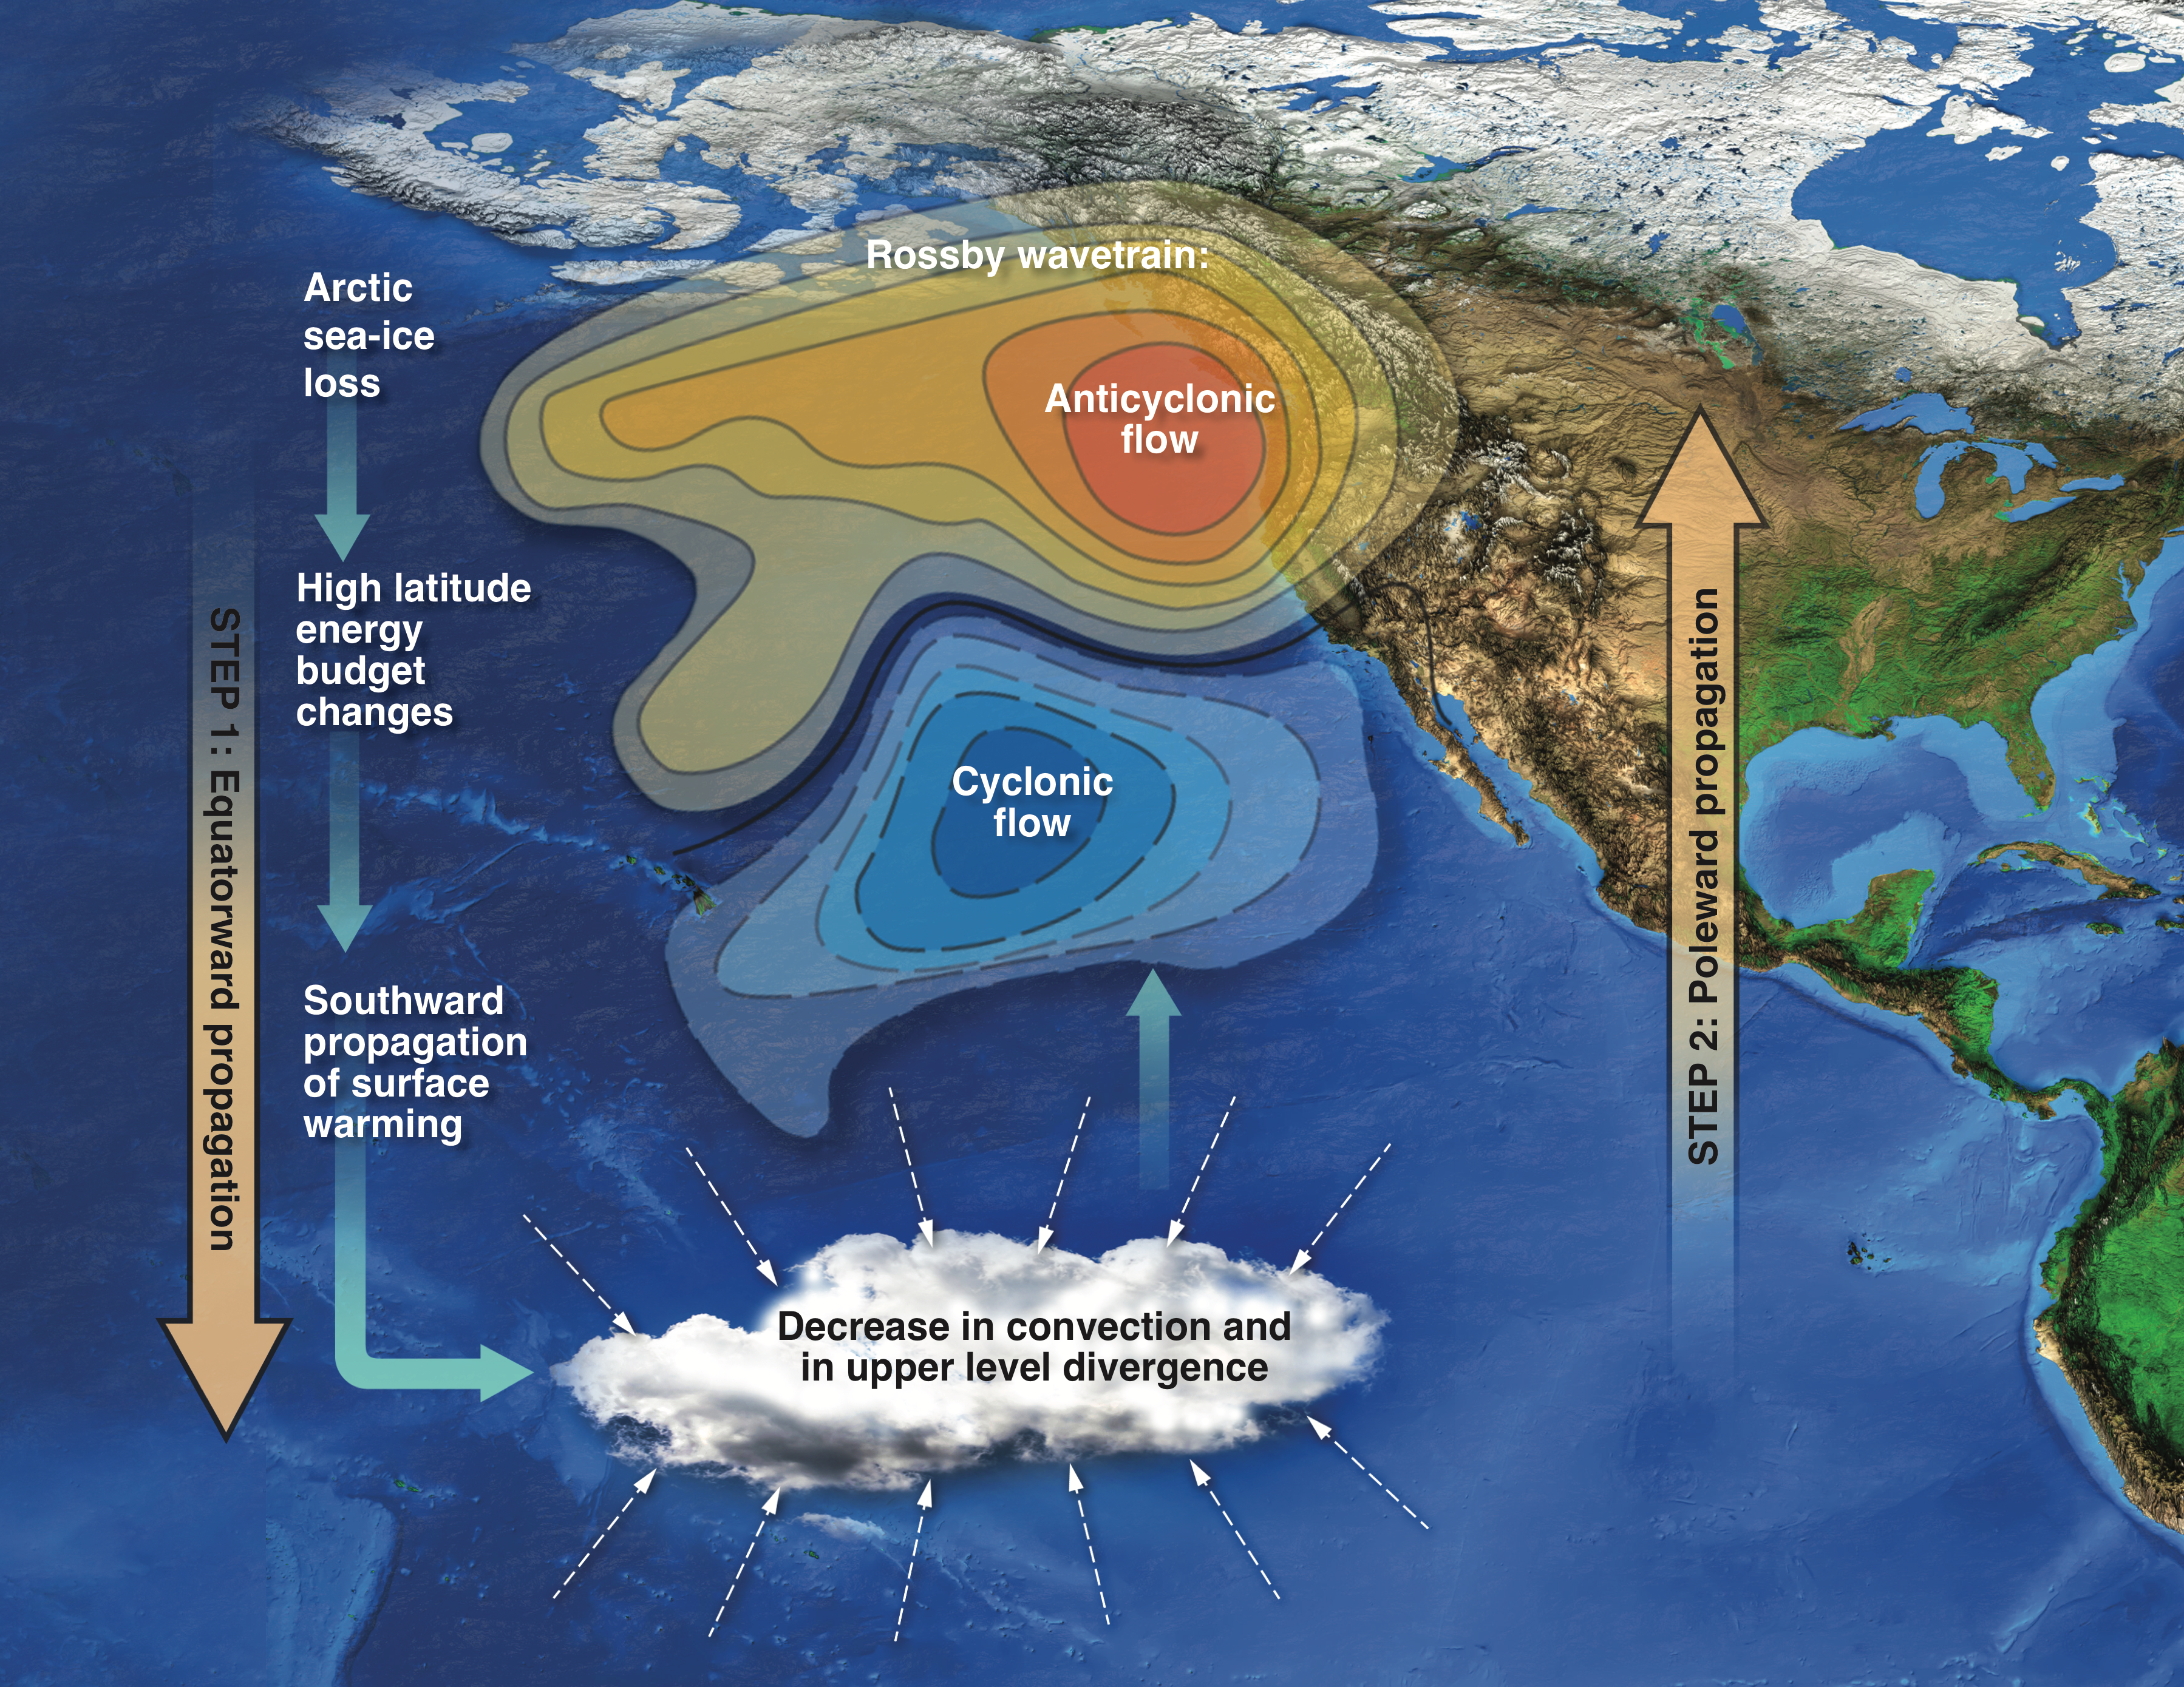
Future loss of Arctic sea-ice cover could drive a substantial decrease in California’s rainfall
Significance and Impact
The sea-ice loss of the magnitude expected in the next decades could substantially impact California’s precipitation, thus highlighting another mechanism by which human-cause climate change could exacerbate future California droughts.
Research Details
Arctic sea-ice loss forces California’s precipitation changes through a two-step teleconnection involving tropical changes.
Step 1 (equatorward propagation): Arctic sea-ice loss induced high latitude changes propagate into tropics, triggering tropical circulation and convection response.
Step 2 (poleward propagation): decreased convection and decreased upper level divergence in the tropical Pacific drive a northward propagating Rossby wavetrain with anticyclonic flow forming in the North Pacific. This ridge is responsible for steering the precipitation-inducing winter storms away from California.
Snow grain radius tuning parameter, thermal conductivity of snow, snow melt maximum radius
Cvijanovic I, Santer BD, Bonfils C, Lucas DD, Chiang JCH, Zimmerman S, 2017: Future loss of Arctic sea-ice cover could drive a substantial decrease in California’s rainfall. Nat. Comm. doi:10.1038/s41467-017-01907-4
This work was supported by the Climate and Environmental Sciences Division and the Regional and Global Climate Modeling Program of the U.S. Department of Energy Office of Science and was performed under the auspices of the Lawrence Livermore National Laboratory (contract DE-AC52-07NA27344). IM tracking #: LLNL-MISC-895204

