Slide 1
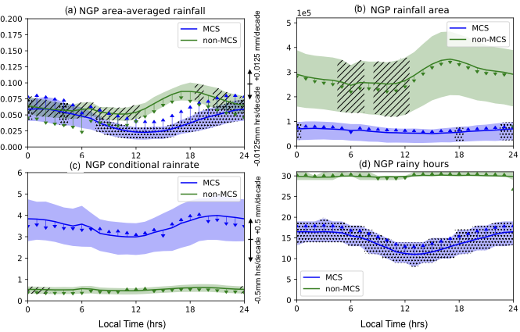
Distinct Characteristics of MCS and non-MCS Rainfall
Objective
Investigated the warm-season rainfall characteristics associated with Mesoscale Convective Systems (MCS) and non-MCS events in the central United States
Approach
Applied an MCS tracking algorithm to observed precipitation data from the North American Land Data Assimilation System and NexRad radar data to distinguish MCS rainfall from the rest
Quantified rainfall characteristics regarding intensity, area, and frequency
Compared rainfall characteristics associated with MCS and non-MCS rainfall and examined their historical trends
Impact
In the warm season, MCS produce rainfall about 7 times more intense than other types of rainfall in this region
Rainfall from MCSs has increased between 1997-2018, due to an increased frequency and a longer duration per storm
Coincidentally, the total wet days have decreased by 11.7% per decade, resulting in longer and more variable dry intervals between storms
Daily cycle of MCS and non-MCS rainfall (a) in the Northern Great Plains and their rainfall characteristics including rainfall area (b), conditional rainrate (c) and rainy hours (d), shaded with 25-75 percentile ranges. Upward (downward) arrows indicate the increasing (decreasing) trend from 1997-2018, with scales shown on the right of each panels. Hours that are stippled have significant increasing trends, while hatched hours have decreasing trends. MCS rainfall shows an increasing trend from more rainy hours while non-MCS rainfall shows a decreasing trend due to reduced rain area.
H Hu, LR Leung, and Z Feng. 2020. “Observed Warm‐Season Characteristics of MCS and Non‐MCS Rainfall and Their Recent Changes in the Central United States.” Geophysical Research Letters, 47: e2019GL086783.
DOI: 10.1029/2019GL086783

