Slide 1
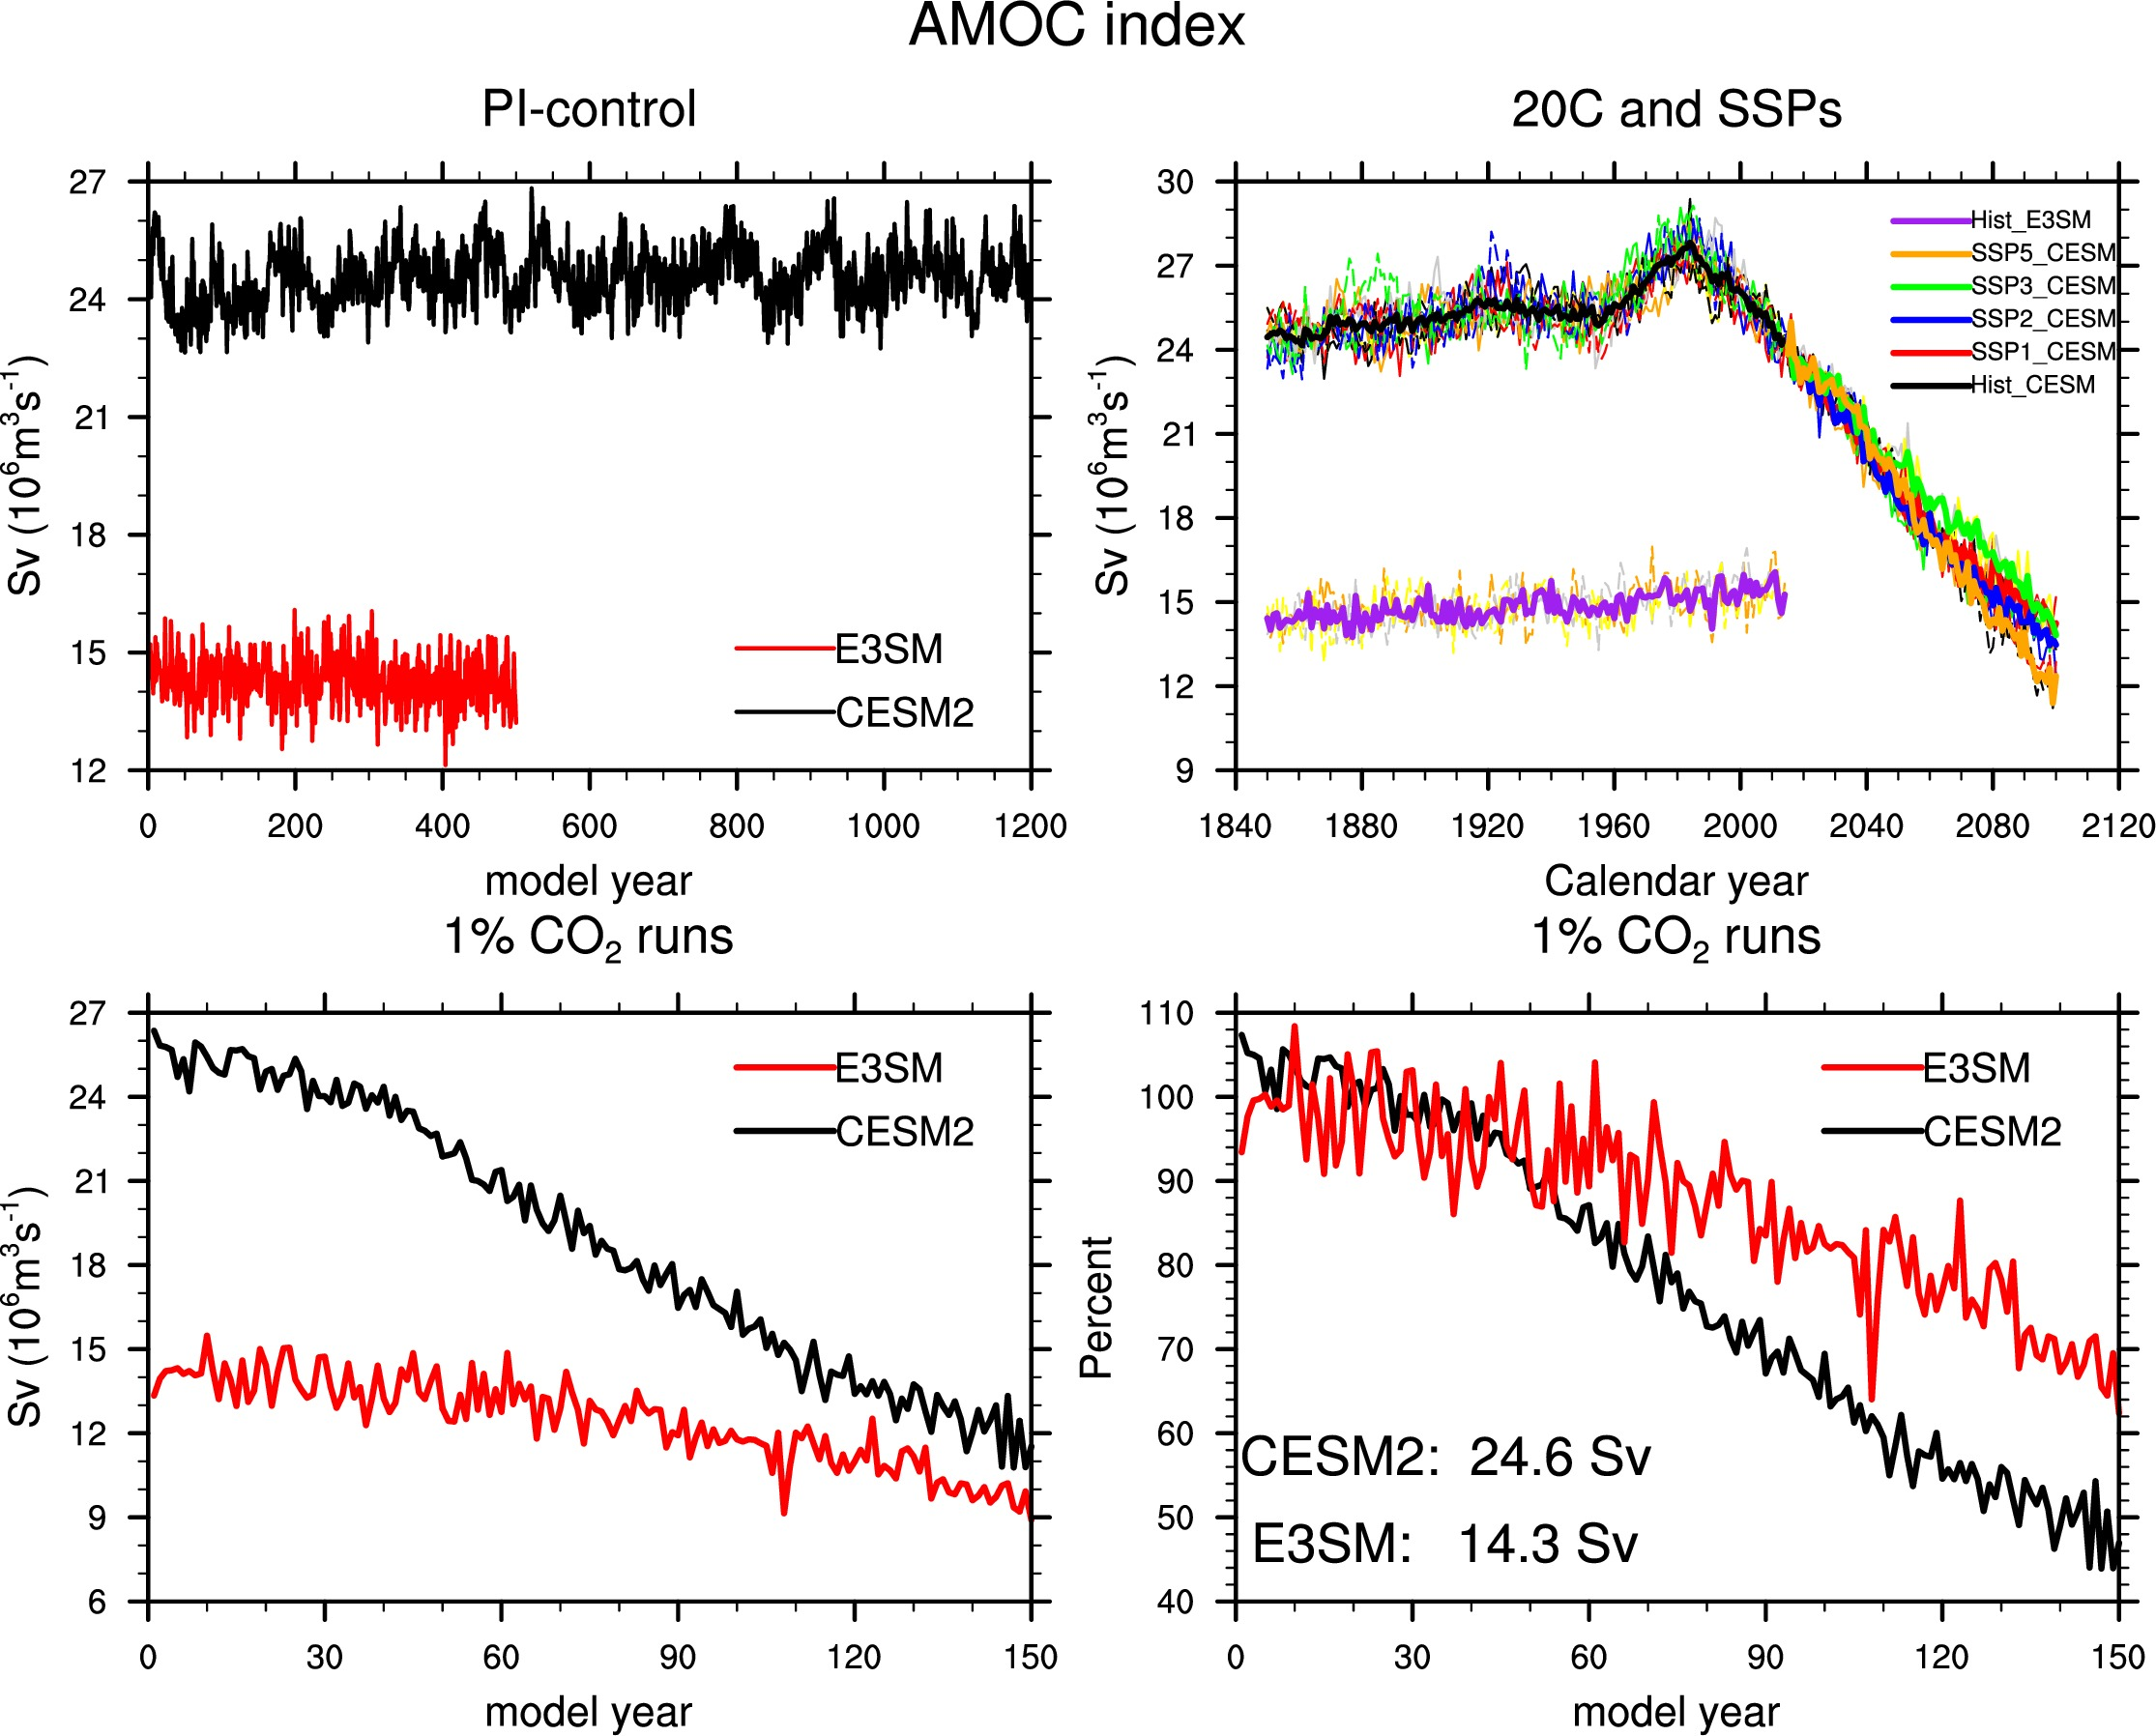
Role of AMOC in Transient Climate Response to Greenhouse Gas Forcing in Two Coupled
Objective: As the greenhouse gas concentrations increase, a warmer climate is expected. However, numerous internal climate processes can modulate the primary radiative warming response of the climate system to rising greenhouse gas forcing. Here the internal climate process that we specifically focus on is the Atlantic Meridional Overturning Circulation (AMOC) and its role in determining transient climate response to greenhouse gas.
Approach: The models used here are the Community Earth System Model version 2 (CESM2) and the Energy Exascale Earth System Model version 1 (E3SM1) and the experiments includes preindustrial control, historical and 1% CO₂ runs.
Results/Impacts: While CESM2 and E3SM1 have very similar equilibrium/effective climate sensitivity, our analysis suggests that a weaker AMOC contributes in part to the higher transient climate response to a rising greenhouse gas forcing seen in E3SM1 by permitting a faster warming of the upper ocean and a concomitant slower warming of the subsurface ocean. Likewise the stronger AMOC in CESM2 by permitting a slower warming of the upper ocean leads in part to a smaller transient climate response. Thus, while the mean strength of AMOC does not affect the equilibrium/effective climate sensitivity, it is likely to play an important role in determining the transient climate response on the centennial time scale.
Hu, A., L. V. Roekel, W. Weijer, O. A. Garuba, W. Cheng, B. T. Nadiga, 2020, Role of AMOC in transient climate response to greenhouse gas forcing in two coupled models, J. Climate, 33, 5845-5859, doi: 10.1175/JCLI-D-19-1027-1.
Figure 1. Time evolution of the AMOC index (top 4 panels) and global mean temperature (bottom 4 panels) in the (top left) preindustrial control run, (top right) twentieth century and future SSP runs, (bottom left) 1% CO2 runs, and (bottom right) the percentage changes relative to the control run mean in 1% CO2 runs

