Slide 1
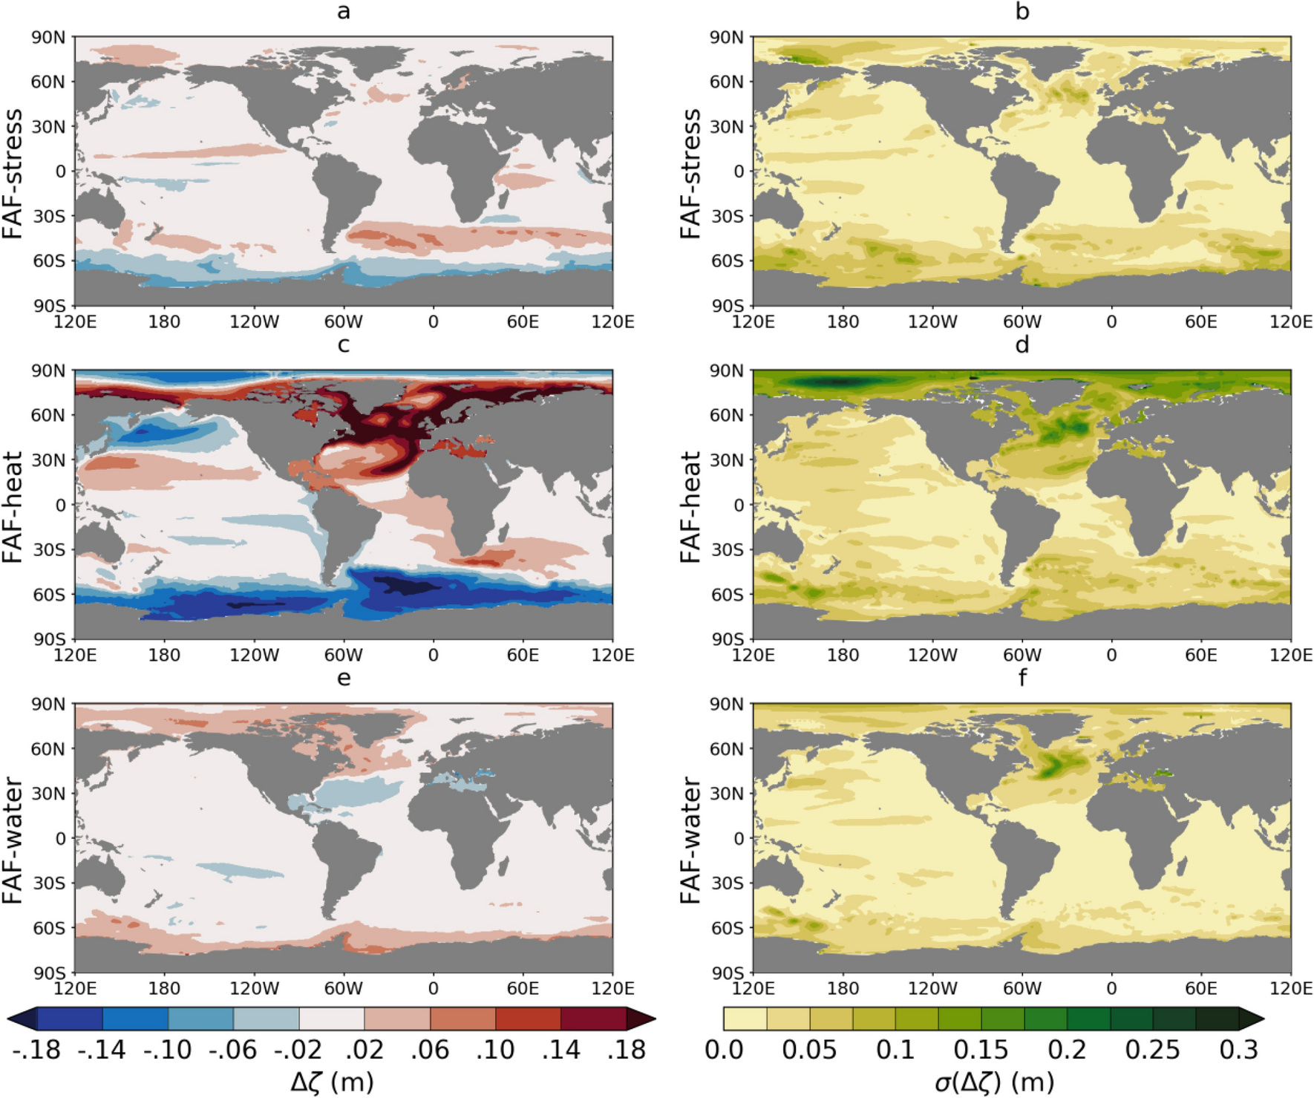
What causes the spread of model projections of ocean dynamic sea-level change in response to greenhouse gas forcing?
Objective: We isolate the role of the ocean dynamics in setting the spatial pattern of dynamic sea-level (ζ) change by forcing several AOGCMs with prescribed identical heat, momentum (wind) and freshwater flux perturbations. This method produces a ζ projection spread comparable in magnitude to the spread that results from greenhouse gas forcing, indicating that the differences in ocean model formulation are the cause, rather than diversity in surface flux.
Approach: here a set of specially designed experiments are carried out under FAFMIP protocol. 13 CMIP6 class models are using, including CESM2.
Results/Impacts: FAFMIP simulations provide new avenues to probe the sea-level response to greenhouse gas forcing, and ocean heat-content change generally. The results presented here represent a step highlighting where AOGCMs give diverse predictions of sea-level change because of their different ocean models. Many details of local processes that cause the sea-level changes described here remain to be fully explored. We have highlighted that a key source of spread of AOGCM predictions of sea-level change in the North Atlantic is because the change of local transport is highly model dependent; subsequent work should uncover what characteristics of ocean models cause this. AOGCMs give diverse predictions about Arctic heat uptake, owing to the interaction between passive and active heat uptake processes that call for more detailed examination. Further process-based analysis of FAFMIP simulations will shed new light on the key areas of uncertainty highlighted here.
Figure 1 Maps of multi model ensemble mean ocean dynamic sea-level response to individually-applied flux perturbations (left) and standard deviation across 13 AOGCMs (right) for the wind stress (FAF-stress, top), heat flux (FAF-heat, middle), and water flux (FAF-water, bottom) experiments. AOGCMs used: ACCESS-CM2, CanESM2, CanESM5, CESM2 (FAF-stress and FAF-water only), GFDL-ESM2M, GISS-E2-R-CC (FAF-stress and FAF-water only), HadCM3, HadGEM2-ES, HadGEM3-GC31-LL, MIROC6, MPI-ESM-LR, MPI-ESM1-2-HR and MRI-ESM2-0.
Couldrey, M. P., J. M. Gregory, F. Boeira Dias, P. Dobrohotoff, C. M. Domingues, O. Garuba, S. M. Griffies, H. Haak, A. Hu, M. Ishii, J. Jungclaus, A. Köhl, S. J. Marsland, S. Ojha, O. A. Saenko, A. Savita, A. Shao, D. Stammer, T. Suzuki, A. Todd & L. Zanna, 2021, What causes the spread of model projections of dynamical sea level change in response to greenhouse gas forcing? , Climate Dynamics, 56, 155-187, doi: 10.1007/s00382-020-05471-4.

