Slide 1
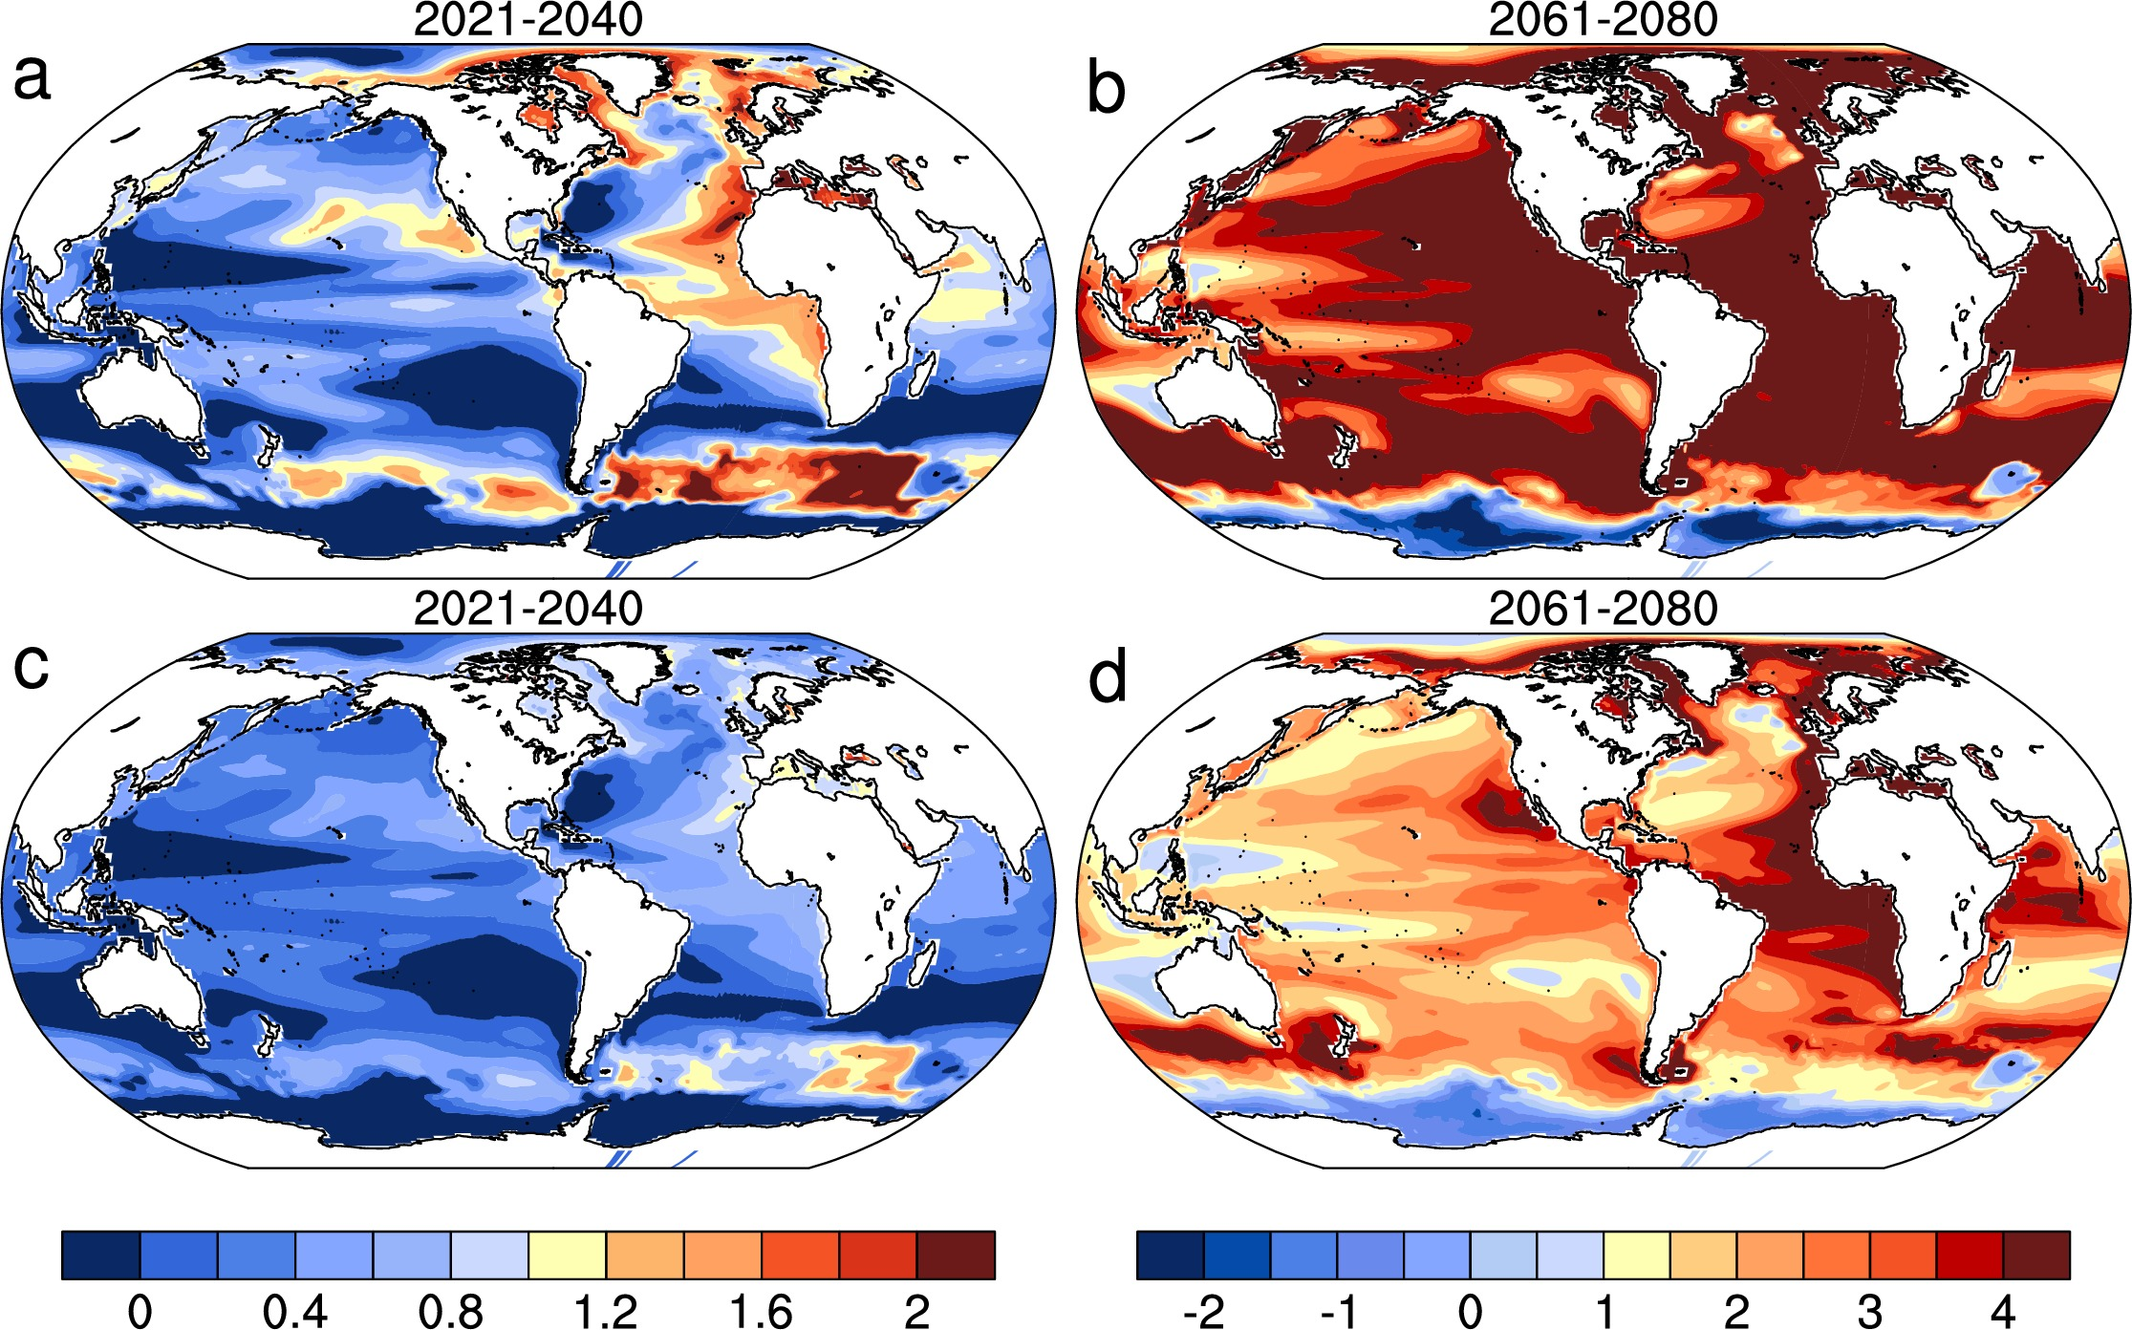
Internal climate variability and the projected future regional steric and dynamic sea level rise
Objective
Observational evidence points to a warming global climate accompanied by rising sea levels which impose significant impacts on island and coastal communities. Studies suggest that internal climate processes can modulate projected future sea level rise (SLR) regionally. It is not clear whether this modulation depends on the future climate pathways. Here, by analyzing two sets of ensemble simulations from a climate model, we investigate the potential reduction of SLR, as a result of steric and dynamic oceanographic affects alone, achieved by following a lower emission scenario instead of business-as-usual one over the twenty-first century and how it may be modulated regionally by internal climate variability.
Figure 1. Ratio of the sea level rise reduction and the standard deviation intra-ensemble members. Panels a and b are the quotient of the SLR reduction for RCP4.5 from RCP8.5 divided by one standard deviation (1σ) of the regional SLR within RCP8.5 ensemble for the period 2021-2040 and 2061-2080, respectively, which represents the 68% significance level if the quotient is greater than 1. Panels c and d are the same as panels a and b, but the SLR reduction is divided by 2σ, which represents a 95% significance level if the quotient is greater than 1. The left color bar is for panels a and c, and the right color bar is for panels b and d.
Approach
Community Earth System Model version 1 (CESM1) with 1 degree resolution is our tool.
30 member ensemble simulations with time-evolving 20th century all known forcings (1920-2005), and RCP8.5 forcings (2006-2080), and 15 member ensemble RCP4.5 (2006-2080).
Global and regional sea level rise
Internal climate variability – PDO, AMOC, NAO. ACC
Impact
Almost no statistically significant difference in steric and dynamic SLR on both global and regional scales in the near-term between the two scenarios, but statistically significant SLR reduction for the global mean and many regions later in the century .
There are regions where the SLR reduction is insignificant, such as the Philippines and west of Australia, that are associated with ocean dynamics and intensified internal variability due to external forcing.
Hu A. and S. Bates, 2018, Internal climate variability and the projected future regional steric and dynamic sea level rise, Nature Communications, doi:10.1038/s41467-018-03474-8, in press.

