Slide 1
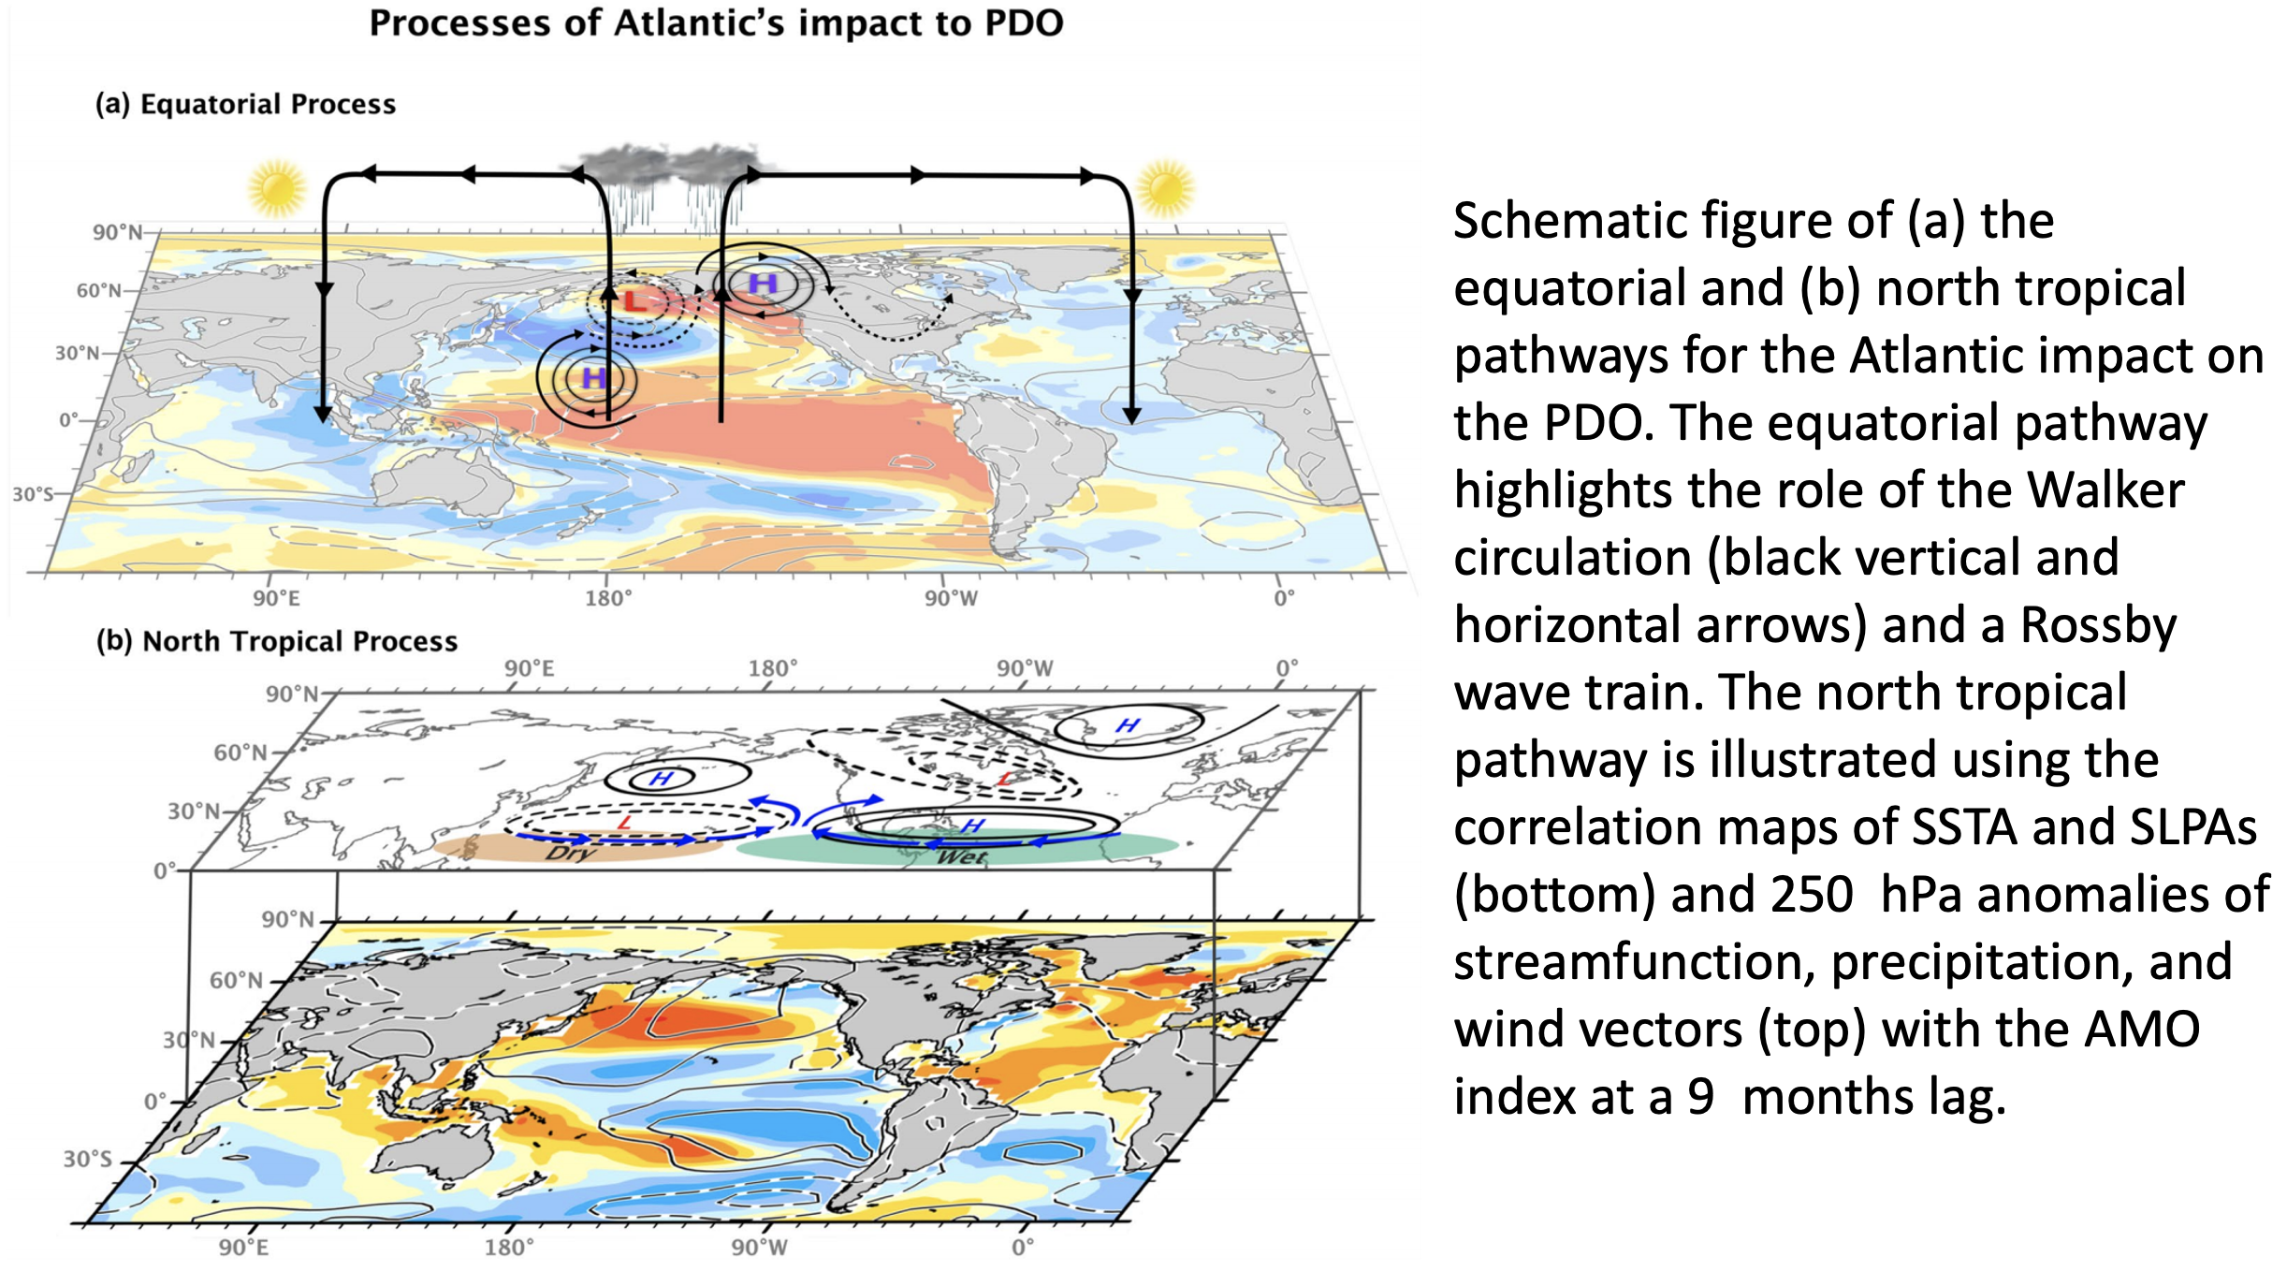

PDO remotely forced by Atlantic Ocean
Several “partial ocean data assimilation experiments” using two earth system models demonstrate that, in addition to the tropical Pacific's role in driving PDO variability, the Atlantic can affect PDO variability by modulating the tropical Pacific climate through two proposed processes. About 12–29% of PDO variance originates from the Atlantic Ocean and 40–44% from the tropical Pacific.
We show that the Atlantic can affect PDO through (i) the equatorial pathway, in which tropical Atlantic variability affects the Pacific through reorganization of Walker Circulation; and (ii) the north tropical pathway, where low-frequency the Atlantic variability induces an atmospheric response in the tropical Pacific north of the equator.
the Atlantic impact on PDO was examined using several 3-dimensional partial ocean data assimilation experiments conducted with two global models: the CESM1.0 and MIROC3.2m
in partial assimilation experiments, the models are constrained by observed temperature and salinity anomalies, one solely in the Atlantic basin and the other solely in the equatorial Pacific basin, but evolve freely in other regions
Johnson, Z. F., Y. Chikamoto, S.-Y. Wang, M. J. McPhaden, and T. Mochizuki, 2020: Pacific Decadal Oscillation remotely forced by the equatorial Pacific and the Atlantic Oceans. Climate Dynamics, DOI:/10.1007/s00382-020-05295-2

