Slide 1
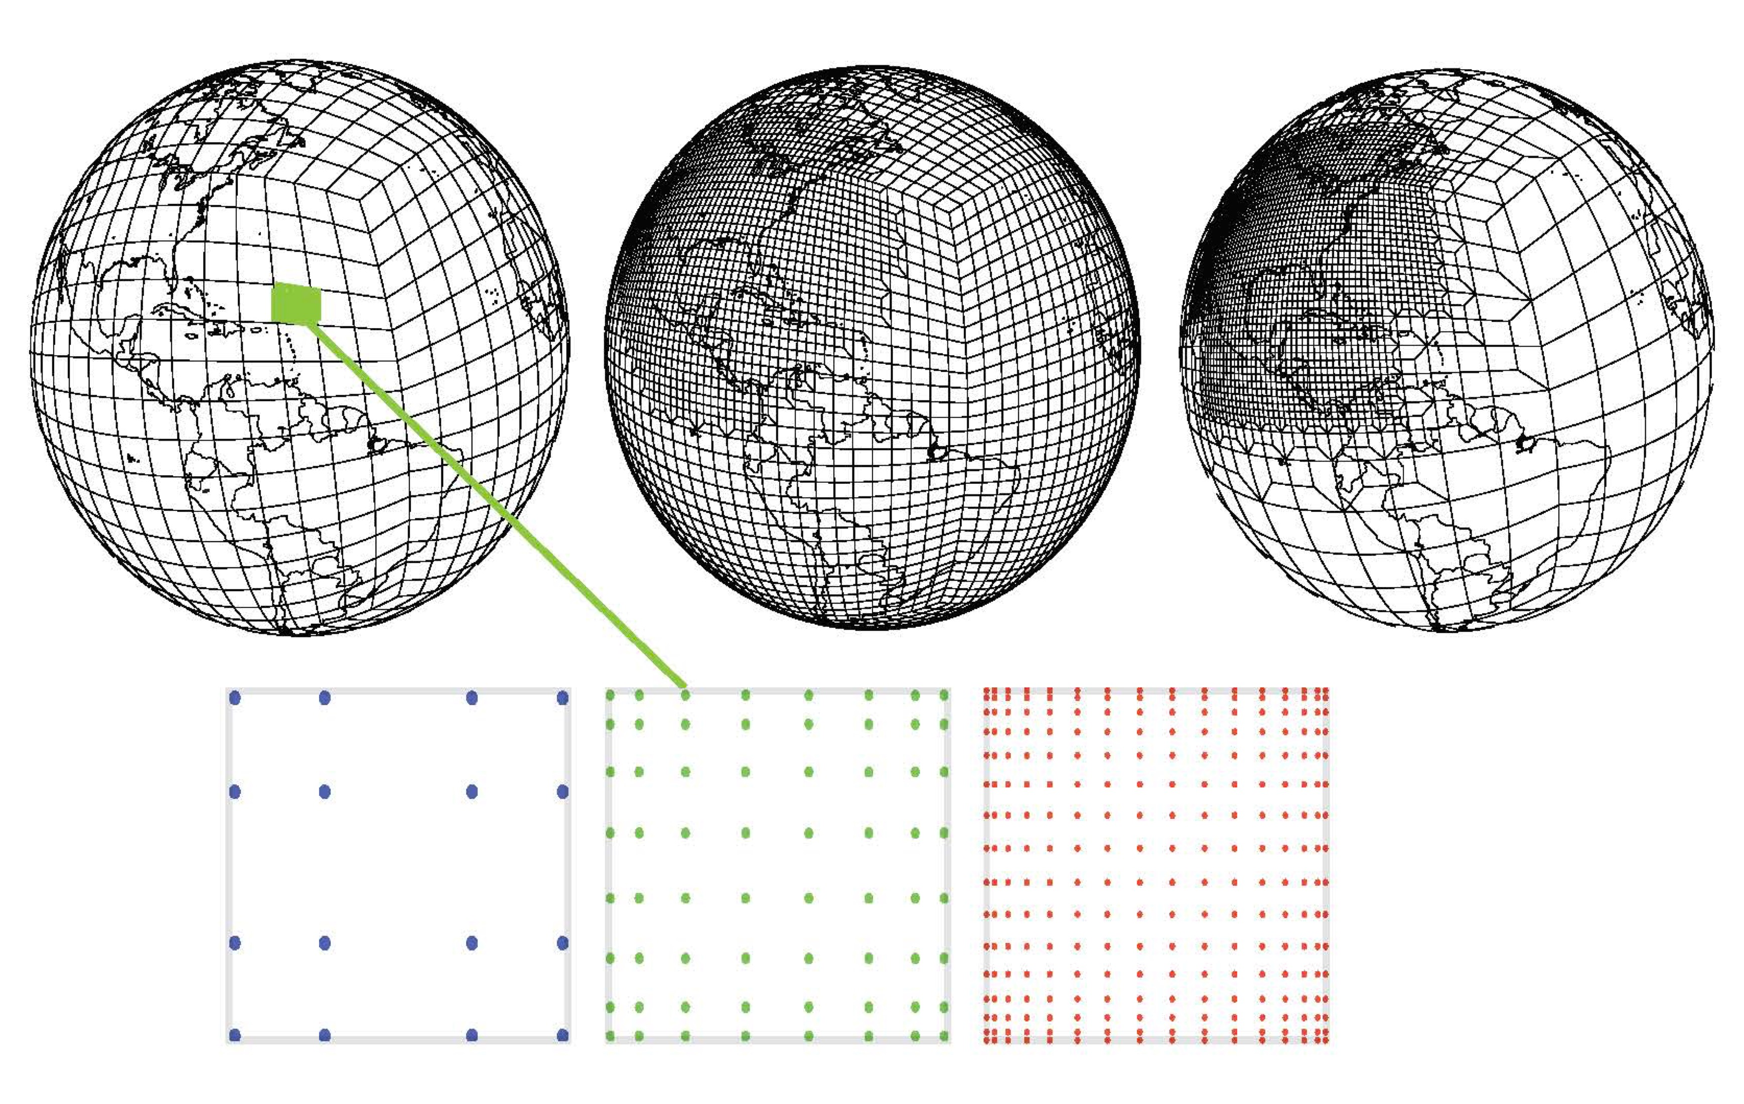
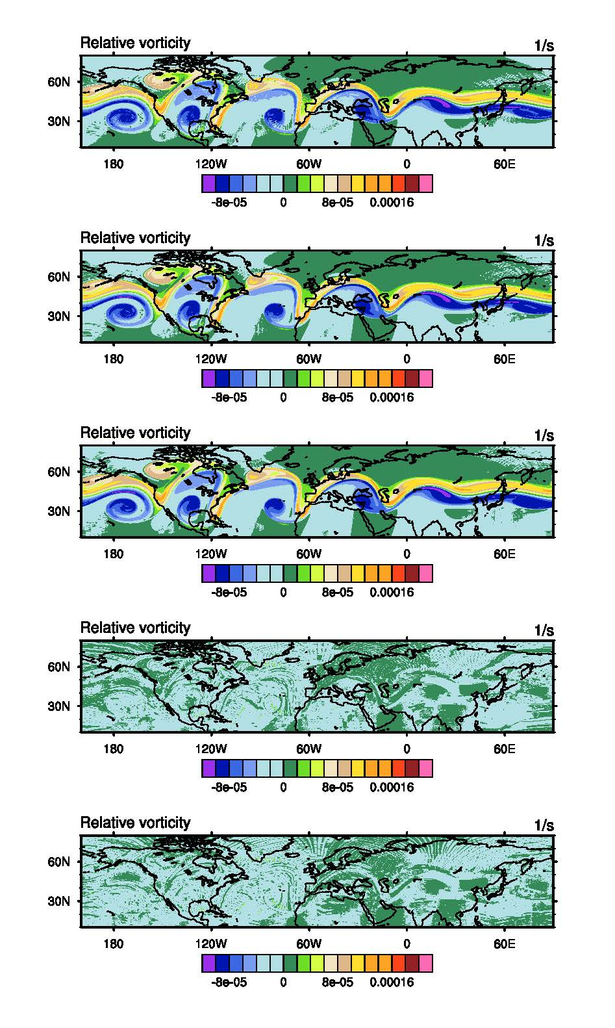
Performance analysis of fully explicit and fully implicit solvers within a spectral element shallow-water atmosphere model
Objectives
New Science
Assess the performance of implicit time stepping methods compared to other schemes within large scale atmosphere models
Assess implicit integration for a range of model configurations and parameter choices
A Trilinos library based implicit solver that uses the GPU within the residual has been implemented within CAM-SE
The implicit solver provides accurate solutions for a range of problem types and scales >86,400 cores.
Newton-based implicit algorithms have been evaluated at this scale of complexity for atmosphere fluid flow applications
Significance
Results
Below: Vorticity field of horizontal flow field at 6 days of simulation of flow instability for 3 different grid layouts, all with a resolution of about ¼ degree, but different spatial grids using the implicit solver, and it matches the explicit.
The implicit solver is able to use time step sizes such that no subcycling of tracers and physics is needed
The implicit solver shows equal performance to explicit for strongly regionally refined configurations
Upper: Mesh for the uniform single refinement (middle), and multiple refinement (right) options for discretization analyzed for performance. Lower: Nodes within each element for 4th (blue), 8th (green), and 16th (red) order. Varying orders and element layouts of the grid creates ’equivalent’ resolutions.
K. Evans, R. Archibald, D. Gardner, M. Norman, M. Taylor, C. Woodward, P. Worley. Int. J. High Perf. Comp. Apps., 10.1177/1094342017736373.
Notes:
1

Slide 2
Performance analysis of fully explicit and fully implicit solvers within a spectral element shallow-water atmosphere model
Summary
Several methods utilizing a Newton–Krylov nonlinear solver are evaluated for a range of configurations of the shallow-water dynamical core of the spectral element community atmosphere model to evaluate their computational performance. These configurations are designed to explore the attributes of each method under different but relevant model usage scenarios, including varied spectral order within an element, static regional refinement, and scaling to the largest problem sizes. The limitations and benefits to using explicit Runge-Kutta versus implicit multistep methods, with different parameters and settings, are discussed in light of the trade-offs with Message Passing Interface (MPI) communication and memory and their inherent efficiency bottlenecks. The recommendation for future work using the implicit solvers is conditional based on scale separation and the stiffness of the problem. For the regionally refined configurations, the implicit method has about the same efficiency as the explicit method, without considering efficiency gains from a preconditioner. Initial simulations with OpenACC directives to utilize a Graphics Processing Unit (GPU) when performing function evaluations show improvements locally, and that overall gains are possible with adjustments to data exchanges.
K. Evans, R. Archibald, D. Gardner, M. Norman, M. Taylor, C. Woodward, P. Worley. “Performance analysis of fully explicit and fully implicit solvers within a spectral element shallow-water atmosphere model,” Int. J. High Perf. Comp. Apps., 10.1177/1094342017736373.
Notes:
Location parameter: indicates the position of the distribution of extremes from the origin (.i.e the change in location parameter implies a shift in the distribution of values).
2

