Slide 1
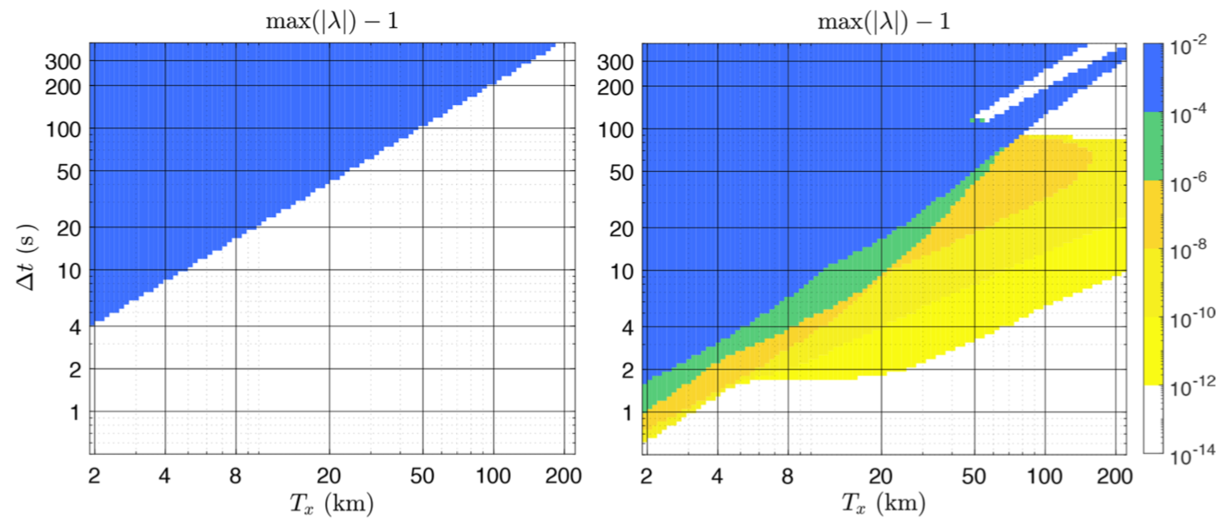
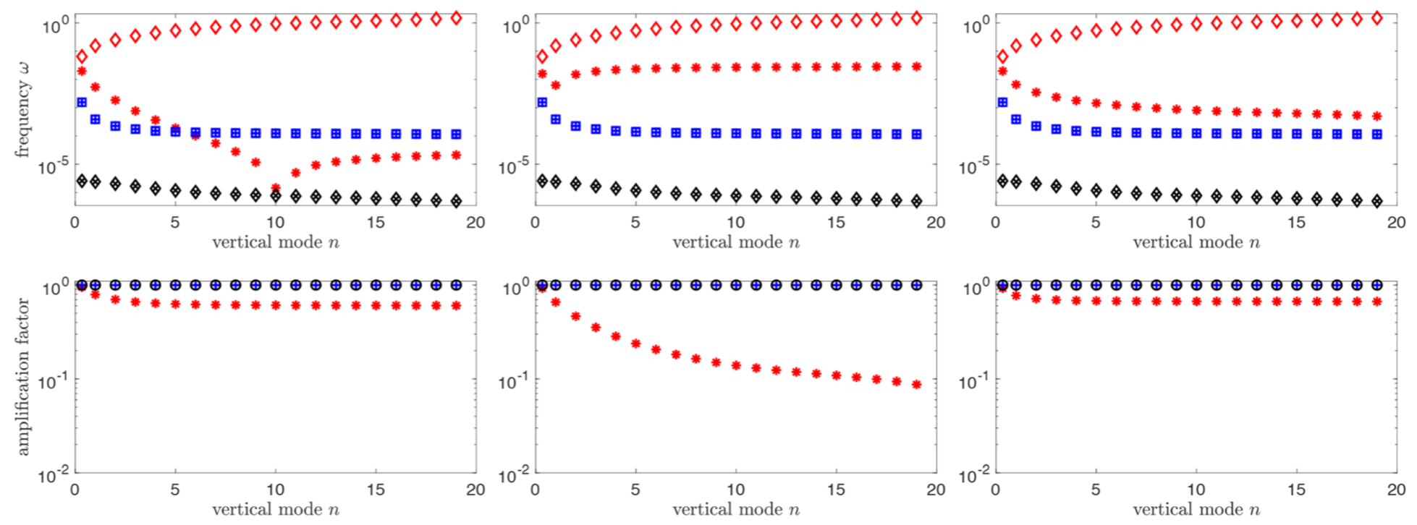
New timestepping algorithm analysis framework
With applications to atmospheric modeling
Figure 1: Numerically stable regions (white) as a function of time step size and wavelength. Previous technique (a); new method (b).
Objective
Physical realism requires good numerical dispersion properties; computational performance concern motivate algorithms that remain stable even for very large time steps. We develop a new framework for analyzing numerical methods with respect to their dispersive properties and their numerical stability, and apply it to E3SM’s non-hydrostatic atmosphere component.
Approach
We add a new technique based on normal mode analysis to analyze the stability of numerical methods for time stepping. Previous analysis techniques may suggest that a particular time step size is numerically stable when in practice, it turns out to be unstable. In Fig. 1 stable regions are white. Fig. 1(a) uses one of the previous techniques, Fig. 1(b) uses our new technique. The much larger non-white region in Fig. 1 (b) shows unstable time step sizes are not being detected by the previous method. With the new technique we also analyze dispersion and dissipation of time stepping methods, Fig. 2.
(a)
(b)
Figure 2: Dispersion and dissipation of a method using the new technique.
Impact
We have developed a new time step algorithm analysis technique that is better matched to the application of non-hydrostatic atmospheric modeling, and applied it to E3SM. The technique guides the design of new algorithms with good dispersion properties and large regions of numerical stability.
Oksana Guba, Mark A. Taylor, Andrew M. Bradley, Peter A. Bosler, and Andrew Steyer, A framework to evaluate IMEX schemes for atmospheric models, Geoscientific Model Development 13, 6467—6480, 2020.

