Slide 1
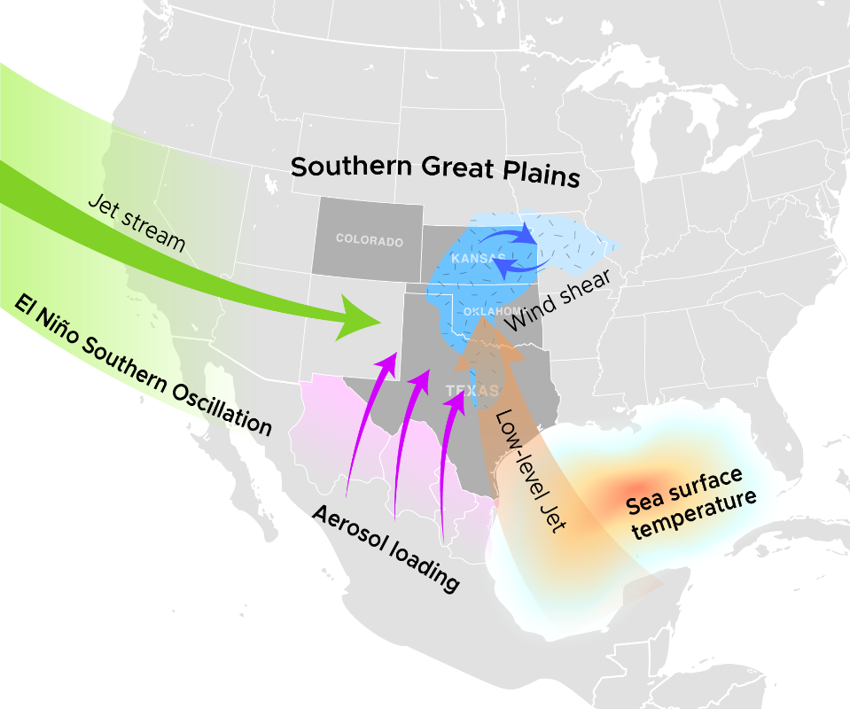
Factors Contributing to Large Hail Annual Variability over the U.S. Southern Great Plains
Objective
Understand the temporal variability of severe hail and its contributing factors in the U.S. Southern Great Plains.
Approach
Analyzed hail spatial and temporal distribution using reports from the Storm Prediction Center and the newly developed radar retrieved maximum expected size of hail (MESH).
Composited the large-scale environment and aerosol data to combined reveal the possible factors contributing to the hail occurrences observed from 2004 to 2016.
Impact
Severe and significant severe hail occurrences have considerable year-to-year temporal variability in the U.S. Southern Great Plains.
The three major factors that can affect the hail interannual variability are aerosol loading, the El Niño-Southern Oscillation, and sea surface temperature anomalies over the northern Gulf of Mexico. Among these factors, aerosols that may be mainly from northern Mexico have the most significant correlation with hail interannual variability.
Three environmental factors—aerosol loading from Northern Mexico, the El Niño-Southern Oscillation, and sea surface temperature anomalies over the northern Gulf of Mexico—correlate with yearly variation in hail occurrence observed over the U.S. Southern Great Plains.
J-H Jeong, J Fan, CR Homeyer, and Z Hou. 2020. “Understanding hailstone temporal variability and contributing factors over the United States Southern Great Plains,” Journal of Climate, 33: 3947-3966.
DOI: 10.1175/JCLI-D-19-0606.1.
Notes:
http://www.pnnl.gov/science/highlights/highlights.asp?division=749

