Slide 1
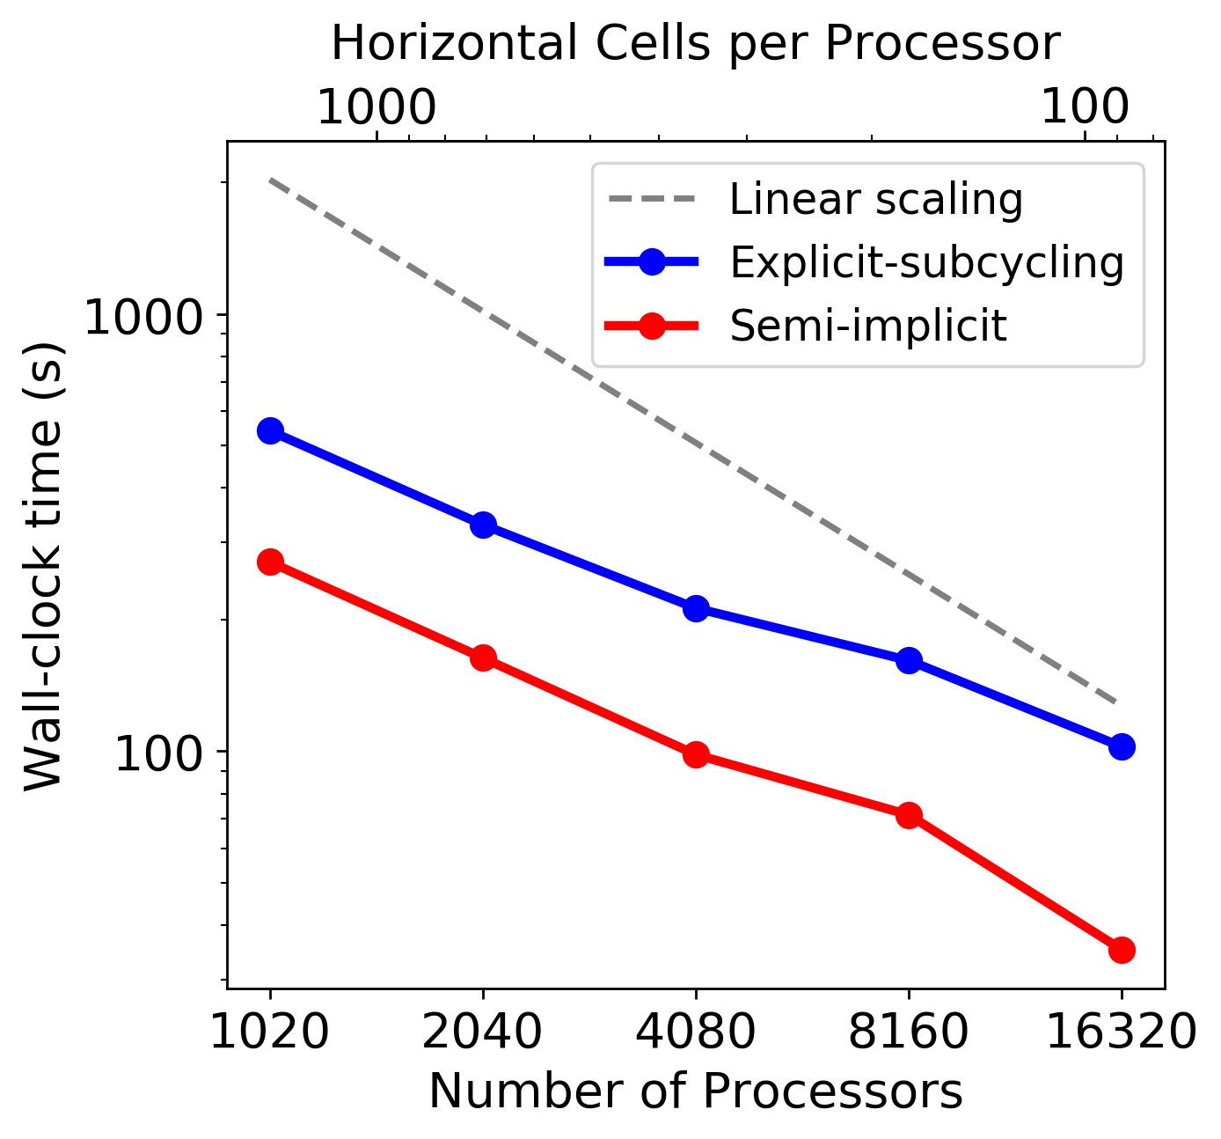
A Scalable Implicit Time-stepping Method for the MPAS-Ocean
Objective | To solve the barotropic mode in the E3SM ocean model more efficiently and stable as a competitor of an existing scheme
New science | Implementing the semi-implicit method for the barotropic mode using a pipelined preconditioned iterative method Constructing a particular form of preconditioner that reorders the linear system for optimal performance Evaluating the semi-implicit solver using several oceanic experiments
Impact | The semi-implicit barotropic mode solver accelerates the barotropic mode up to 2.9 faster than the existing scheme on 16,320 processors. The semi-implicit solver provides faster ocean simulations as well as a more flexible choice of a time step size to model users.
Kang, H.-G., Evans, K. J., Petersen, M. R., Jones, P. W., & Bishnu, S. (2021). A scalable semi-implicit barotropic mode solver for the MPAS-Ocean. Journal of Advances in Modeling Earth Systems, 13, e2020MS002238. https://doi.org/10.1029/2020MS002238.
Figure: Strong scaling results for the barotropic mode solved by the explicit-subcycling scheme (the existing scheme; the blue solid) and the semi-implicit method (the new scheme; the red solid). The MPAS-O model was run on the National Energy Research Scientific Computing Center’s Cori supercomputer.

