Slide 1
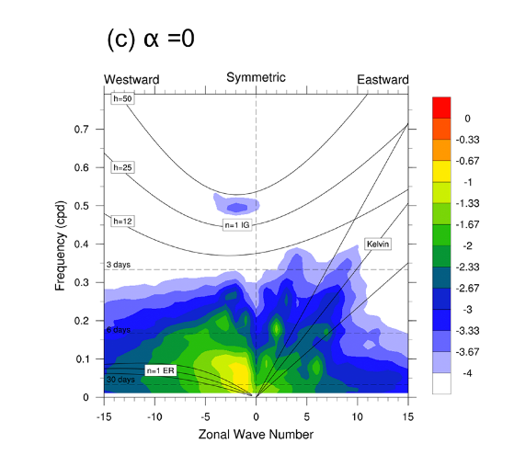
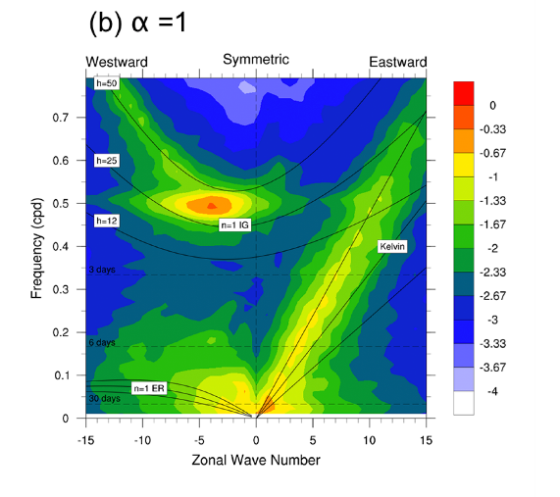
Developing Simplified Tools to Understand the Relationship Between Convection and Large-Scale Circulation
Objective
Construct a simple modeling framework that helps separate tropical weather variability from its background state to cleanly test the role of convection’s moisture sensitivity in tropical waves without incurring large changes in mean climate
Approach
Cast moist convection in the model as a linear response function matrix that acts on anomalous temperature and moisture profiles (Figure A)
Embed the matrix in a global primitive equation solver with a realistic background state
Scale free-tropospheric moisture sensitivity via parameter α to study the impact on tropical variability (Figure B)
Figure A
Figure B
Impact
This new tier on the atmospheric model hierarchy holds promise for exploration and understanding of how convection couples to large-scale flow.
Kelly P, B Mapes, I-K Hu, S Song, and Z Kuang. 2017. “Tangent Linear Super-Parameterization of Convection in a 10-Layer Global Atmosphere with Calibrated Climatology.” Journal of Advances in Modeling Earth Systems 09. DOI: 10.1002/2016MS000871
Notes:
http://www.pnnl.gov/science/highlights/highlights.asp?division=749

