Slide 1
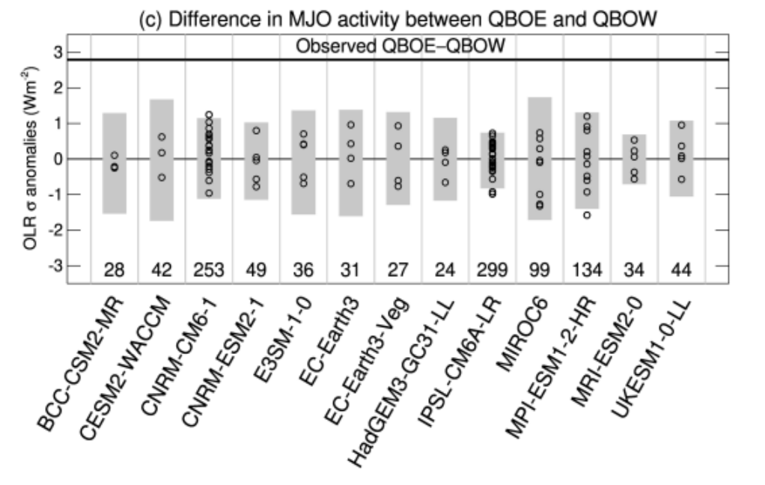
The lack of QBO-MJO connection in CMIP6 models
H. Kim, JM Caron, JH Richter, and IR Simpson, (2020): GRL: https://doi.org/10.1029/2020GL087295
OBJECTIVE
To evaluate the connection between the quasi-biennial oscillation (QBO) and the Madden-Julian Oscillation (MJO) in CMIP6 models.
APPROACH
We examined historical simulations in 13 CMIP6 models.
IMPACT
The MJO is the main mode of intraseasonal tropical variability. In observations, there is a robust relationship between the QBO and the MJO, with MJO activity being stronger during the easterly phase than the westerly QBO phase. This relationship is not likely obtained by chance.
We show here that not a single CMIP6 model shows the observed QBO-MJO relationship. Differences in MJO related OLR anomalies in models are not distinguishable from sampling natural variability. The lack of simulated QBO-MJO connection in CMIP6 models maybe due to the weaker than observed QBO amplitude in the lowermost stratosphere.
Circles indicate response for each ensemble member. Grey bars indicate the 2.5th-97.5th range of anomalies obtained by resampling with replacement from the QBO neutral years with an equivalent sample size to observations.

