Slide 1
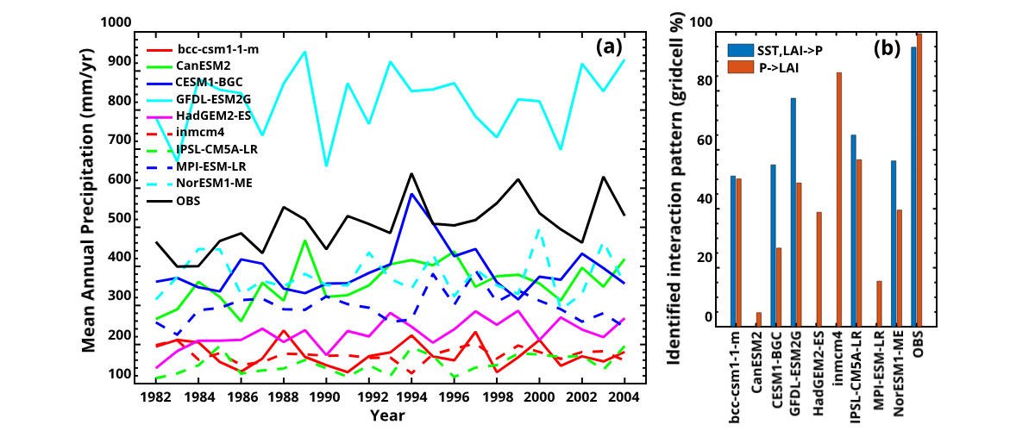
Using Information Theory to Evaluate Directional Precipitation Interactions Over The West Sahel Region In Observations and Models
Scientific Achievement
We propose that “directional information transfer” is a powerful mechanistic benchmark to assess model fidelity at the process level
We successfully apply directional information transfer to study West Sahel precipitation variation in models and observations
Significance and Impact
Most CMIP5 ESMs represented either the unidirectional control of SST on precipitation or the bidirectional interaction between vegetation and precipitation
No ESM represented both interactive patterns. The GFDL and IPSL-CM5A-LR models successfully reproduced observed patterns over ~50% of the West Sahel region, but were not accurate in reproducing observed precipitation regional trends or inter-annual variation
Figure 1: (a) Emergent benchmarks for West Sahel precipitation from observations and CMIP5 ESMs. (b) Percentage of model gridcells exhibiting interactions consistent with the observed mechanistic benchmark for West Sahel precipitation. SST, LAI, and P are sea surface temperature, leaf area index, and precipitation, respectively.
Research Details
West Sahel precipitation seasonal variation is controlled by Sea Surface Temperature (SST) variation over the Gulf of Guinea
West Sahel precipitation variation is also affected by local vegetation dynamics
CMIP5 ESMs represented either the unidirectional control of SST on precipitation or the bidirectional interactions between vegetation and precipitation, but no ESM properly represented both controls
Liu, B. Y., Zhu, Q., Riley, W. J., Zhao, L., Ma, H., Van Gordon, M., & Larsen, L. (2019). Using Information Theory to Evaluate Directional Precipitation Interactions Over The West Sahel Region In Observations and Models. Journal of Geophysical Research: Atmospheres. https://doi.org/10.1029/2018JD029160

