Slide 1
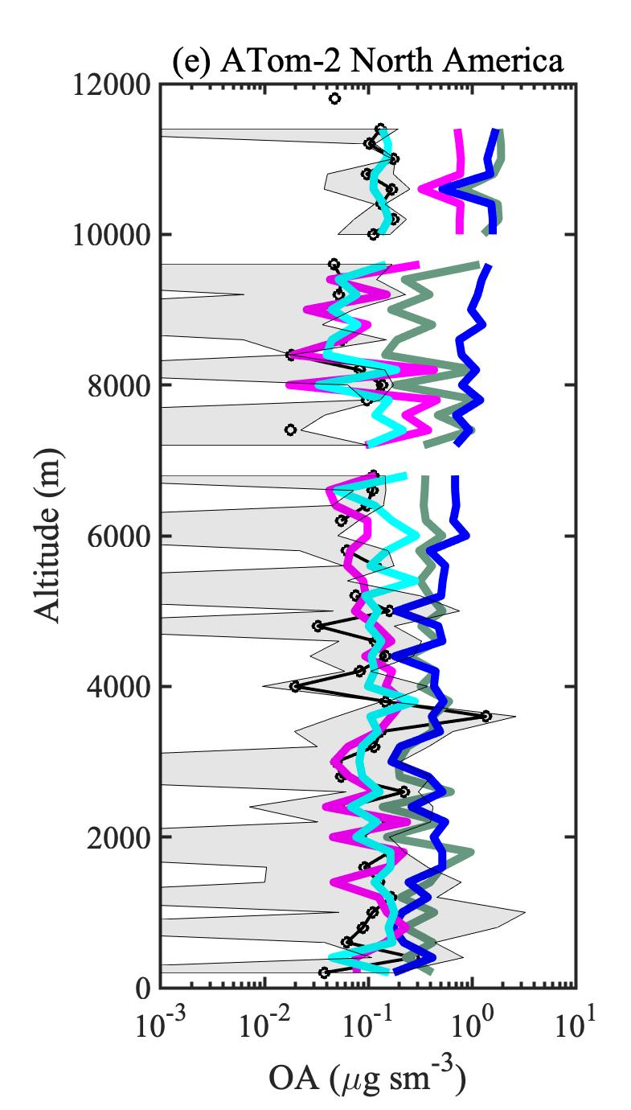
Strong Chemical Sources and Sinks Govern Secondary Organic Aerosols
Objective
Develop complex but computationally efficient model formulations of secondary organic aerosols (SOAs) within the Energy Exascale Earth System Model (E3SM).
Approach
Developed and implemented four different model formulations of SOAs, with sources and sinks of varying chemical strengths, within E3SM.
Evaluated model predictions with a suite of ground-based, aircraft, and satellite observations.
Impact
The new SOA formulations for E3SM showed that models need both chemical sources and sinks of SOA to explain observed organic aerosol loadings.
Particle-phase photolysis is a key chemical sink of SOAs and is necessary to model high-altitude measurements.
The new formulations parameterize complex SOA chemistry with high computational efficiency.
Due to the explicit coupling of SOA chemistry processes with natural and anthropogenic sources, this work provides a more accurate framework for future research aimed at understanding aerosol-cloud-radiation interactions.
Including particle-phase photolysis of SOAs as a chemical sink is key to bringing E3SM predictions (cyan) into agreement with high altitude aircraft measurements (black) over several regions: Equatorial Ocean, Southern Ocean, and North America. ATom‐1 and ATom‐2 are field campaigns during Jul–Aug 2016 and Jan–Feb 2017, respectively.
Lou, S., Shrivastava, M., et al. 2020. “New SOA treatments within the Energy Exascale Earth System Model (E3SM): Strong production and sinks govern atmospheric SOA distributions and radiative forcing.” Journal of Advances in Modeling Earth Systems, 12, e2020MS002266. https://doi.org/10.1029/2020MS002266
Notes:
http://www.pnnl.gov/science/highlights/highlights.asp?division=749

